Slide 1
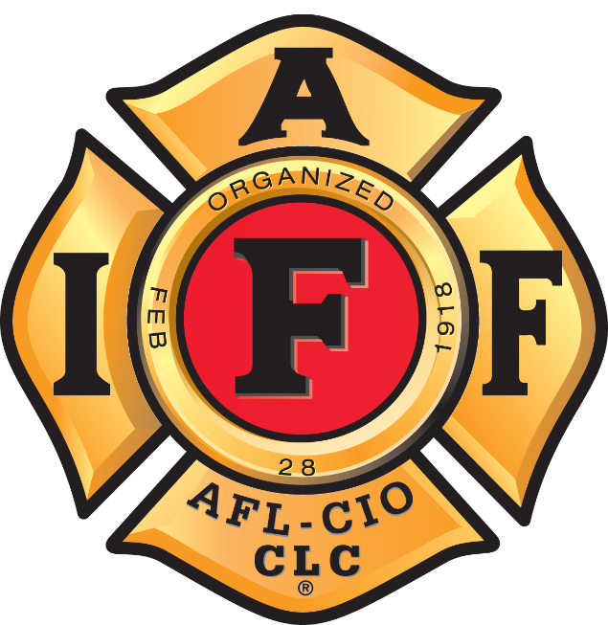
Welcome to Your Union
YOUR LOGO
HERE
Notes:
Instructor note: This orientation program is designed to be customized for your local. Slides 34-42 need to be modified to fit your local, district, and state or province.
Opening slide: Keep on the screen until the following activities have been completed:
Introduce yourself and describe your experience briefly:
Years in the fire service
When you became a union member
Positions you’ve held in the union
What the union has meant to you
Have each new member introduce themselves describing why they are joining the department (i.e., “Glad you are here”; “excellent choice” (for people changing careers)... ) Note when appropriate any generations of fire service.
Acknowledge and welcome each person individually to the union after they have finished their introduction.
Encourage questions during or after the presentation, depending on the your time or instructor preference.

Slide 2
Our Mission
The goals of the IAFF are to:
Organize the profession, promote a safer
working environment, create reasonable working conditions and secure just compensation.
The IAFF was formed to:
Address the working conditions of fire fighters in the early 20th century – today the IAFF addresses major issues including wages, benefits, worker rights, working conditions, safety and health, training and political action.
Notes:
The purpose of the IAFF is to take care of our own, on the job and off.
Each and every one of us is responsible to ourselves, our families and those we work with to come home safe. Our mission is to get you home safely every day. If we cannot get you home safe, we have not done our job.
We fight for safe and reasonable work conditions and fair compensation for the work we do. We also look out for the communities we serve to ensure that our departments are providing the best emergency response possible to protect our citizens.

Slide 3
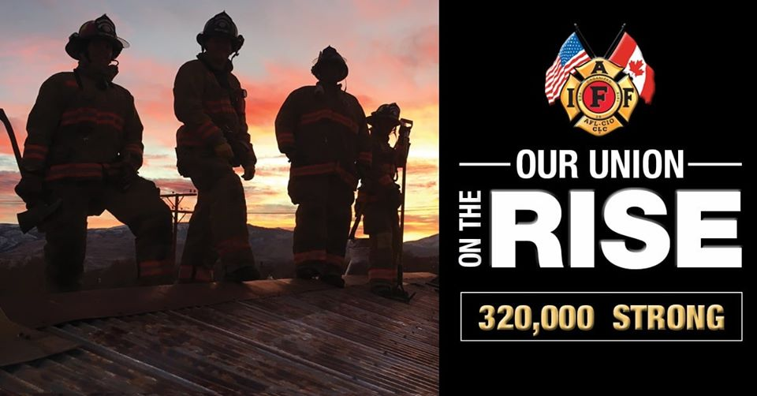
Union
A group of people gathered together for a common purpose.
Notes:
When you serve the public and put your life on the line you need someone behind you. The IAFF will be there. These aren’t just words. In the fire service, actions speak louder than words. We define who we are as a union by what we do.
As you progress in your career you’ll realize what a special group of people you work with. The IAFF, is about us: professional fire fighters taking care of our union family.

Slide 4
IAFF Membership
IAFF membership is made up of more than 320,000 full-time professional fire fighters and emergency medical personnel in the United States and Canada.
As a member, you are the most important part of our union.
Notes:
The IAFF is a membership driven organization.
As elected leaders we do not dictate down to you. We serve you. YOU tell us what to do.
This membership-driven structure is the same on every level of the organization, whether it as the state/provincial, District or at the International level.
All of the programs we will discuss today, have been created at the IAFF in response to the needs of our members.

Slide 5
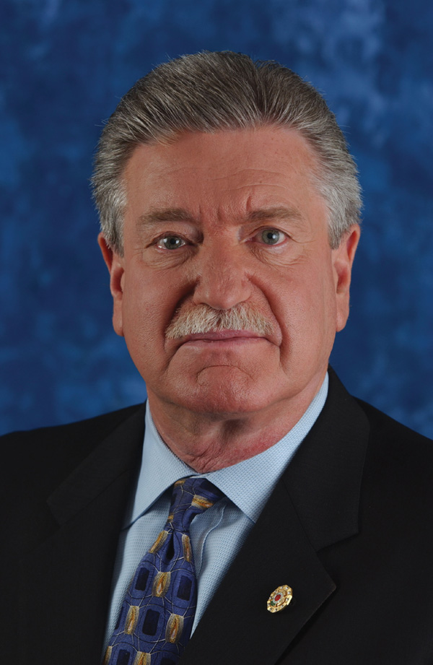
General President’s Office
General President
Harold A. Schaitberger
Ninth IAFF General President
Chairman of the IAFF Executive Board
CEO IAFF Financial Corporation
Chairman of the IAFF Foundation
AFL-CIO Executive Committee member
Vice President of the Muscular Dystrophy Association
Notes:
Harold A. Schaitberger, the 9th General President in the IAFF’s history, was first elected in 2000. He is also a vice president of the AFL-CIO, serving on the Executive Committee, and has served on the AFL-CIO Executive Council since 2000.
During his tenure as General President, Schaitberger has demonstrated a strong commitment to ensure the health, safety and security of IAFF members and their families.
Under his leadership, he has ensured that the IAFF is at the forefront in addressing health issues in the fire service, including cancer and behavioral health, devoting resources to preventing and treating cancer – which is scientifically proven to occur in fire fighters at higher rates than the general population – as well as push for presumptive protections. And, the IAFF is leading efforts to help members struggling with post-traumatic stress and other behavioral health issues, including opening the IAFF Center of Excellence for Behavioral Health Treatment and Recovery, specifically for fire fighters.
Briefly address the role of the General President, include in the discussion that the GP:
Presides over all the meetings of the Executive Board.
Is ex officio of all IAFF committees.
Manages all of the IAFF publications, printing and releases and editor of official IAFF publications.
Enforces strict observance of the Constitution and By-Laws of the IAFF.
Interprets the laws of Constitution and By-Laws and decides on any disputes or controversies concerning their meaning or application.

Slide 6
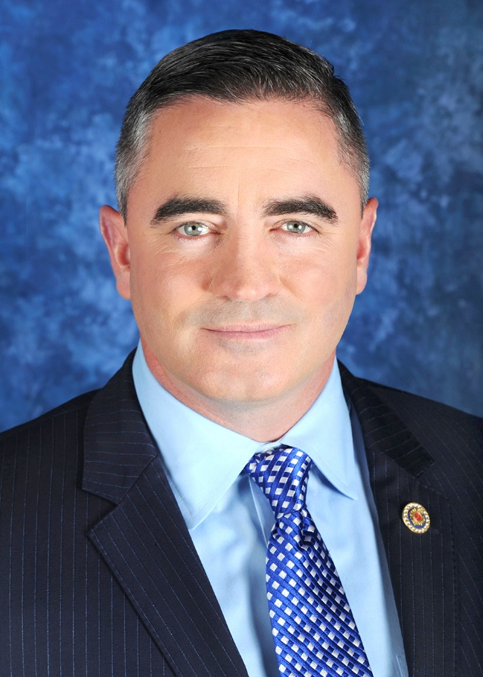
General Secretary-Treasurer
General Secretary-Treasurer
Edward A. Kelly
Chief Financial Officer for the IAFF
Serves as the CFO on the Board of Directors for the Financial Corporation
Trustee for the Charitable Foundation
Fiduciary Responsibility for the Financial Activities of the IAFF
Maintains Federal and State Reporting Requirements
Custodian of IAFF Official Records and Documents
Responsible for Membership Services and General Administrative Services in the IAFF
Notes:
Edward A. Kelly is the 11th General Secretary-Treasurer in IAFF history, elected in 2016 at the IAFF 53rd Convention.
The son, grandson, brother, nephew and cousin of fire fighters, Kelly joined the Boston Fire Department as a fire fighter/EMT in 1997, where he was assigned to the Technical Rescue team that assisted Worcester Local 1009 at the Cold Storage Warehouse fire in 1999. Kelly was among the hundreds of fire fighters at Ground Zero after the September 11 attacks on the World Trade Center, and also responded to the Boston Marathon bombing in 2013.
He served as president of Boston, MA Local 718 and went on to become president of the Professional Fire Fighters of Massachusetts in 2011, a post he held until his election as General Secretary-Treasurer.
Before becoming a Boston fire fighter, Kelly attended the Department of Defense Fire Academy and from 1994 to 1997 served in the U.S. Air Force, stationed at Tyndall Air Force Base in Panama City, Florida, where he worked as part of the crash and rescue crew.
Briefly address the role of the General Secretary-Treasurer, include in the discussion that the GST:
Is designated as a permanent member of the Finance Committee
Is the custodian of the official seal and all records, books, papers and property of the IAFF
Maintains accurate journal of all convention proceedings and shall maintain such records
Maintains all records of all members of the IAFF together with their local union or other subordinate union affiliation and their addresses.

Slide 7
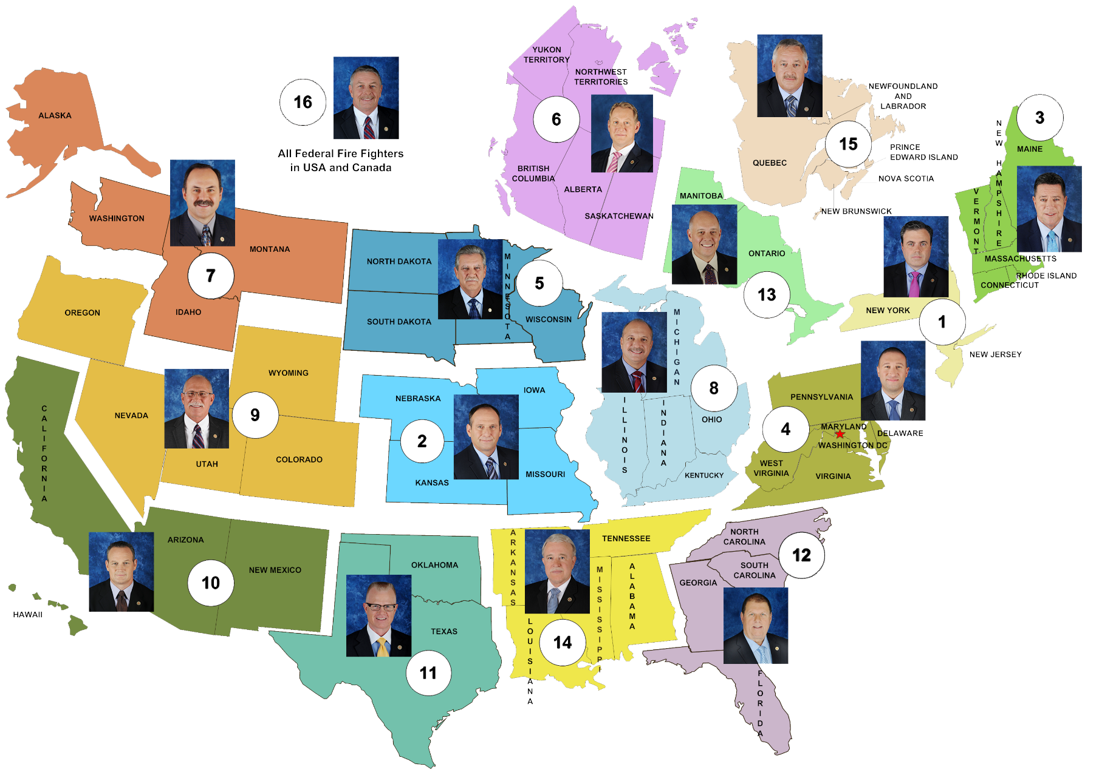
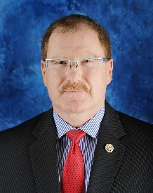
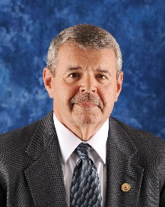
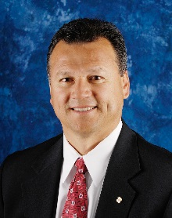
District Vice Presidents and IAFF Trustees
IAFF Trustees
Notes:
District Vice Presidents
Sixteen District Vice Presidents (elected by their district membership)
Serve as a part of the IAFF Executive Board
Executive Board is responsible for all policy decisions
Provide service to their respective districts
For References
D# DVP NAME MEMBERS*
1 James Slevin 18,630
2 Mark Woolbright 12,246
3 Jay Colbert 22,542
4 Andrew Pantelis 30,975
5 Thomas Thornberg 6,469
6 Mike Carter 10,116
7 Ricky J. Walsh 11,734
8 Mark Sanders 42,595
9 Ray Rahne 13,606
10 Frank Lima 47,078
11 Roy L. "Sandy" McGhee 27,531
12 Walter J. Dix 35,393
13 Fred LeBlanc 13,420
14 Danny Todd 16,200
15 David Burry 3,621
16 James B. Johnson 3,573
* Member Numbers as of 3/4/19 – Subject To Change
IAFF Trustees
Alex Forrest
Mark S. Ouellette
Anthony Mejia

Slide 8
Our District – IAFF XXX District
XXX District Vice President
Represents:
STATES
ADD E-MAIL

Slide 9
IAFF DIVISIONS
Canadian Office
Communications, Media & Strategic Campaigns
Information Systems
Education, Training and Human Relations
Government Affairs and Public Policy
Grants Administration and HazMat/WMD Training
Occupational Health, Safety and Medicine
Legal
Technical Assistance and Information Resources

Slide 10
Advancing Our Profession
The IAFF works to secure fair
compensation for professional fire
fighters and improved response
for the citizens they serve.
Notes:
Whether its fighting to guarantee increases in your salary or working to lower the response time on calls with fully staffed engines, the IAFF is on the frontline for professional emergency responders.
The Labor Issues and Collective Bargaining Department performs customized analysis of fire fighter wages, hours, benefits, and working conditions. They provide resources, like manuals, IAFF publications, and CDs which are provided to local leaders so they may be effective in winning improvements.
The EMS/GIS Department provides comprehensive information on fire departments and fire-based EMS that assists in improving the working conditions of IAFF members. The Department promotes appropriate staffing and deployment for fire suppression and the effectiveness of fire-based emergency medical services systems by providing local affiliates with the tools necessary to develop, enhance and protect their working conditions.

Slide 11
Voice at the Table
Many decisions that affect the fire service are made by elected officials who often do not have a background in emergency response.
The IAFF serves as the voice of first line fire fighters when these decisions are made.
Notes:
The IAFF is fire fighters’ collective voice:
Local government officials, whether it is the city or county council are ultimately responsible for making decisions that affect the wages and benefits of fire fighters. To secure the best working conditions for your members, it is essential that IAFF members become politically active to ensure that those candidates who support fire fighter issues are elected and remain in office.
Many times, city or county managers control the money that is need by fire departments. Often fire administration personnel cannot influence these individuals as well as the local union can through their collective political voice. In the best scenario, labor (fire fighters who belong to the IAFF) and department management (Fire Chief, etc.) work together to make sure the politicians hear and take care of the concerns of the fire service. In a worst case scenario, the politicians are informed on how management is not performing their job and hurting both the responders and the community they serve.

Slide 12
Active in Politics
The IAFF educates politicians about issues important to fire fighters and emergency medical personnel, such as safe staffing, first responder training, and collective bargaining.
Notes:
SAFER
The SAFER and FIRE grant programs were created by Congress to help address the significant staffing, equipment, training and health and safety needs of fire departments. SAFER provides funding to help pay the costs associated with hiring personnel to maintain safe staffing levels, while FIRE grants fund equipment, training and other fire department needs.
The importance of adequate fire department staffing has been well-documented by independent studies. The National Fire Protection Association (NFPA), the consensus standards-making body of the fire service, and the Occupational Safety and Health Administration (OSHA), have both promulgated standards for the minimum number of fire fighters needed to respond safely and effectively to emergencies. Far too few jurisdictions meet these minimum safe staffing levels, a problem made even more acute by the Great Recession.
Similarly, the FIRE grant program allows fire departments to purchase equipment and receive training that such departments could not otherwise afford. Equipment and training funded by the FIRE grant program help fire fighters do their jobs safely and effectively by improving the effectiveness of fire department operations and protecting the health and safety of local fire fighters.
Grants Administration
Assistance to Fire Fighters (AFG)
$310 Million Available- Provides for Vehicles, Equipment and Training
On average 10,000 applications submitted requesting $2 Billion
Staffing for Adequate Fire & Emergency Response Grants (SAFER)
$345 Million Available- Provides Salary/Fringe Benefits for frontline fire fighters – new hires only
On average 1,000 applications submitted requesting $1Billion
Fire Prevention and Safety (FP&S)
$34.5 Million Available- Provides for Public Education & Outreach, Research, etc.

Slide 13
Standing By Those Who Stand With Us
IAFF members work to elect candidates from any party who support fire fighter and emergency medical provider issues, regardless of party affiliation.
Notes:
When it comes to politics, the IAFF is focused only on issues related to the fire service. Accordingly, the IAFF supports both Democratic and Republican candidates who support our issues including:
Homeland Security—We support increasing funding to FIRE and SAFER Act grants that provide increased staffing, training and equipment to fire departments
Health Care—We support strengthening employer-provided insurance systems
Pensions—We support strengthening defined benefit pensions systems
Collective Bargaining — We support collective bargaining rights for public safety employees

Slide 14
FIREPAC
FIREPAC is the IAFF’s political action committee (PAC). This fund, supported through voluntary contributions, promotes the political interests of all professional fire fighters and paramedics.
While not every FIREPAC supported candidate gets elected, each one stands strongly in support of issues important to fire fighters and emergency medical personnel.
Notes:
Politics affects your life everyday. You can either have a voice or let others decide for you. FIREPAC has been on the front line for fire fighter issues by raising consciousness within the federal government about fire fighter staffing, labor issues, safety and equipment. FIREPAC has helped to prevent station closings, secure federal funding for fire fighting, and train members to become active in their government. The program educates members on the importance of political action through seminars, the annual Legislative Conference, and the IAFF’s Political Academy.
FIREPAC statistics:
Since its creation more than three decades ago, FIREPAC has raised and contributed more than $16 million to federal candidates and their campaigns either through direct contributions or through independent expenditures efforts in support of pro-IAFF candidates.
Over a 600% Growth in FIREPAC Since 2000
FIREPAC Is NOW In the TOP ½ of 1% of ALL PACs
Electing IAFF Members to Public Office
Most Bi-Partisan of ALL major Unions
Gold and Black Branding
Access to Leaders Within Both the Democratic and GOP Parties
Successful Membership Field Program
Quality Member Educational Programs

Slide 15
Protecting Our Rights
The IAFF protects the First Amendment rights of fire fighters to speak out on issues affecting fire fighters and the public.
Example Cases:
A Texas president of the local fire fighters union was discharged after he informed the press that recent budget cuts and staffing reductions may have played a part in an deadly incident.
Ιn Missouri, a fire fighter was discharged after publicly announcing the local union’s endorsement of a local fire district board candidate at a political meeting.
Notes:
In Texas, a fire fighter was discharged for speaking to the media following a routine fire in which a fire fighter died of a heart attack, and another fell from a ladder, sustaining serious injury. The fire fighter, who was president of the local fire fighters union, informed the press that recent budget cuts and staffing reductions may have played a part in the incidents. The court found the fire fighter’s statements to the media constituted speech on a matter of public concern, protected under the First Amendment. The fire fighter was reinstated with back pay, benefits, and payment of his attorneys’ fees and costs.
Ιn Missouri, a fire fighter was discharged after publicly announcing the local union’s endorsement of a local fire district board candidate at a political meeting. The union-endorsed candidate was running against a long time incumbent, who had the support of the fire chief and his fellow fire board members. Although the fire department claimed the fire fighter was fired due to abuse of sick leave, the jury concluded that this was a false reason given by the fire department to disguise its true motive of punishing the employee for engaging in protected political speech. The jury awarded the fire fighter substantial damages, including back pay, compensatory damages for pain and suffering, and attorneys’ fees and costs. In addition, the fire district was ordered by the court to reinstate the fire fighter.

Slide 16
Working for Fair Compensation
Average fire fighter earns 29¢ an hour and works 84 hours per week.
Fire fighter compensation improves to 50¢ per hour and a 70 hour work week.
Average firefighter earns over $2.00 an hour, 56 hour work week.
Fire fighters earn over $13.00 per hour and work 50 hours per week.
Fire fighters hourly wage is $17.40 with a 50 hour work week.
Notes:
From its start, the IAFF has made it a mission to improve the work hours of fire fighters and to increase our wages. Through collective bargaining, the IAFF has worked effectively to increase the hourly salary and decrease the hours worked for professional fire fighters in the United States and Canada.

Slide 17
Democracy in Action
Membership-Driven Organization: Actions taken by the IAFF must be approved by the membership or their representatives.
Elected Leadership: IAFF officers are elected, not appointed.
Local Autonomy: Leaders are responsible to their members, not to the elected officers above them.
Notes:
The IAFF is an organization that is built by and for the membership. For example, every union officer is nominated and elected by the membership. Budgets and projects undertaken by the local are reviewed and approved by the membership. In this organization, the membership has the majority voice over their elected leadership.

Slide 18
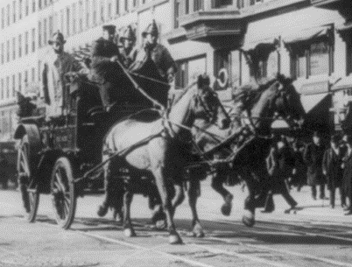
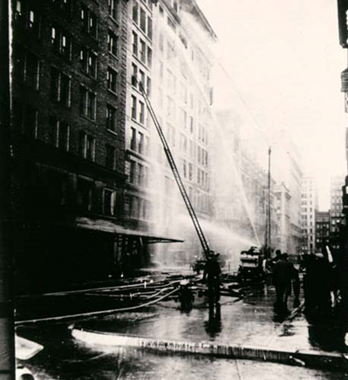
Our Legacy
In 1886, some skilled trades united to form the American Federation of Labor (AFL).
A turning point came in the 1911, with the Triangle Shirtwaist Fire, one of the worst tragedies in American labor history.
Notes:
1911 Fire at the Triangle Shirtwaist Factory, New York City
One of the most pivotal events in United States labor history, this tragic fire at a women’s clothing factory caused the death of 146 of the 500 workers. Most of the laborers were young women who were locked into the factory during work hours and died from jumping out the ten-story windows to escape the fire. Ladders could not reach the higher floors. The incident’s magnitude brought attention to their horrific work environment, ninety hour work week, and extremely low pay. Before there were unions a large majority of American workers, including young children, had little rights, died in work related accidents, and were often fired for speaking out against their employer. Fire fighters wore no protective gear. Multiple fatalities were common.
In response, workers such as fire fighters, joined together in unions to improve their working conditions and their lives. These unions gave them a voice to improve the safety in their workplace and the money they took home to feed their family. Unions then joined together under the leadership of Samuel Gompers, a former cigar maker from New York City, to form the American Federation of Labor. Later, in 1955, the AFL joined the Congress of Industrial Organizations (CIO) to form one the largest organizations in the world. Today, the IAFF is one of largest of the 53 unions that make up the AFL-CIO—along with teachers, miners, machinists, nurses, and other trades.
(Photos: Fire fighters respond to the Triangle Shirtwaist Factory. Library of Congress)

Slide 19
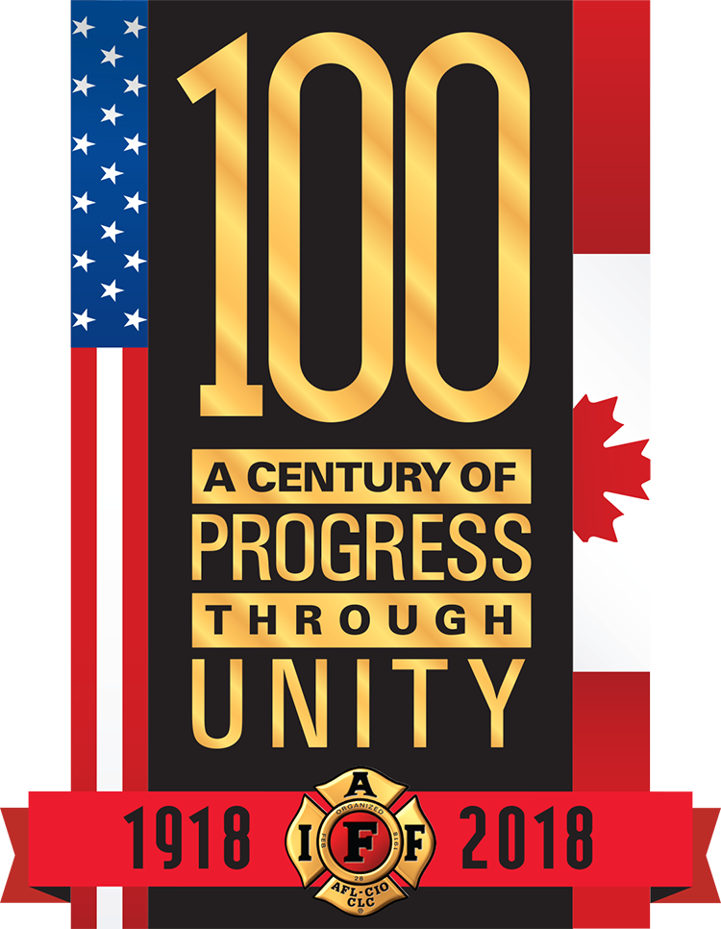
Our History
Founded in 1918, the IAFF was formed to give fire fighters a democratic voice in their workplace.
At a time when workers had little rights – long hours, low pay, no safety – the IAFF became the fire fighter’s voice and remains so today, taking on issues facing all of our members.
Notes:
In 1918, the IAFF was founded as part of the AFL and has gone on to be a positive force in fire fighter’s increased wages, reduced hours, improved safety, and overall well being.
For almost a Century, the IAFF has been there for our members and continues to be a driving force in advancements within the fire service. It’s the IAFF that introduced the first safety standards and today is designing state of the art PPE for 21st fire fighters. It was the IAFF who urged President Ford to sign the Public Safety Officer Benefit Act, which provides money to families of fire fighters who died in the line of duty and when hurricanes Katrina and Rita hit the Gulf coast region in 2005 it was the IAFF who rushed to assist IAFF locals and their families.

Slide 20
IAFF On the Frontline
1970 National Commission on Fire Prevention and Control
1971 Project FIRES: NASA and IAFF begin technology exchange program to build better protective gear
1980 OSHA 29 CFR 1910.156 Fire Brigades: First industry standards issued requirement for organization, training, and PPE.
1986 NFPA 1500 enacted: Occupational Health and Safety Standards
1995 IAFF/IAFC Wellness Fitness Initiative
2002 Project HEROES: more effective bunker protection
Notes:
Throughout its history, the IAFF is always on the frontline looking out for fire fighter safety.
In 1970, the National Commission on Fire Prevention and Control reported growing destruction and fire fighter death caused by fires. Until then, fire fighting had changed very little, other than the introduction of the fire engine. The IAFF’s Health and Safety Department soon began working on improving protecting clothing for fire fighters through their program, Project FIRES (Fire Fighter Integrated Response Equipment System).
In 1980, the IAFF’s Health and Safety Department was behind one of the first regulations for the fire service, which today is regarded as a milestone in providing regulations to the fire service. The Fire Brigades Standard, as it was known, contained requirements for the organization, training, and PPE of fire brigades, and was considered milestone legislation—created by the IAFF for fire fighters.
In 1986, the National Fire Protection Association (NFPA) passed their standard, NFPA 1500, which provides guidelines for establishing, implementing, and managing a comprehensive occupational safety and health program.
In 1995, the IAFF started an initiative with the IAFC to improve the overall wellness and fitness in the fire service.
In 2002, the IAFF began Project HEROES (Homeland Emergency Response Operational and Equipment System) and is developing state of the art protective gear for modern emergencies. In 2005, the Project HEROES prototype gear went into field testing

Slide 21
IAFF On the Frontline
2006 Peer Fitness Trainer Certification: Improve fire fighter wellness and fitness.
2007 WFI: Medically validated in conjunction with NFPA 1582 and the two mirror each other.
2008-12 Continued growth in contributions.
2010 Fire Ground Survival Program: Comprehensive survival skills and MAYDAY prevention program.
2011 SCBA New Technology SAFER: $810 million in funding.
2013 NIST High Rise study: More than 6,000 fire fighters participate in order to better understand safer staffing needs for buildings over 7 stories.
Notes:
2013 NIST High Rise study: More than 6,000 fire fighters participate in to better understand safer staffing needs for building over seven stories. According to the report, a fire fighting crew of six fire fighters is able to complete 14 “critical tasks” – including search and rescue- 23 minutes faster than three-member crews.

Slide 22
IAFF On the Frontline
2014 The IAFF and MDA: Celebrate a 60 year partnership raising money and awareness for the Muscular Dystrophy Association.
2015 Fallen Fire Fighter Memorial: The reconstructed memorial includes 121 granite slabs that display more than 7,300 names dating back to 1918.
2017 IAFF Center of Excellence for Behavioral Health Treatment and Recovery: The first of the IAFF’s treatment centers opens.
2018 IAFF’s 100th Anniversary!
Notes:
2014 The FILL THE BOOT campaign has raised more than $625 million since 1954 for the MDA. The contributions of the fire fighters goes towards MDA’s summer camps for children, professional and public health education, and other programs.
2015 Fallen Fire Fighter Memorial: The reconstructed memorial includes 121 granite slabs that display more than 7,300 names dating back to 1918, including hundreds who died of illnesses such as cancer from exposure to toxins on the job.
2017:
In late spring, Vice President Biden’s office helped connect Advanced Recovery Systems to IAFF.
ARS acquired property in Maryland and wanted to create a state-of-the-art treatment center and interested in partnering with IAFF to focus on fire fighters.
General President convened an Advisory Committee to determine need and give guidance on treatment protocol
IAFF Center of Excellence of Excellence for Behavioral Health Treatment and Recovery opened in Spring 2017 – and we are working to build more!
It provides treatment for successful recovery from substance abuse, PTSD and other co-occurring behavioral health issues
2018: On February 28, 2018, the IAFF will be celebrating the 100th anniversary of its founding.

Slide 23
Safety
Nothing matters more to our members and their families than the health and safety of fire fighters and paramedics.
Notes:
The IAFF has established a number of health programs for members including:
Project HEROES—new and developing PPE for all types of emergencies
The Fire Service Joint Labor Management Wellness/Fitness Initiative – to help fire fighters stay conditioned and ready to respond
The Candidate Physical Ability Test – to ensure standardized entrance testing
Fit to Survive-Online Nutrition Guide
John P. Redmond Foundation—Education and research for fire fighter's occupational hazards

Slide 24
Stay Prepared
Hazardous Materials and Weapons of Mass Destruction Training
Wellness-Fitness Initiative
Safety Alerts
Health and Safety Fact Sheets
Health and Safety Online Job Aids
Notes:
Training and preparation are the most important actions a fire fighter can take to stay safe on the job. Without practice and planning, unexpected events on the fireground can easily turn tragic.
To prevent this from happening, the IAFF has fought consistently for additional money for emergency response training for the fire service in Hazardous Materials and Weapons of Mass Destruction, and in the field of health and safety through the Wellness-Fitness Initiative and Online Health and Safety programs.

Slide 25
Disaster Response
Resources
Incident Response Team
Behavioral Health Support
Funding
Disaster Relief Fund
Hurricane Relief Fund
Notes:
When disaster strikes, the IAFF is prepared to be first on the scene looking out for their members and our communities.
2001
IAFF members across the United States and Canada provide assistance and support immediately following the terrorist attacks of September 11, 2001. In addition to providing Critical Incident Stress Management (CISM) teams and creating a incident command center to assist in recovery efforts, the IAFF raised $111 million for a non-profit fund earmarked for the families of Firefighters who were killed in the line of duty at the World Trade Center.
2005
In the first two months after Hurricane Katrina and Rita, the IAFF spent $1.6 million to help members and their families whose lives were hit by the storm. The IAFF also provided Critical Incident Stress Management (CISM) teams to disaster sites, in addition to supplies, food, water, and manpower.
2014-2015
In just the past two years, the Fund has distributed more than $526,000 to fire fighters and their families.

Slide 26
Last Alarm
Line of Duty Death (LODD) Investigation
Fallen Fire Fighter Memorial
Public Safety Officer Benefits
$359,000 for families of those who die in the line of duty
McClennan Scholarship
Notes:
The IAFF provides for the families of our fallen fire fighters:
Line of Duty Death Investigations are conducted in each incident. If we don’t know what causes the harm, we cannot prevent it.
The Fallen Fire Fighter Memorial in Colorado honors those who died in the line of duty. It was reconstructed in 2015 to include the names of every fallen firefighter since the beginning of the IAFF in 1918.
The McClennan Scholarship Fund provides money for higher education to the children of fire fighters who died in the line of duty.
The Public Safety Officers Benefit Act, which the IAFF urged Congress to pass, provides money to families of fire fighters who died in the line of duty.

Slide 27
IAFF Financial Corporation
The IAFF-FC provides financial services to members and contribute additional resources back to the IAFF
Programs
Canadian Programs
Home and Auto
Workplace Assault & Hazard Insurance and Pension Protection plan
Supplemental Lifetime Income Program
Insurance
Workplace Assault & Hazard Insurance and Pension Protection plan
Group Life, Dental, Group Medicare Supplemental Plans
Auto and Home Insurance
Deferred Compensation/Post Employment Health Plan
Banking Program with Amalgamated Bank
Notes:
Discuss the following:
IAFF-FC Banking Center –
Offers high yield savings and CD products in addition to regular checking.
Business banking accounts are also available to local affiliates.
For more information visit www.iaff-fc.com
Mortgage Loan/Refinance –
Competitive rates
Low-cost lender
Best Price Guarantee – see web site for details
For more information call (888)-630-9099 or visit www.iaff-fc.com
Auto and Home Insurance (U.S. and Canada) –
US
IAFF members and alumni in the U.S. can access high-quality auto, home, renters and motorcycle insurance at a discounted rate through Liberty Mutual
Rates guaranteed for 12 months
Around-the-clock claims service
Multi policy discount for insuring auto and home
For more information call (800) 835-0894
Canada
IAFF members and alumni in Canada have access to high quality home and auto insurance through TD Insurance Meloche Monnex
Group rates
Home, auto and motorcycle insurance
Fast, efficient service
For more information call (866) 296-0666
Life Insurance Program (U.S. and Canada)
Group and individual term life
Long Term Care insurance
Members in both U.S. and Canada can call (866) 423-3757

Slide 28
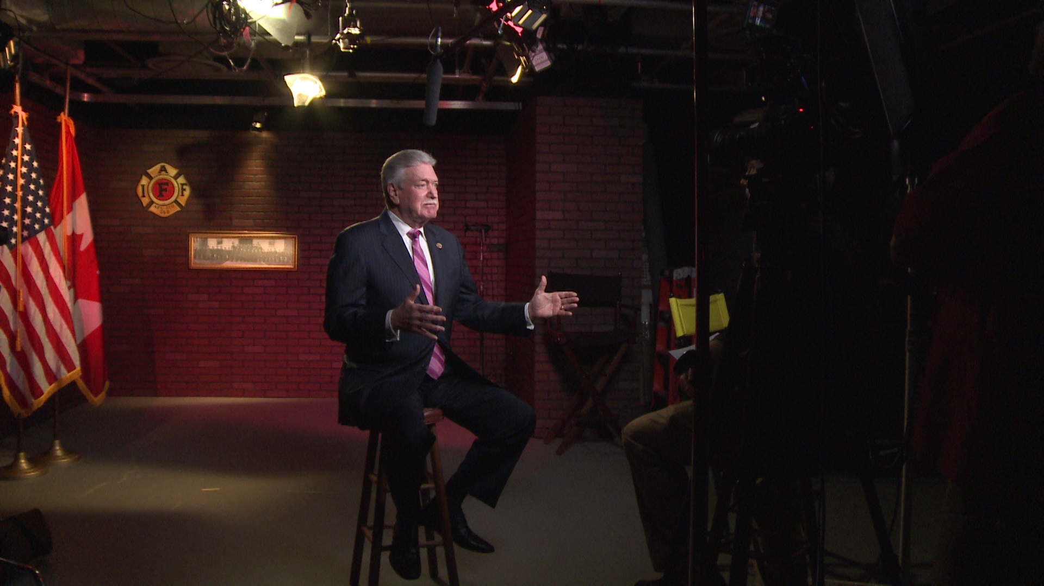
E-18 MEDIA
SERVICES PROVIDED
The IAFF’s rapid response multi-media company for locals needing assistance.
Live feed capabilities to beam back to local news affiliates for expert interviews.
Development of radio spots and online ads.
Edit the videos locals shoot.
Can buy media for campaigns, saving locals thousands in commission costs.
Notes:
No dues money goes to E-18. It Is owned and operated by the IAFF Financial Corporation.
Studio located at IAFF Headquarters. Can live feed into any media market in the nation.
Also provides digital ad buys and targeting on social media after videos are produced.

Slide 29
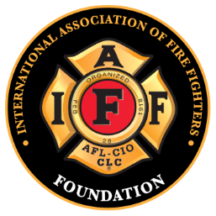
Serving Our Community
IAFF Foundation
The Burn Fund
The Disaster Relief Fund
Fallen Fire Fighters Memorial
McClennan Scholarship Fund
John P. Redmond Fund
Notes:
The IAFF is active in the community at all levels including:
MDA
The International Association of Fire Fighters (IAFF) is the largest national sponsor of the Muscular Dystrophy Association (MDA). More than 320,000 members of the IAFF in the United States and Canada are pledged to saving lives, both as fire fighters and paramedics and as the strongest campaigners for the worldwide research efforts of MDA to eradicate 40 neuromuscular diseases.
Burn Foundation
Created in 1982 as a nonprofit, tax exempt, organization affiliated with the IAFF, the Fire Fighters Burn Foundation is now the largest non-government source for burn research grants and the sponsor of the annual IAFF National Children’s Burn Camp, held each fall in Washington, D.C.
Fire Safety Programs
Whether it is teaching children the basics of stop drop and roll or assisting senior centers with their evacuation plans IAFF locals are committed to providing the citizens in their community with the information they need to stay safe.

Slide 30
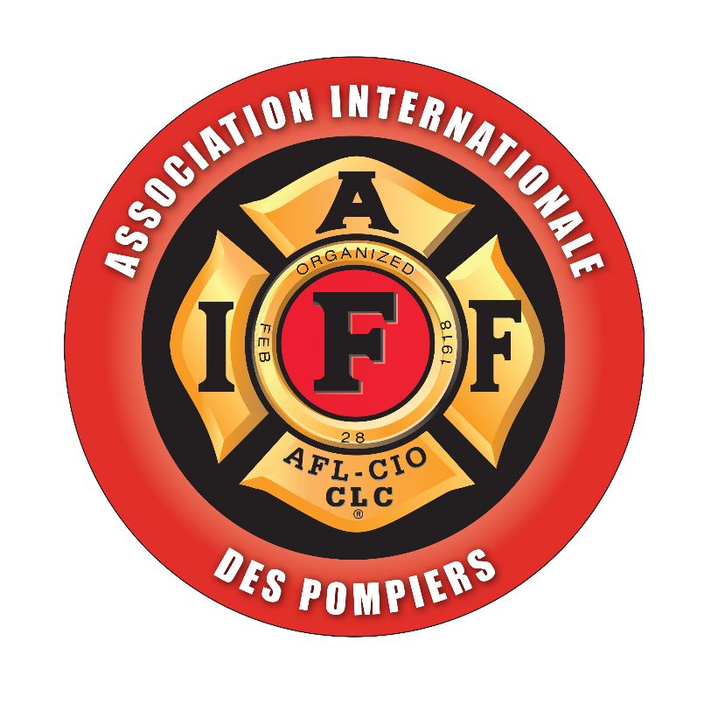
IAFF Canadian Office
Canadian Office established 1969
Facilitating the delivery of IAFF Services to 22,547 Canadian members
182 Canadian IAFF Locals
Eight provinces, two territories
English and French Services
Advice and support
Notes:
Office is now in downtown Ottawa, Ontario
Two blocks from Parliament Hill
Open 9 a.m. to 4:30 p.m. weekdays
A visible, national presence
A focal point for info/issues
Bilingual Staff (French & English)
Four full-time staff:
Scott Marks – AGP for Canadian Operations
Greg Hewitt – Research Assistant
Sandy Hamamoto – Gov’t Affairs Assistant
Linda Côté – Administrative Assistant
Advice and Support –
Canadian Office staff provides advice and support to affiliates on labour issues, including collective bargaining, health and safety matters, legal issues, legislative initiatives, and other regulatory issues
Daily contact with IAFF Headquarters; Access to IAFF expertise, resources; Facilitate delivery of IAFF programs and services; Fully integrated, seamless delivery
Staff tailors materials and programs where necessary to meet the unique needs of Canada’s labour, legislative and legal systems.

Slide 31
IAFF Canadian Office
Canadian Legislative Program
Canadian Legislative Conference
Custom Research and Assistance
Biennial Canadian Policy Conference
Canadian Political Training Academy
FIREPAC Canada Fund
Canadian Legal Assistance
Notes:
Programs that the Canadian Office runs.
Canadian Legislative Program –
The IAFF Canadian Legislative Program consists of year-round lobbying and culminates in the annual Canadian Legislative Conference
Fire fighters from across Canada meet in Ottawa with Members of Parliament and press for action on issues of importance such as pension reform and important health and safety protections.
FIREPAC Canada, the Canadian arm of the IAFF’s successful political action fund, is administered through the Canadian Office.
Canadian Labour Congress –
Provides Canadian affiliates a forum to debate and vote on the policies that govern the International.
Canadian Legal Assistance
Canadian Legal Counsel
Sean McManus
McManus Hubler Lawyers, Calgary
Former AGP Canadian Operations
Arbitrations, grievances for Canadian IAFF locals
Retainer: Canadian Office
Guardian Policy cases – Canada

Slide 32
IAFF: More Than Just a Sticker
Resources for Fire Fighters and Emergency Medical Responders
Geographic Information Survey
Municipal Financial Analysis
Seminars and Conventions
Health & Safety Information
Political Action
Legal Assistance
Financial Corporation
www.iaff.org
Notes:
Instructors: Hold up IAFF sticker. “The IAFF is more than just this.”
Resources for improving your job performance and keeping you safe
GIS for providing the most effective response
Municipal financial analysis gives you information about your local budget help you to get you the best pay and benefits.
Legal assistance—job protector

Slide 33
Our State Association
[insert your state president with related accomplishments]
[Describe work with allies such as Central Labor Councils, other labor coalitions, include community and political accomplishments]

Slide 34
About Us (Local Info)
Local members elect officers
who are responsible for representing their interests.
Local Executive Board
[insert your board]

Slide 35
What We Do (Local Info)
Describe your local’s responsibilities to the members and accomplishments
Local members approve their own contract
Your local makes decisions on grievances and arbitrations

Slide 36
Where We’ve Been (Local Info)
[insert your local history, why did your local form?
Over the course of your local’s history - what struggles has your local undertaken and successfully completed]

Slide 37
Where We’re Going (Local Info)
Current issues, campaigns, activities

Slide 38
How Your Money Is Used
[insert your information]
Notes:
This slide is arguably the most important in the presentation. New members especially want to know how their dues money is spent.
Describe each organization that the money goes to and their recent accomplishments and current activities.
Stress that the vast majority of the money is directly spent on the local level and that, as members, they will vote on how these funds will be expended.

Slide 39
How We Get There
[insert your next meeting, website, email and other basic communication information.]

Slide 40
Member Responsibilities
Be the best in your profession
Know your rights and look out for each other
Learn everything you can
Bring your interests and talents to the local
Protect your voice through the political process
Help in the community with charities and fundraisers
STAY INVOLVED
Notes:
Your local depends on you to be involved. (Refer to the list you created at the start of the presentation: What do you think of unions?)
Debrief the participants on their thoughts on unions and what they think about the IAFF. Answer concerns and highlight successes/accomplishments.
Have your thoughts on unions changed? How do you feel about them now?
Thank the participants for their time and conclude with a description of the next union meeting time and any upcoming activities. Offer follow up appointments or a night out for new members. Be sure to mention benefits and union discounts in your area.
Ask if they had any more questions at this time.
Ask for interested members to sign up. Gather a list of contact information. Provide them with your contact information and the local’s website.

Slide 41
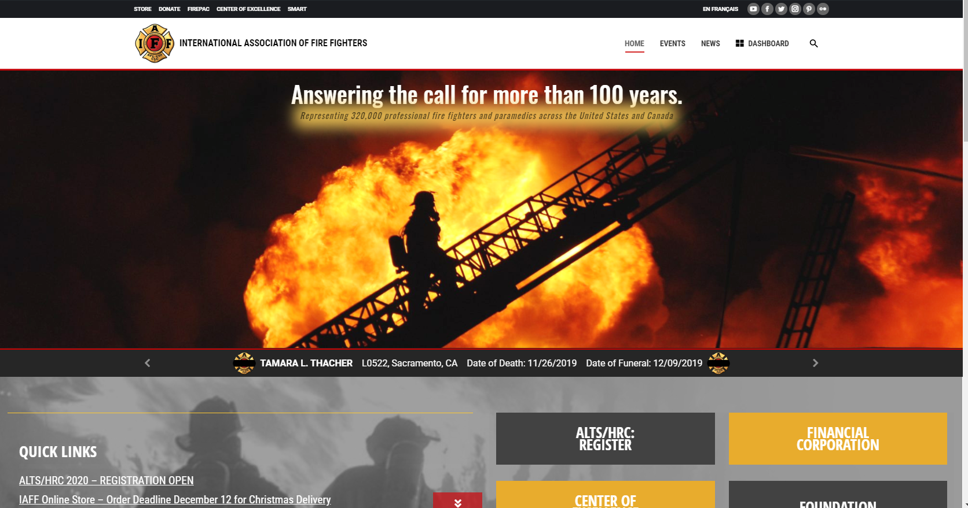
IAFF.ORG
Official website of the IAFF
Lots of information on what the IAFF does and the training it provides to improve your career.
Make sure you are properly registered. This helps the IAFF pinpoint members during disaster relief operations.

Slide 42
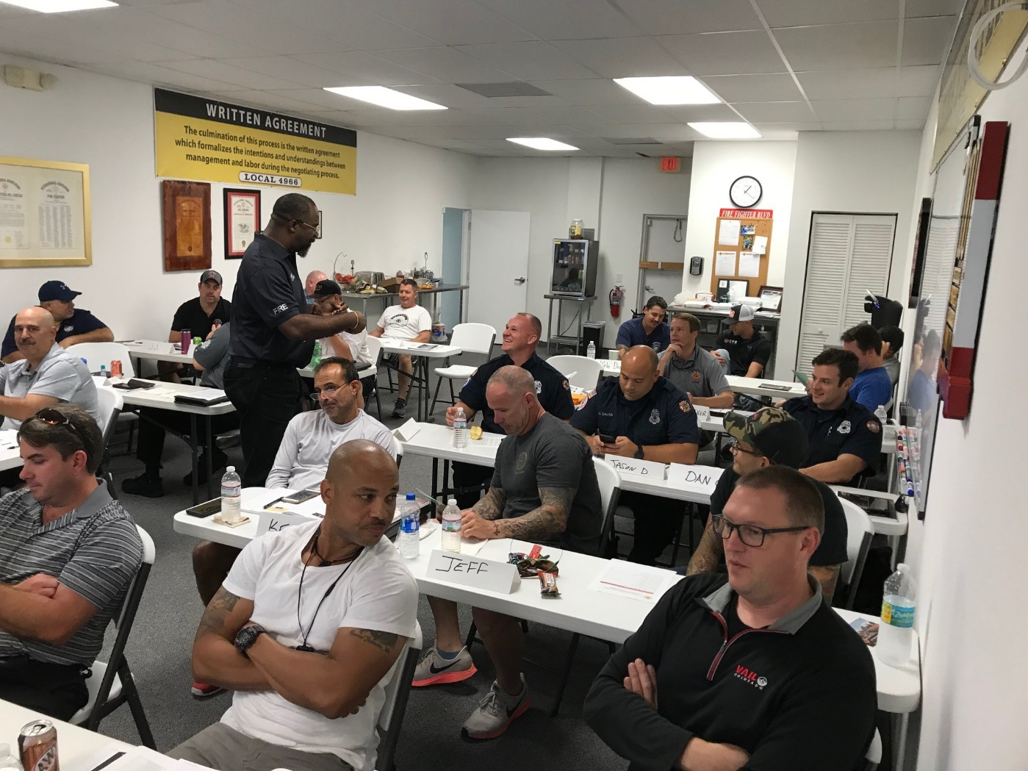
IAFF PEER SUPPORT
When it comes to getting help, fire fighters are more likely to speak with a peer who understands the job.
The IAFF has over 5,500 members trained to provide peer support to members when the need arises.
IAFF Peer Support responds to LODDs, active shooter events, natural disasters and more.

Slide 43
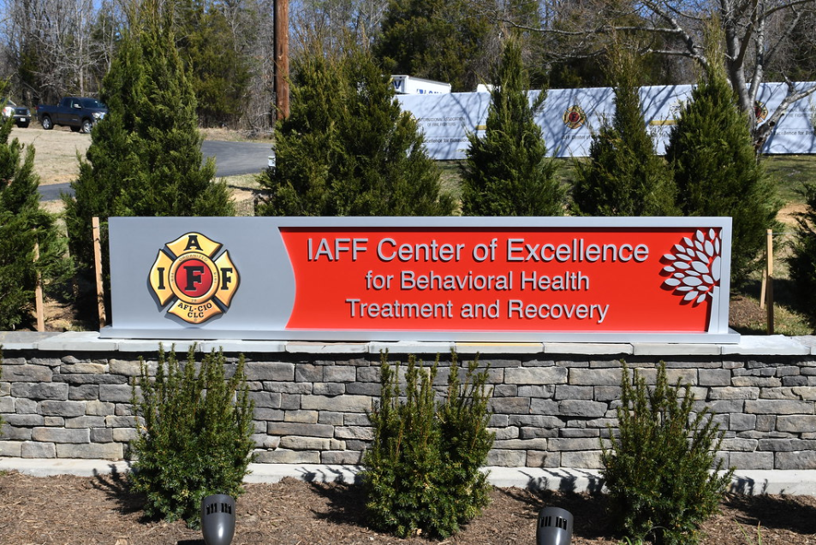
IAFF Center of Excellence
Behavioral health treatment center exclusively for IAFF members focusing on assisting members in their fight against:
Alcoholism
Substance Abuse
Post Traumatic Stress
Over 1,000 members treated since the Center opened in March of 2017.

Slide 44
IAFF SOCIAL MEDIA
Facebook: @iaffonline
Twitter: @iaffnewsdesk
Instagram: @iaff1918

