Slide 1
TITLE SLIDE WITH PICTURE TO USE TITLE GOES HERE
Nov. 2, 2023
Notes:
There are two title slide options: One with photos (here)

Slide 2
NO PICTURE COVER SLIDE
TWO LINE TITLE
Nov. 2, 2023
Notes:
There are two title slide options: One without photos (here)

Slide 3
SECTION TITLE
Notes:
The section breaks can feature any colors from the IAFF primary palette – IAFF Red and IAFF Blue are preferrable, and are preset in this template.

Slide 4
SECTION TITLE

Slide 5
Slide Content Title Here
You have several options to present content.
Try to use as little text as possible.
Do not use bullets as substitute for your notes.

Slide 6
Two Columns
Another example of how to present content.
Donec ullamcorpe
Vestibulum id ligula porta felis euismod semper.
Donec ullamcorper nulla non metus auctor fringilla.

Slide 7

Title
You can remove bullets
And present your content in a different way.
The image to your right (or two your left, when inserting a new slide) can be a photo, a chart, or any other form of media.

Slide 8

Title
Vestibulum id ligula porta felis euismod semper. Donec ullamcorper nulla non metus auctor fringilla.
Morbi leo risus, porta ac consectetur ac, vestibulum at eros.

Slide 9
Notes:
A blank slide with footer only is available for use

Slide 10
Big Stats to Share
80%
200k
389
Is a big number
Is also a big number
Could be a big number

Slide 11
Etiam porta sem malesuada magna mollis euismod. Nullam id dolor id nibh ultricies vehicula ut id elit. Maecenas sed diam eget risus varius blandit sit amet non magna. Curabitur blandit tempus porttitor. Cras justo odio, dapibus ac facilisis in, egestas eget quam.”
— DAPIBUS CRAS MALESUADA

Slide 12
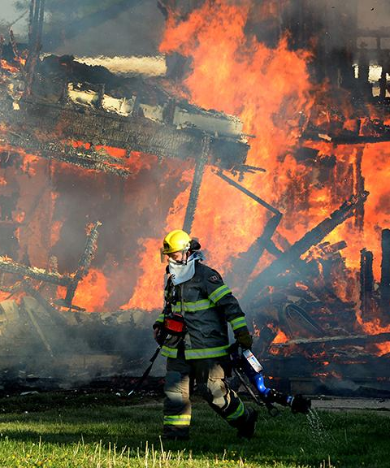
Adipiscing Porta Ultricie
Praesent commodo cursus magna, vel scelerisque nisl consectetur et. Vivamus sagittis lacus vel augue laoreet rutrum faucibus dolor auctor. Morbi leo risus, porta ac consectetur ac, vestibulum at eros.
Notes:
You may want to highlight an image – and use the picture to tell a story. The next slides allow you to do that, using elements from the IAFF Brand.

Slide 13
Adipiscing Porta Ultricie
Praesent commodo cursus magna, vel scelerisque nisl consectetur et. Vivamus sagittis lacus vel augue laoreet rutrum faucibus dolor auctor. Morbi leo risus, porta ac consectetur ac, vestibulum at eros.
Notes:
You may want to highlight an image – and use the picture to tell a story. This slide allows you to do that, using elements from the IAFF Brand.

Slide 14
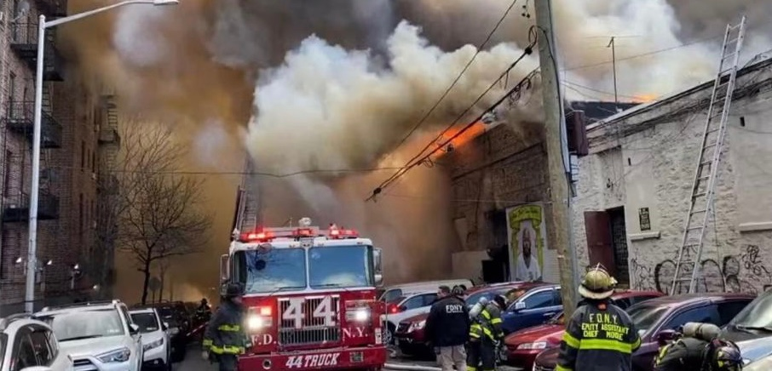
Notes:
You may want to highlight an image – and use the picture to tell a story. This slide allows you to do that, using elements from the IAFF Brand. This slide can also be inserted from NEW SLIDE with blue or navy as a background.

Slide 15





5 PRODUCTS TO KEEP UP AND AWAY FROM KIDS.
Laundry Packs
E-Nicotine
Fusce dapibus, tellus ac cursus commodo, tortor mauris condimentum nibh, ut fermentum massa justo sit amet risus. Donec sed odio dui.
Hand Sanitizer
Button Batteries
Medication
Notes:
The new icon style utilizes a simplistic outline style that ties back into the outlined ‘stamp’ version of the logo. Any color from the primary and secondary palettes can be applied to icons. Additional icons are available in the Communications Division Sharepoint.

Slide 16


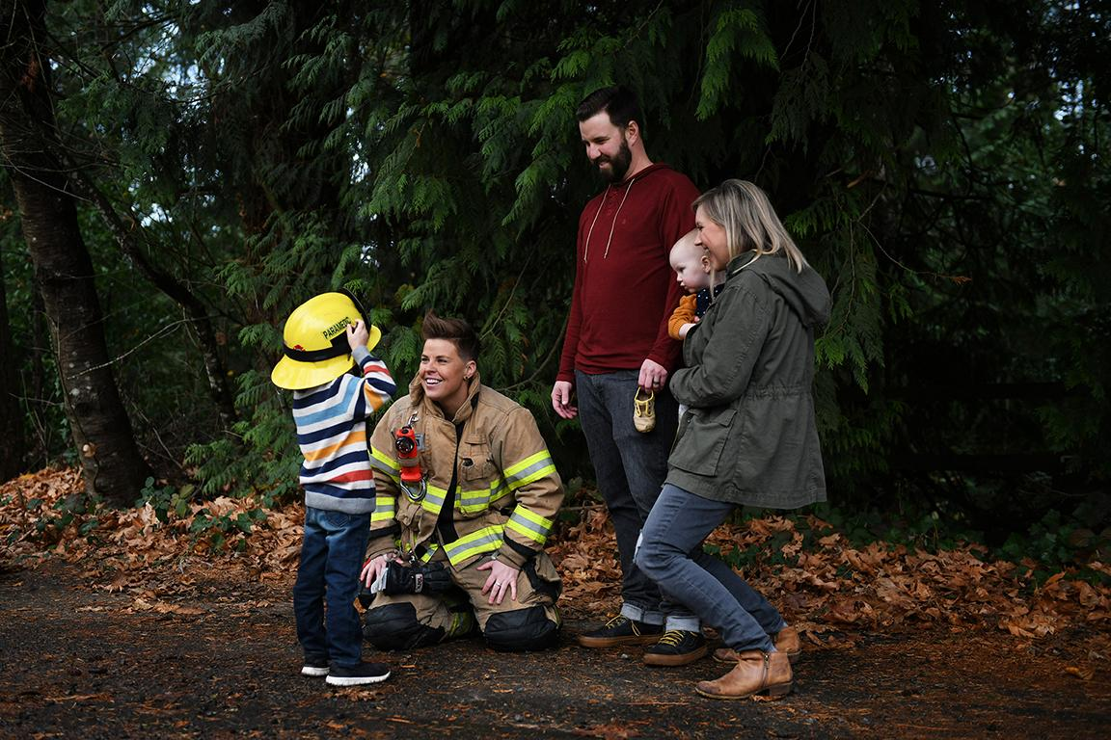


LT. JOHNNY LONGNAME
Appropriate photography for the IAFF brand is heavily focused on action-oriented scenarios, portrait-style profiles for members, and photos centered around community and families. Black and white photography is acceptable when emphasizing in-action moments to convey seriousness and bravery.
Tristique Tortor Sollicitudin

Slide 17

THANK YOU!
ANY QUESTIONS?
JOHNATHAN DOELONGNAME
Speaker Title | email@iaff.org
Notes:
Keeping the photo? Right-click on the image, select “Change Picture,” find your file, and place the image. If you need to reposition the face to be centered, use the “crop” tool in the “Photo Format” menu. Contact Communications Division or Education Department for assistance.

Slide 18
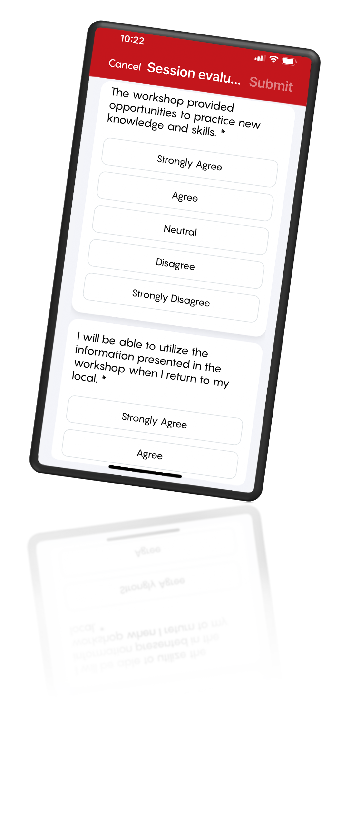
EVALUATION AND WIN AN IPAD!
Submit your workshop and overall evaluations to be automatically entered in two drawings for a new iPad!
Complete your evaluations using the IAFF app:
Download the IAFF app and sign in with your iaff.org username
Tap the 2025 ALTS event image to enter the event’s dashboard
Tap “Sessions” and tap on the workshops you attended
Tap “Evaluation” and complete the evaluation
Tap “Submit”
For the event’s overall evaluation, follow steps 1 and 2, then tap “Event Evaluation” located in the event’s Dashboard.

