Slide 1
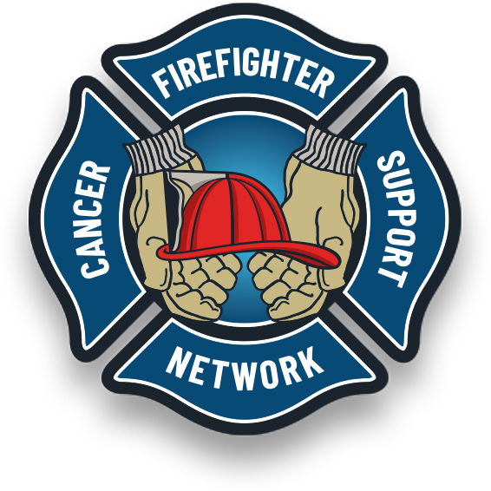

Modifiable Risk Factors
Call To Action
Modifiable Risk Factors for Cancer Prevention
You fight fire. We fight cancer!
FFCAM 2024
Notes:
Drag & Drop to add a picture in the back placeholder

Slide 2
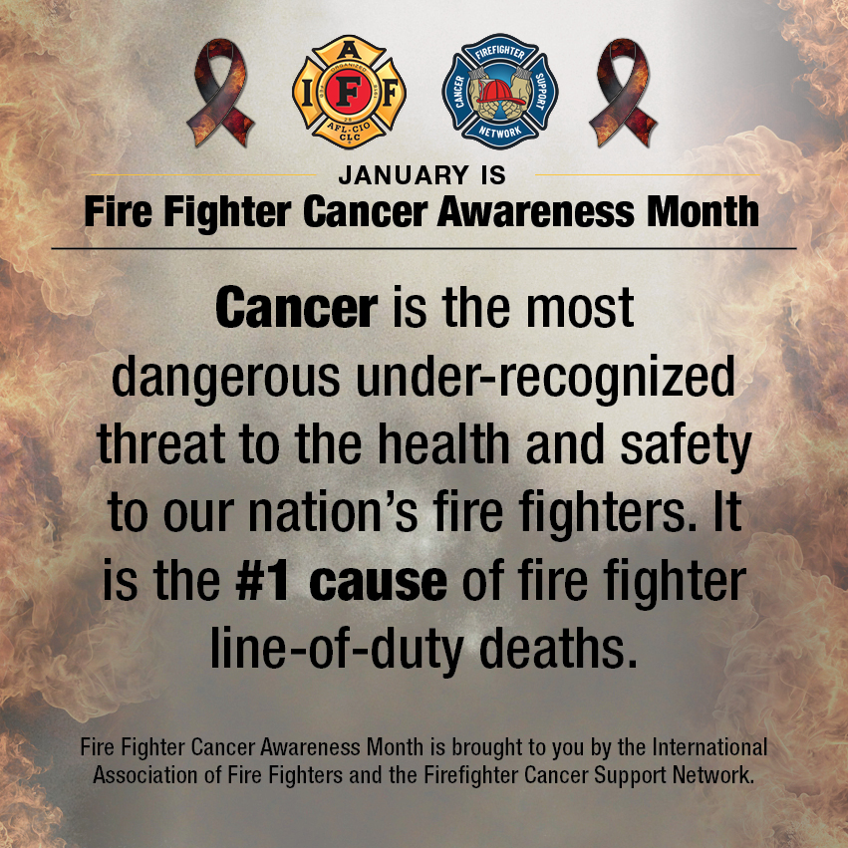
Objectives
What are modifiable risk factors
Use of sunscreen
Tobacco cessation
Physical Fitness
Sleep hygiene &
Medical Exams
Alcohol use
Notes:
Drag & drop to add a picture in the placeholder

Slide 3
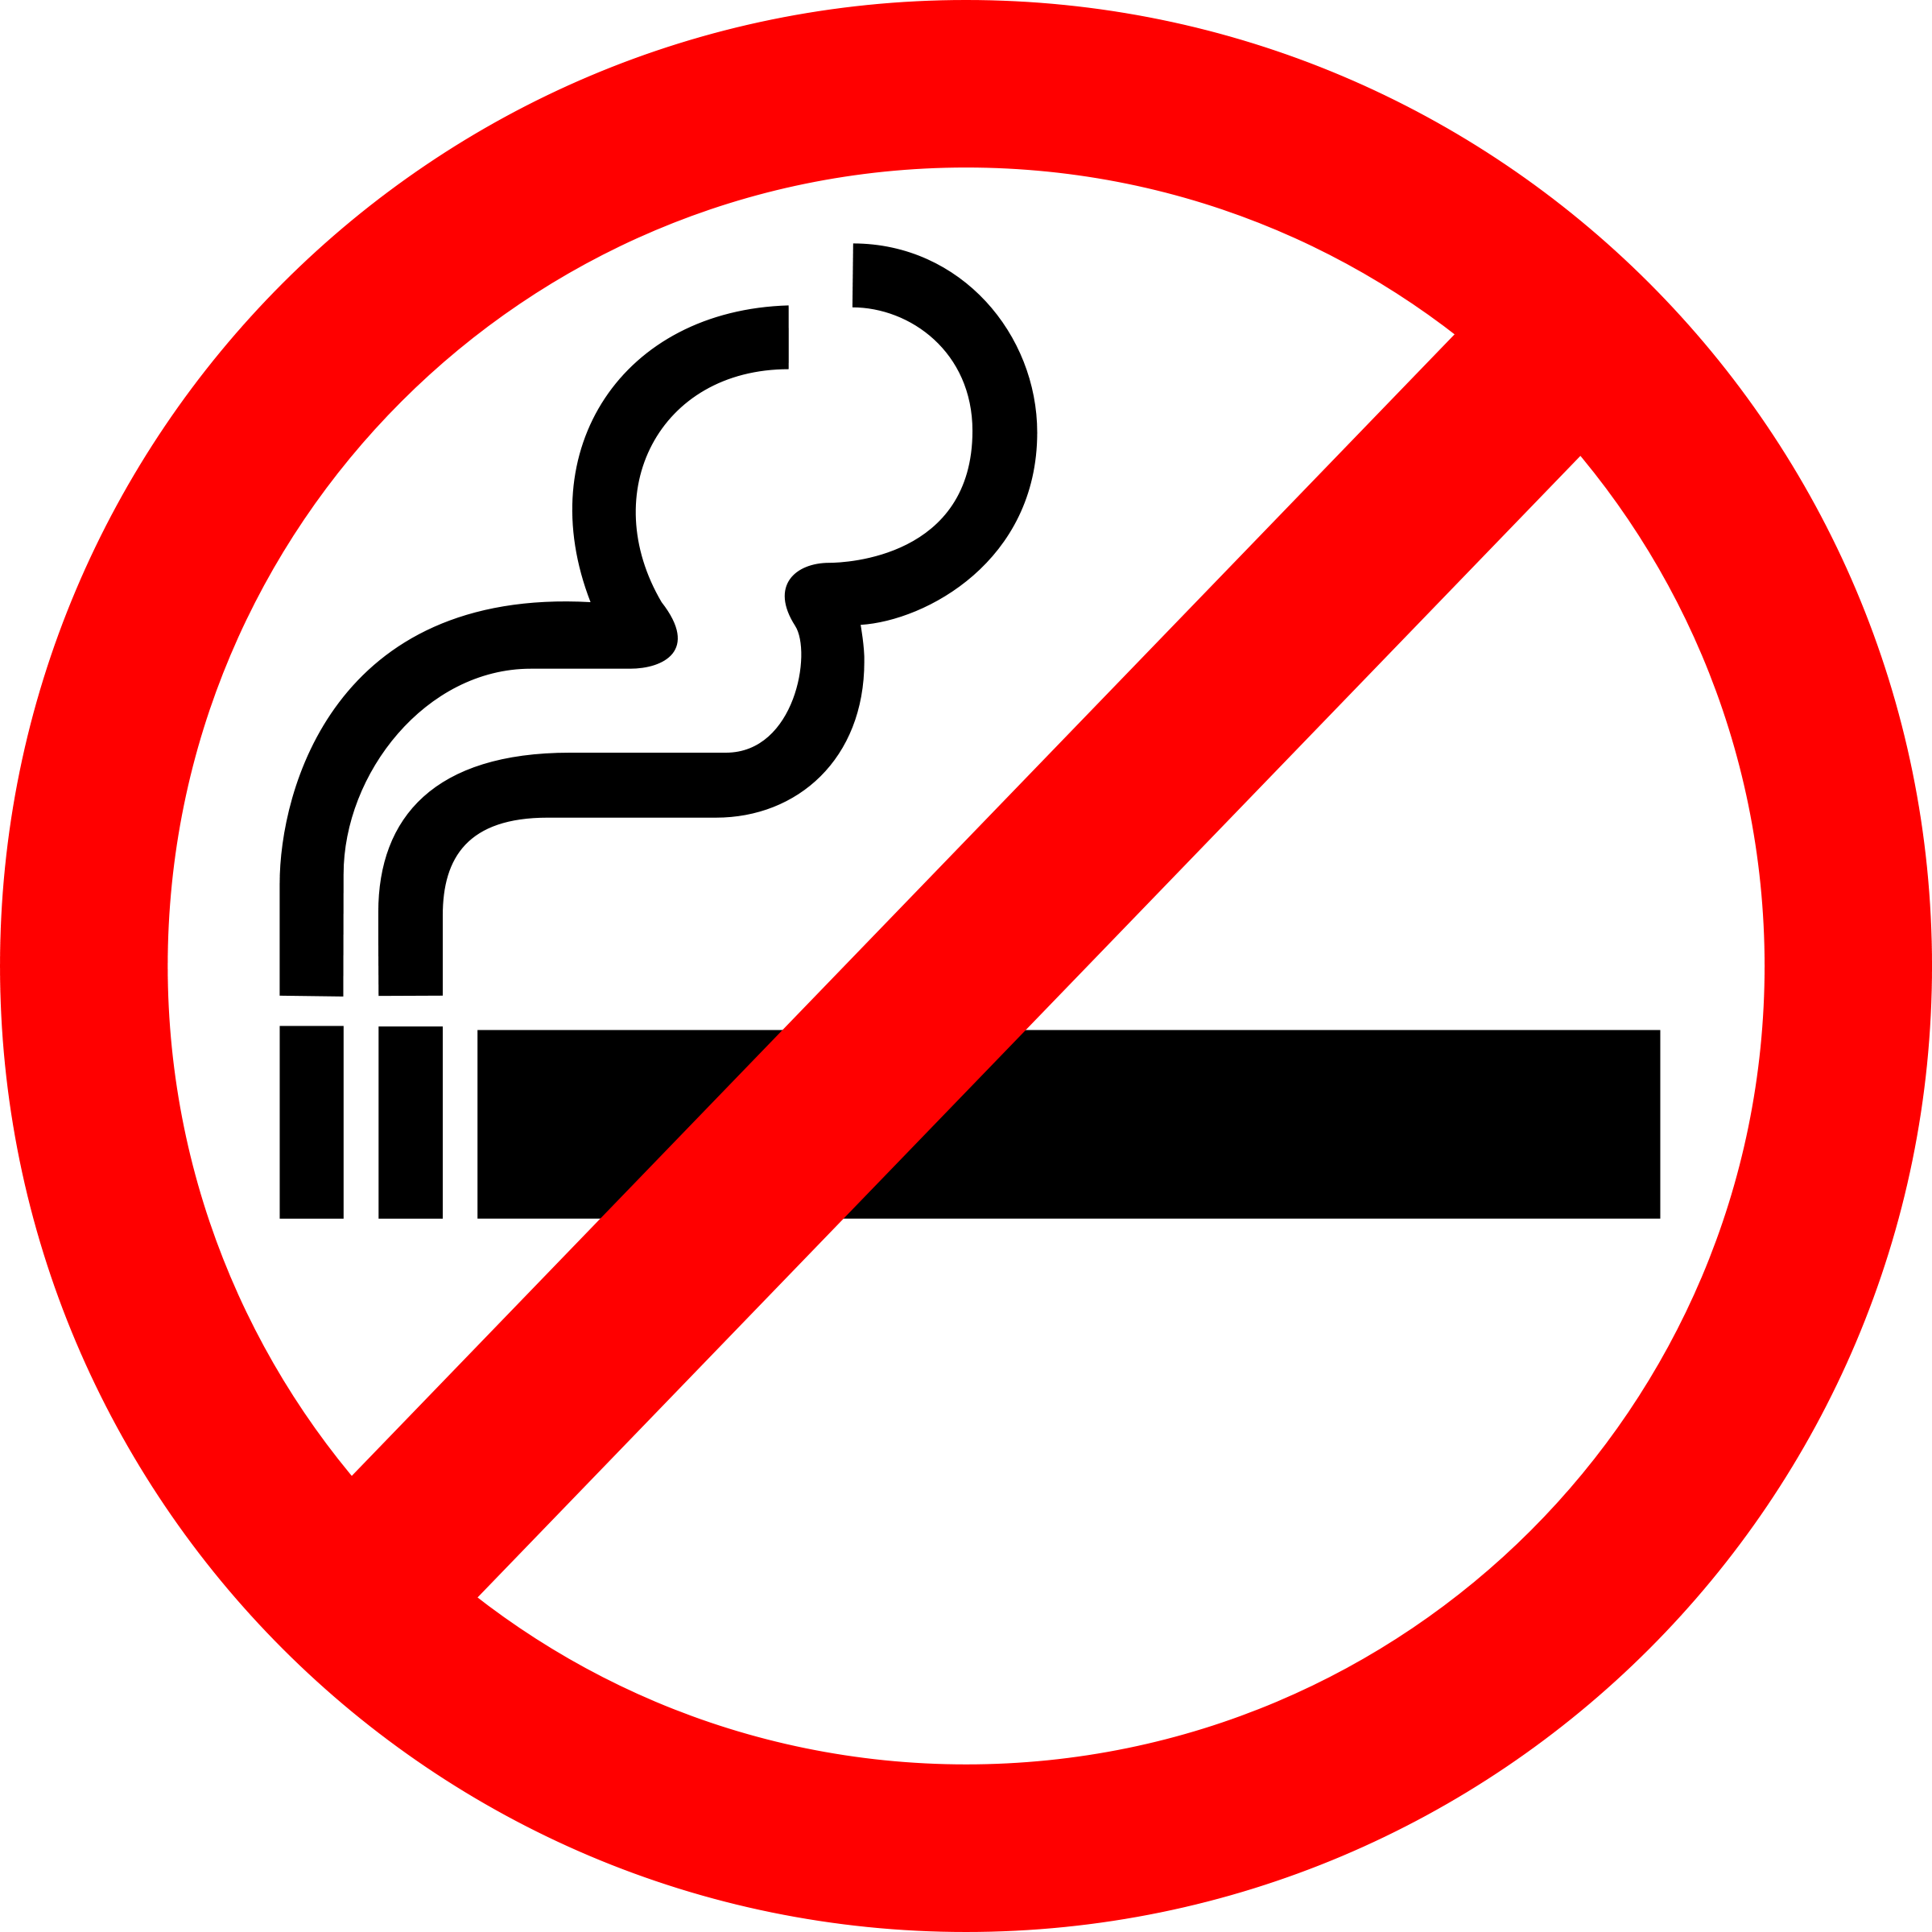


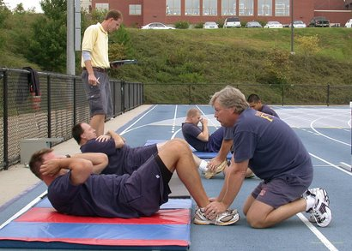
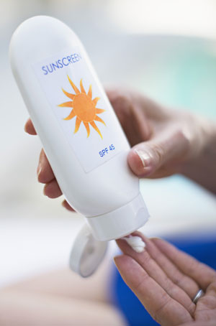
Risk Factors
Tobacco Products
Alcohol Use
Diet
Exercise
Sun Screen
Do not use Tobacco products, this includes smokeless tobacco as well.
Limit alcoholic drinks to 2 for men and 1 for women a day.
Eat more of a
variety of vegetables, fruits, and whole grains
  Be physically active for at least 30 minutes every day.
Use sun screen daily. Do skin checks with a dermatologist reguarly.
Notes:
Although some risk factors for different cancers cannot be prevented--such as age, sex, and genetics--other risk factors are preventable. Living a healthy lifestyle contributes to decreasing the risk for certain cancers. It's important to be informed about the changes that can be made that help to decrease risks for certain diseases such as cancer and other chronic illnesses.
Eat more of a variety of vegetables, fruits, and whole grains. The best rule of thumb is to go for color! In general, the deeper or brighter the color, the more antioxidants and cancer-fighting substances a fruit or vegetable contain.”
Be as lean as possible without becoming underweight.
Prevention guidelines for everyone:
Do not smoke or use other tobacco products.
Avoid sugary drinks
Limit consumption of energy-dense foods (particularly processed foods high in sugar, or low in fiber, or high in fat).
Limit supplement use to those that are necessary
Limit consumption of red meats, such as beef, pork and lamb, and avoid processed meats.
If consumed at all, limit alcoholic drinks to 2 for men and 1 for women a day.
Be as lean as possible without becoming underweight
Be physically active for at least 30 minutes every day.
Use of sunscreen regularly.
Performing monthly testicular self-exams for men or monthly breast self-exams for females.
Be up to date on the Hepatitis B vaccinations, to lessen the risk for liver cancer.

Slide 4
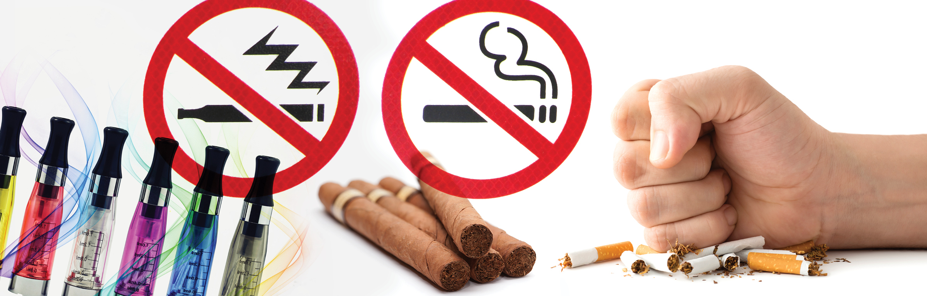
Tobacco use
According to the WHO & CDC:
The tobacco epidemic is one of the biggest public health threats the world has ever faced, killing over 8 million people a year around the world.
Smoking leads to disease and disability and harms nearly every organ system of the body. It is the leading cause of preventable death.
Notes:
Key facts
The tobacco epidemic is one of the biggest public health threats the world has ever faced, killing over 8 million people a year around the world. More than 7 million of those deaths are the result of direct tobacco use while around 1.3 million are the result of non-smokers being exposed to second-hand smoke (4).
Source: https://www.who.int/news-room/fact-sheets/detail/tobacco
Smoking can cause cancer and then block your body from fighting it:⁴
Poisons in cigarette smoke can weaken the body’s immune system, making it harder to kill cancer cells. When this happens, cancer cells keep growing without being stopped.
Poisons in tobacco smoke can damage or change a cell’s DNA. DNA is the cell’s “instruction manual” that controls a cell’s normal growth and function. When DNA is damaged, a cell can begin growing out of control and create a cancer tumor.
Doctors have known for years that smoking causes most lung cancers. It’s still true today, when nearly 9 out of 10 lung cancers deaths are caused by smoking cigarettes or secondhand smoke exposure.⁵ In fact, people who smoke have a greater risk for lung cancer today than they did in 1964, even though they smoke fewer cigarettes. One reason may be changes in how cigarettes are made and what chemicals they contain.⁵
Source: https://www.cdc.gov/tobacco/campaign/tips/diseases/cancer.html

Slide 5
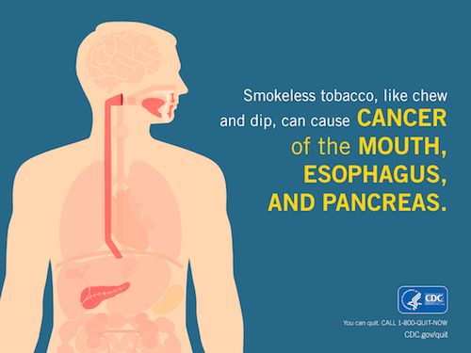
Smokeless Tobacco use
According to the CDC:
Smokeless tobacco is associated with many health problems. Using smokeless tobacco:
Can lead to nicotine addiction
Causes cancer of the mouth, esophagus (the passage that connects the throat to the stomach), and pancreas (a gland that helps with digestion and maintaining proper blood sugar levels)
Is associated with diseases of the mouth.
Notes:
Source:
https://www.cdc.gov/tobacco/data_statistics/fact_sheets/smokeless/health_effects/index.htm

Slide 6
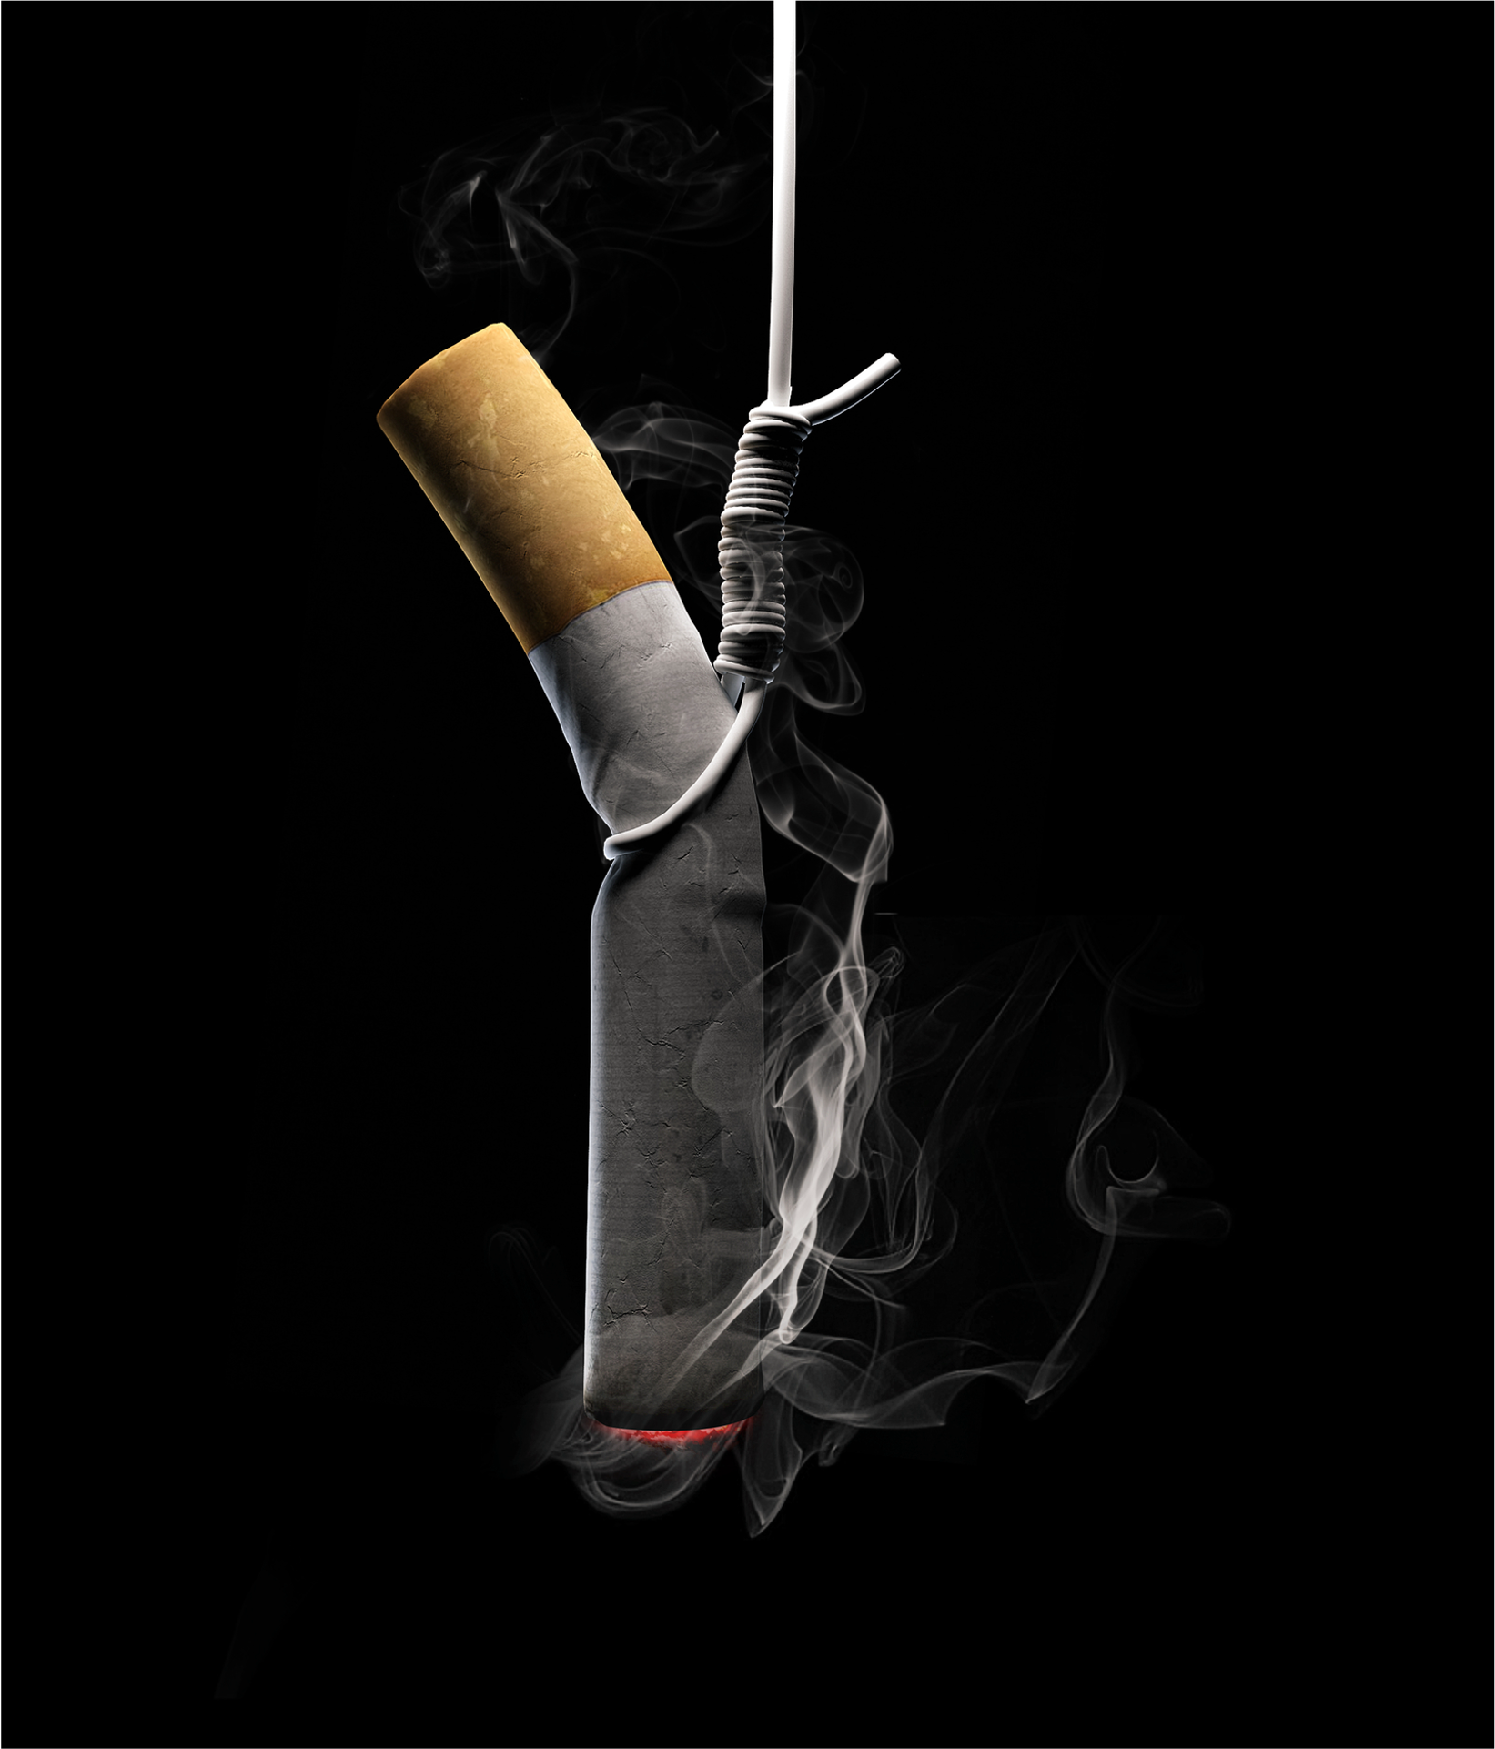
Tobacco use
It’s pretty simple. If you smoke,
you are buying yourself a trip to the cancer ward”. – Dr. Michael Hamrock
Smokeless tobacco included
Notes:
Smoking is the most preventable cause of death in the United States.¹⁵ Simply put, don’t smoke or use any kind of tobacco or nicotine. Tobacco use is a simple way to buy yourself a trip to the cancer ward. Tobacco smoke contains more than 7,000 chemicals. At least 250 of those are known to be harmful, and 69 of them can cause cancer.
Chew or chewing tobacco is also unsafe; there are no safe forms of tobacco. At least 28 chemicals in smokeless tobacco have been found to cause cancer. In addition to a variety of nitrosamines commonly found in cancer, other cancer-causing substances in smokeless tobacco include polonium–210 (a radioactive element found in tobacco fertilizer) and polycyclic aromatic hydrocarbons.
A 2018 report on e-cigarettes from the National Academies of Science reports that there is evidence that except for nicotine, under typical conditions of use, exposure to potentially toxic substances from e-cigarettes is significantly lower compared with combustible tobacco cigarettes. However, there are chemicals present in e-cigarette aerosols such as formaldehyde and acrolein that are capable of causing cancer. The long-term exposure to e-cigarette aerosols could increase risk of cancer. Whether the levels of exposure are high enough to contribute to human carcinogenesis remains to be determined.
Many firefighters think smokeless tobacco products are harmless, they are not. Smokeless tobacco is linked to several different types of cancer, including cancer of the mouth, esophagus and pancreas.
Smokeless tobacco use can cause gum disease, tooth decay, tooth loss and the formation of white or gray patches inside the mouth called leukoplakia that can lead to cancer.
Smokeless tobacco contains at least 28 cancer-causing chemicals (carcinogens).
National Cancer Institute (2018) Harms of Cigarette Smoking and Health Benefits of Quitting retrieved from: https://www.cancer.gov/about-cancer/causes-prevention/risk/tobacco/cessation-fact-sheet
National Cancer Institute (2018) Smokeless Tobacco and Cancer Retrieved from: https://www.cancer.gov/about-cancer/causes-prevention/risk/tobacco/smokeless-fact-sheet
National Academies of Sciences, Engineering, and Medicine. 2018. Public Health Consequences of E-Cigarettes. Washington, DC: The National Academies Press. https://doi.org/10.17226/24952.
Key Facts about Smokeless Tobacco American Lung Association:
https://www.lung.org/quit-smoking/smoking-facts/health-effects/smokeless-tobacco#:~:text=Key%20Facts%20about%20Smokeless%20Tobacco&text=Smokeless%20tobacco%20use%20can%20cause,that%20can%20lead%20to%20cancer.&text=Smokeless%20tobacco%20use%20during%20pregnancy,for%20early%20delivery%20and%20stillbirth.

Slide 7
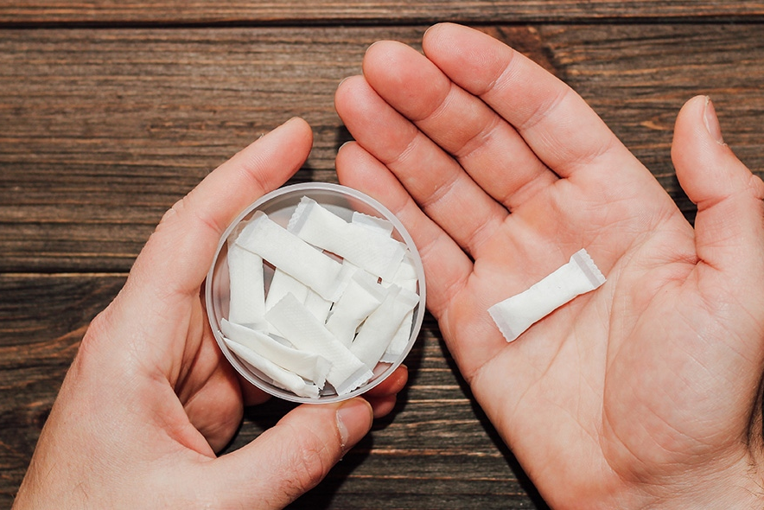
Nicotine Pouch use
Even though nicotine pouches contain fewer harmful chemicals than smokeable tobacco, they still contain cancer-linked tobacco-specific nitrosamines and carry a risk of several side effects, including nausea, hiccups, and mouth irritation.
Notes:
Nicotine pouch use is on the rise in the fire service. Nicotine pouches don’t contain tobacco like traditional cigarettes, but the nicotine contents still pose health risks, including addiction.
When a person addicted to nicotine goes without it for too long, they can experience irritability, depression, anxiety, craving, sleep disturbances, increased appetite, and cognitive and attention deficits.
The long-term health impact of nicotine pouches is still unknown. They are not technically categorized as smokeless tobacco, so the Food and Drug Administration (FDA) does not regulate them as strictly as smoked tobacco products or combustible tobacco. Without long-term data, we cannot be certain if or how reduced exposure will prevent harm to one’s health.
Source: https://pubmed.ncbi.nlm.nih.gov/34034614/
https://www.ncbi.nlm.nih.gov/pmc/articles/PMC9985244/
https://health.unl.edu/nicotine-pouches-are-they-safer-chewing-smoking-or-vaping

Slide 8
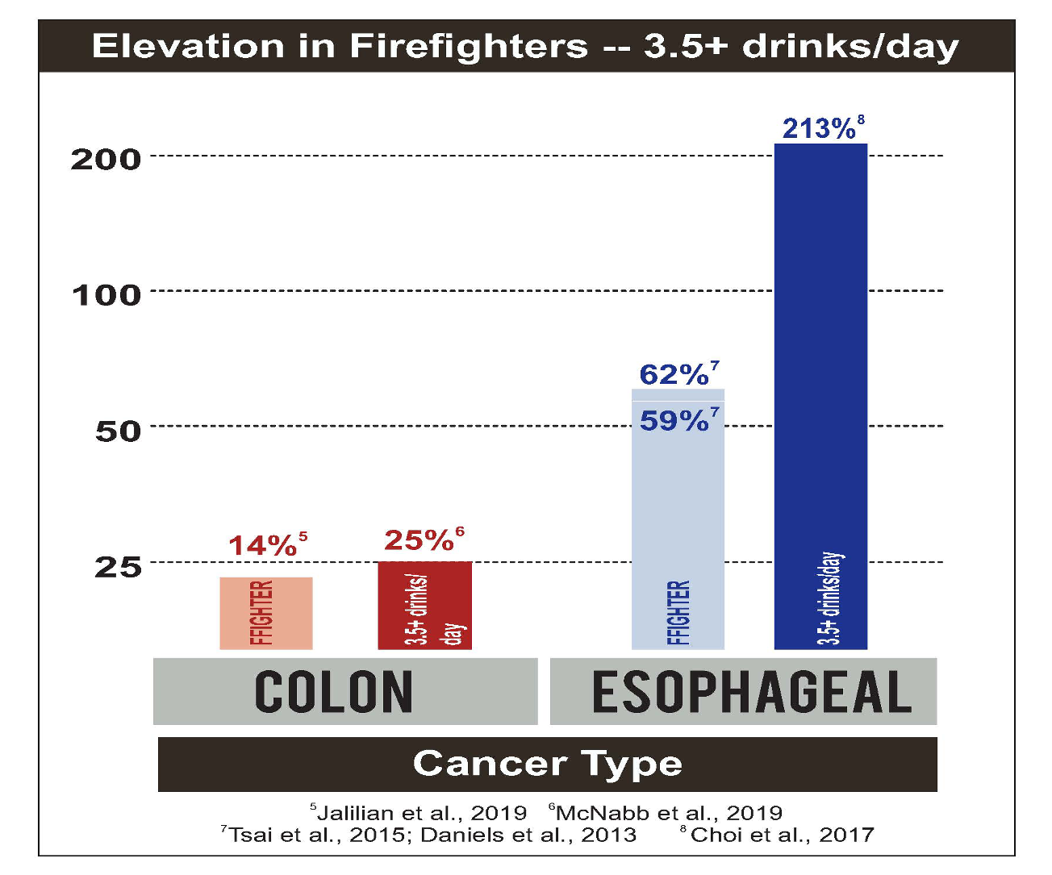

Alcohol use
Alcohol should be used in moderation
Notes:
Alcohol should be used in moderation. The general rule of thumb is two drinks a day for men, one drink per day for women.¹⁵ Again, moderation is key. Alcohol consumption is a risk factor for cancers of the mouth, pharynx, larynx, esophagus, liver, colorectal, breast, and, possibly, the pancreas.
Alcohol has an effect on other harmful chemicals. It can act as a solvent and dissolve toxins that may be in the mouth, esophagus, or stomach.¹⁵

Slide 9
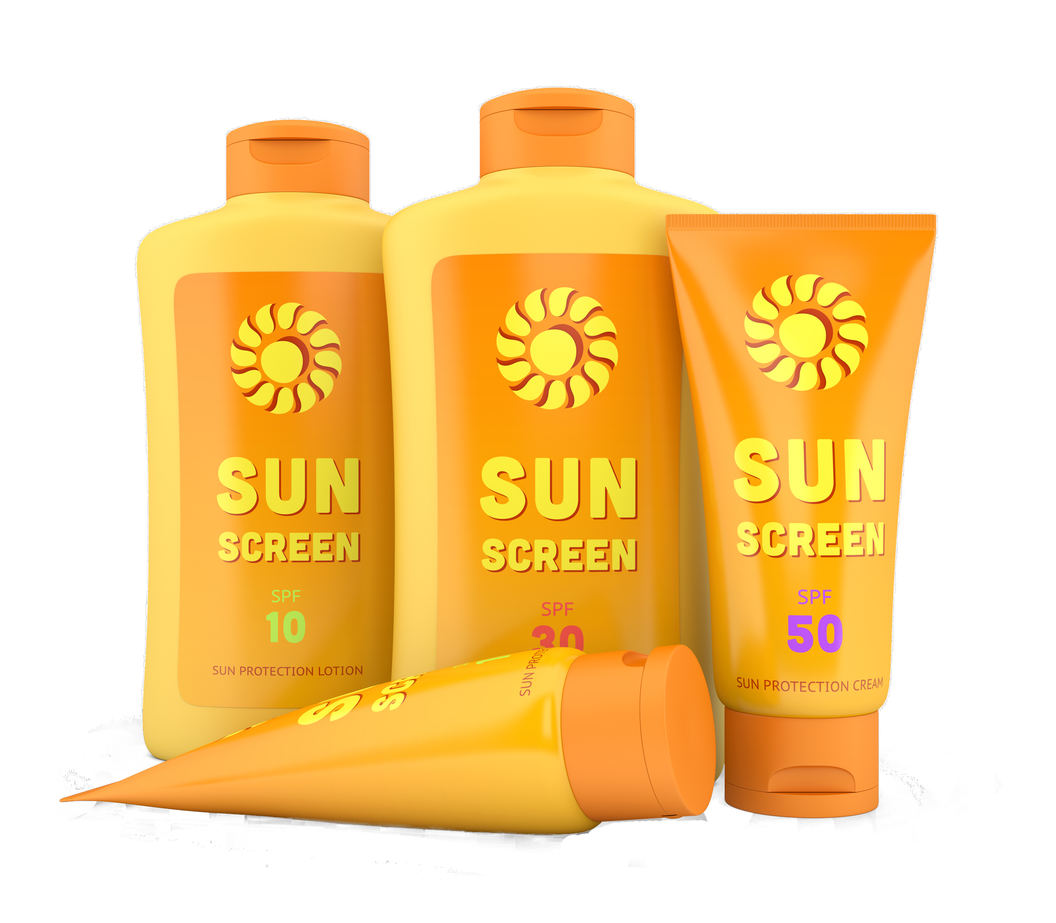
Suncreen
The scientific facts are inescapable—regular use of sun protection reduces skin cancer and cancer precursors.
– Dr. David Leffell
Yale School of Medicine
Use sun screen regularly
Notes:
Sunscreen that blocks UVA and UVB rays can prevent sunburns, and it goes a long way to preventing skin cancer. Firefighters are already exposed to a host of chemicals that can be linked to skin cancer, so excessive sun exposure is one of those risks be reduced. Sunscreen is one way to do it.
Research suggests that nearly 90% of melanoma, the deadliest form of skin cancer, is caused by overexposure to (UV) ultraviolet radiation.
Sunscreen is only one way to avoid this exposure to harmful UV exposures. Avoidance measures include wearing clothing that prevents exposure and moving into the shade during peak hours 10am-4pm.
Sunscreen should be at least SPF 30 broad spectrum to provide adequate protection.
The safety of sunscreen has been challenged and studied. Results show that there is no published data that demonstrates any adverse health effects on humans. ³¹
Vitamin D, which is produced from sun exposure, is known to improve bone health and reduce the risk of certain cancers. Vitamin D is also found in foods and dietary supplements without the risks associated with UV exposure.³¹
Melanoma Research Foundation. (2015) The MRF’s Sunscreen Position Statement Retrieved from https://www.melanoma.org/sites/default/files/MRFSunscreenStatement.pdf

Slide 10
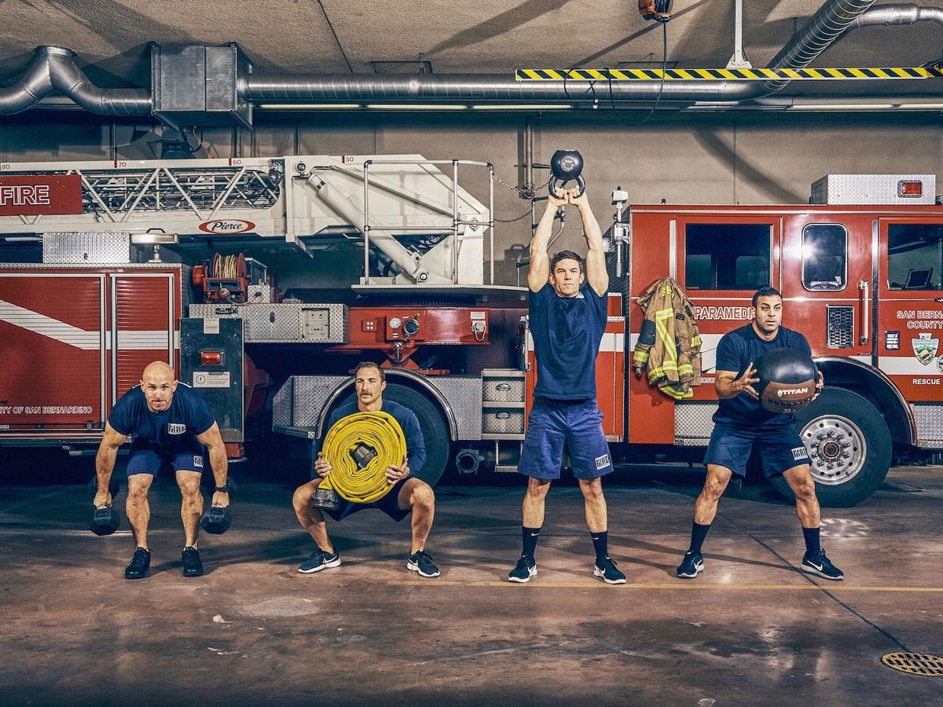
Physical Fitness
Physical fitness is crucial for fire fighters as it helps to prevent injuries, improve job performance, increase career longevity and enhance quality of life after retirement.
The physically demanding tasks performed on the fireground can put stress on the heart, making it important for fire fighters to maintain their fitness levels to reduce the risk of heart attacks, which are a leading cause of fire fighter fatalities.
Notes:
Exercise is important to firefighters for many reasons. Dr. Mike Hamrock was a Boston firefighter before he attended medical school. He is a primary care physician and former medical officer for the Boston Fire Department. He stresses that 45 minutes a day of vigorous exercise is necessary to maintain a healthy weight, good endurance, and physical conditioning. Exercise not only helps firefighters’ ability to perform well on the job, but also helps during the fight and recovery should a firefighter get cancer.
Exercise contributes a 10-50% lower risk of: colon, breast, endometrial, esophageal, liver, stomach, kidney, head and neck, rectum, bladder, and lung cancers, myeloid leukemia and multiple myeloma
(Moore et al 2016)
Physical activity also indirectly reduces the risk of developing obesity related cancers
because of its role in helping to maintain a healthy weight.¹⁵
Hamrock, M. (2010). Extinguishing Cancer in Firefighters. Retrieved From: http://www.fireengineering.com/articles/2010/08/extinguishing-ff-cancer.html

Slide 11
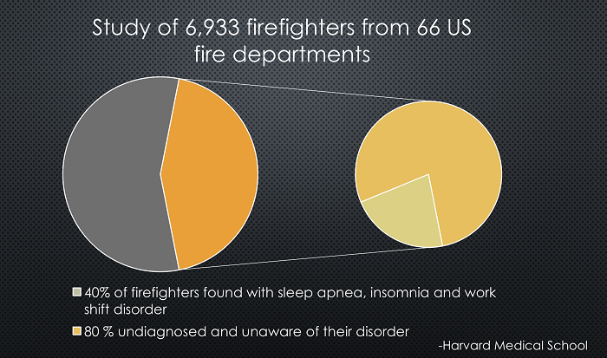
Sleep Hygiene
    A study published in the Journal of Clinical Sleep Medicine investigated 7,000 firefighters in 66 fire departments for obstructive sleep disorders, insomnia, restless leg syndrome and shift-work disorder.
    Researchers found that about 37% were positive for at least one sleep disorder.
    The study revealed more
    than 80% were positive for a common sleep disorder and were undiagnosed and untreated.
Notes:
The hard truth is that almost 40 percent of firefighters suffer from a sleep disorder. According to a screening of 6,933 firefighters, 80 percent of those who tested positive had no prior awareness or previous diagnosis of their condition. This one study, was conducted by Laura K. Barger, Ph.D., instructor in medicine at Harvard Medical School.
Source https://www.ncbi.nlm.nih.gov/pmc/articles/PMC4346644/
Barger’s research found that the firefighters who screened positive for a sleep disorder were more likely to report having cardiovascular disease, diabetes, depression, and anxiety, and report poorer health status than those who did not screen as positive. Barger identified sleep apnea as the primary sleep disorder from which firefighters suffer. Note that over an eight-year period, men with severe sleep apnea are 58 percent more likely to develop congestive heart failure, linking the connection between poor sleep and heart health.
Dr. Faith S. Luyster of the American Academy of Sleep Medicine and Sleep Research Society states that chronic sleep deficiency is causal in the development and exacerbation of cardiovascular and metabolic diseases and, ultimately, a shortened life span.

Slide 12
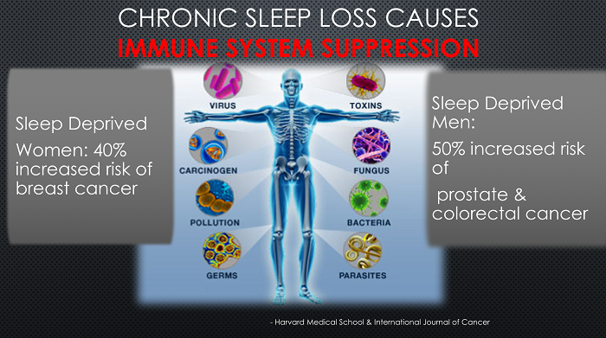
Sleep Hygiene
According to the International Journal of Cancer, sleep deprived women have a 40 percent increased risk of breast cancer, and sleep deprived men have a 50 percent increased risk of prostate and colorectal cancer.
Notes:
In 1996 Dr. Irwin of UCLA kept 42 healthy men awake between 10:00 pm and 3:00 am The results showed a 70 percent reduction of cancer-fighting immune cells known as “natural killers” (NK) after one night!
NK cells are best known for detecting and controlling early signs of cancer. In other words, one bad night at work can reduce a firefighter’s defense against cancer and other diseases.
The University of Texas’s Southwestern Medical Center studied a group of participants with decreased sleep. Researchers concluded that little sleep equates to negative health outcomes such as all-cause mortality, obesity, diabetes, cardiovascular disease, and impaired vigilance and cognition. This coincides with Barger’s research which found that the firefighters who screened positive for a sleep disorder were more likely to report having cardiovascular disease, diabetes, depression, and anxiety, and report poorer health status than those who did not screen as positive. Barger identified sleep apnea as the primary sleep disorder from which firefighters suffer. Note that over an eight-year period, men with severe sleep apnea are 58 percent more likely to develop congestive heart failure, linking the connection between poor sleep and heart health.
https://www.ncbi.nlm.nih.gov/pmc/articles/PMC4615350/
https://www.ncbi.nlm.nih.gov/pmc/articles/PMC4849511/
https://pubmed.ncbi.nlm.nih.gov/7871104/

Slide 13
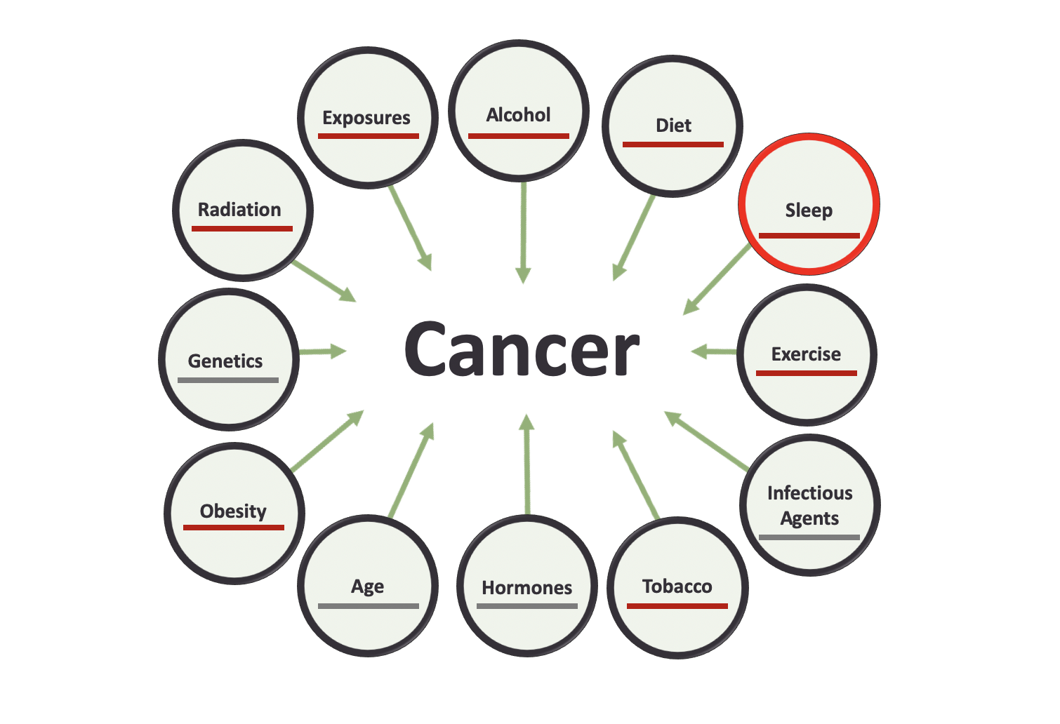
Sleep Hygiene
    We need to make efforts to support sleep hygiene in the fire service that promotes the natural circadian rhythm
Notes:
Leadership needs to understand the positive benefits of sleep hygiene and rest and how it will increase optimized performance
Those who snore loudly, who are tired in the daytime, need to be encouraged to do a sleep study.
Departments should ensure a daily rest and recovery time dedicated to unplugging, napping, or doing Sleep Recovery Practices

Slide 14
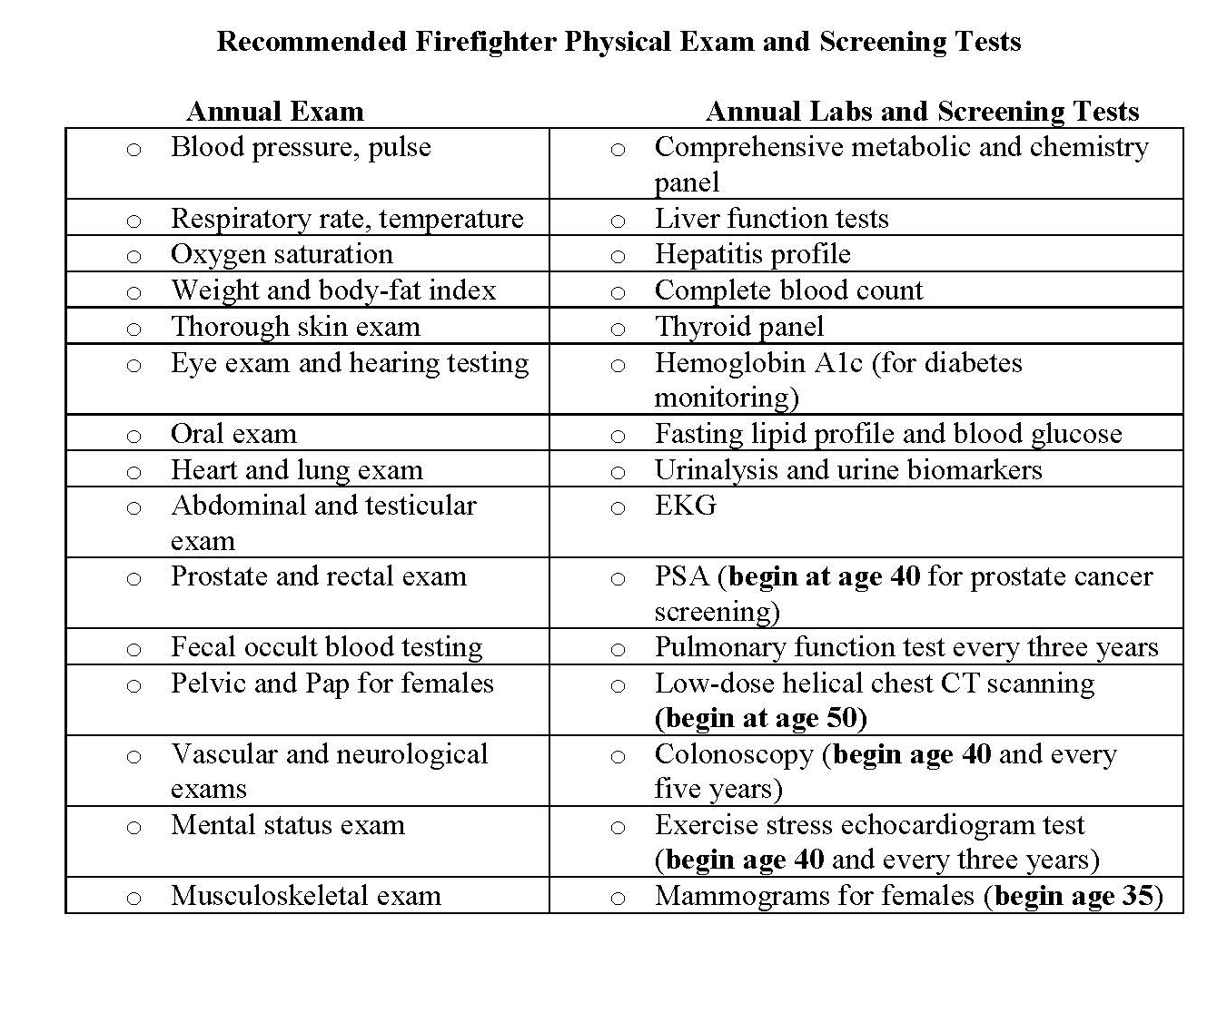
Medical Exams
Dr. Michael Hamrock developed this form for firefighters to take to their primary care physician.
It outlines the cancer screening tests and annual exams elements designed for firefighters.
There are several test firefighters should take earlier than the general population due to our profession and what we are exposed to:
  Colonoscopy: Normally this begins at age 45. For firefighters it should begin at age 40.
  Lung cancer screening
  PSA test age 40
Notes:
Dr. Mike Hamrock, who was a Boston firefighter before he went to medical school, developed a letter for firefighters to take to their primary care physician.
This letter outlines the evidence for the recommended cancer-screening tests and annual exam elements designed for firefighters.
There is a form specific for female firefighters as well.
Firefighters should receive several tests earlier than the general population.
Insurance coverage for these tests vary, but with the proper support from the physician the tests often can be ordered and covered.
Colonoscopy used to be recommended for the general public by age 50, now the age is 45. Firefighters are considered high risk. The recommended age is 40.
Tests may be expensive. Cancer treatments are really, really expensive.
Download this file directly:
https://firefightercancersupport.org/wp-content/uploads/2020/01/Primary-care-cancer-evaluations-for-firefighters_HamrockMD_2016_FCSN.pdf

Slide 15
Medical Exams
There is a form specific for female Firefighters as well

Slide 16
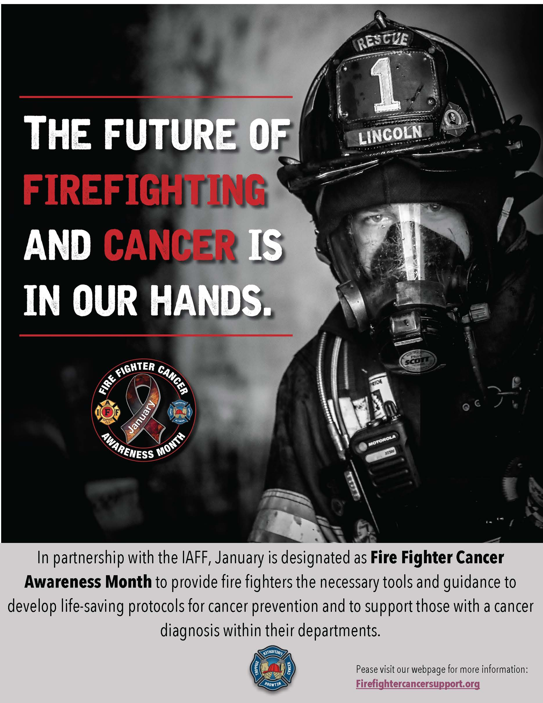
Modifiable Risk Factors
Summary
In this presentation we discussed modifiable risk factors and how they relate to occupational cancer prevention.
Make the necessary changes to protect yourself

Slide 17
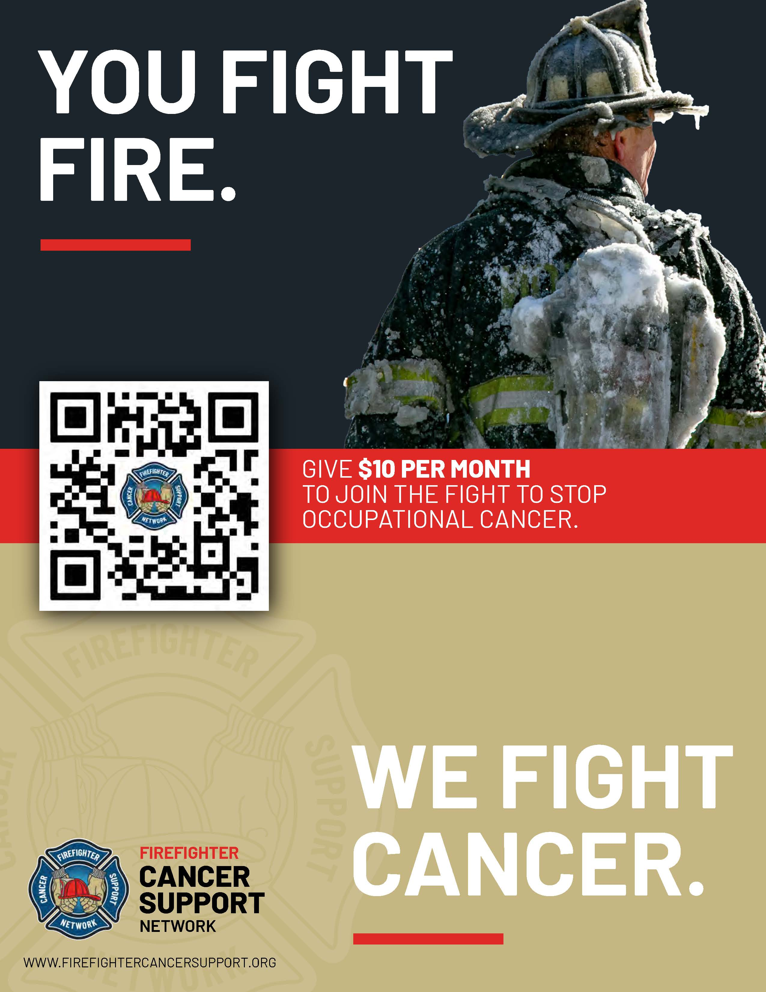
We hope you found this presentation to be valuable for you and your brother and sister firefighters and EMS providers.
If you did, please consider making a small donation to help FCSN continue to spread the word nationwide about the dangers firefighters face and the precautions they can take to reduce their chances of getting cancer
THANK YOU!

