Slide 1
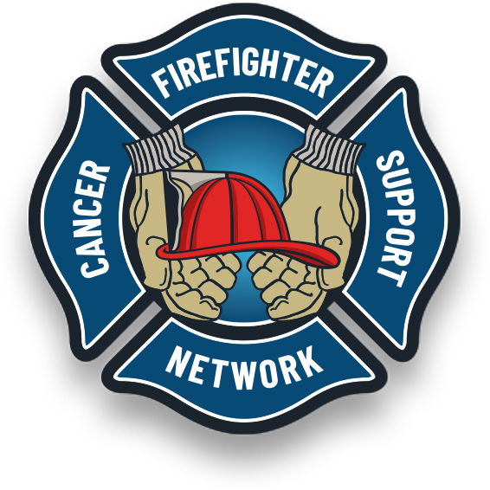

Fireground Best Practices
Call To Action
Cancer Prevention on the
Fireground
You fight fire. We fight cancer!
FFCAM 2024
Notes:
Drag & Drop to add a picture in the back placeholder

Slide 2
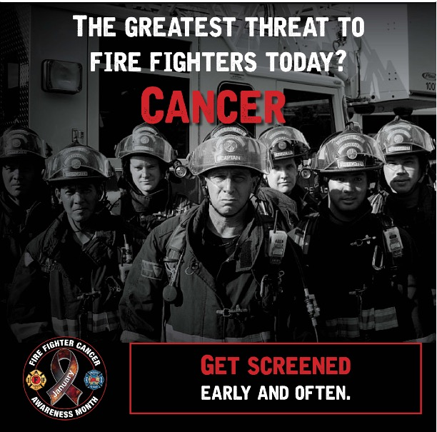
Objectives
01
02
03
04
05
06
07
Discuss occupational exposure
Discuss fire zones on the fireground
The Importance
of SCBA use
Preliminary Exposure Reduction
Use of wet wipes
Bagging and transporting contaminated PPE
12 Steps to protect yourself
Notes:
Drag & drop to add a picture in the back placeholder

Slide 3
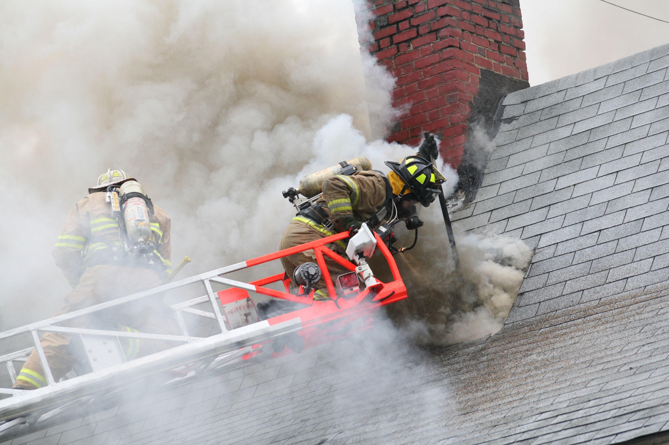
Fireground Cancer Prevention
Occupational Exposure
Personnel should be cognizant that an exposure to products of combustion does not require visible smoke.
Inhalation and absorption of low doses, in the part per million (ppm) range or microscopic amounts, can have a potential carcinogenic effect.
Notes:
Wearing SCBA from the beginning of fire attack to the end of overhaul, when everything is cool to the touch and nothing’s off gassing, is an important step in reducing unnecessary exposures.
The fire-smoke slide earlier demonstrated that there are many, many chemicals in the products of combustion. It’s not just carbon monoxide and hydrogen cyanide.
There is no way to tell how much off gassing of those many other chemicals found in fire smoke is taking place.
Wearing SCBA and managing air use throughout fire operations, including overhaul, should be the standard practice for firefighters. This includes having policies and procedures about air management that will provide guidance on protection in the modern fire environment.
20 minutes of burning wood = 1 pack of cigarettes.
Gagliano, M., Phillips, C. R., & Jose, P. (2008). Air Management for the Fire Service. PennWell Corporation.

Slide 4
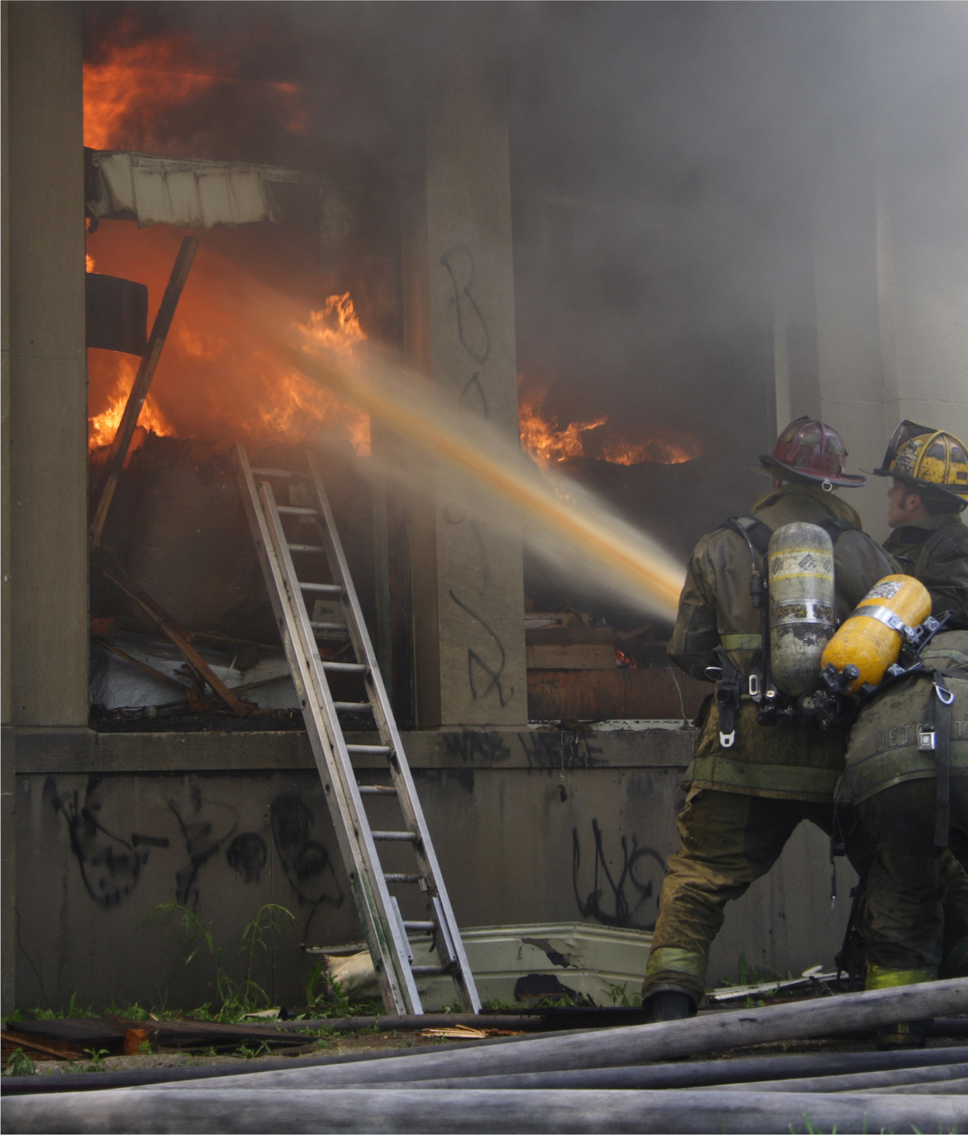
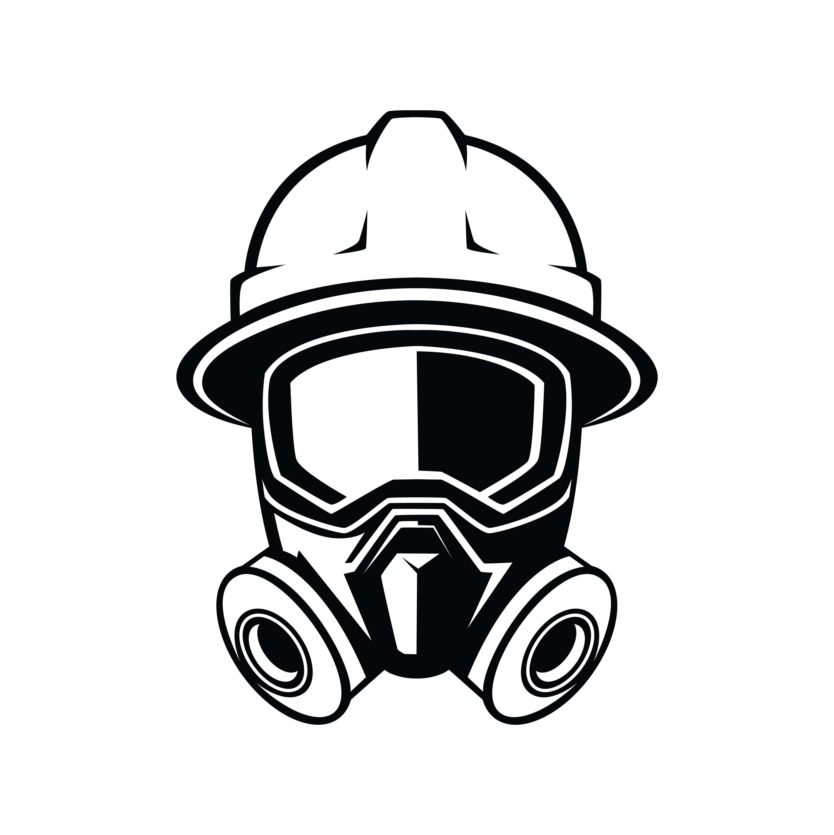
Fireground Cancer Prevention
Occupational Exposure
Generally, the definition of an occupational exposure is when a firefighter comes into direct contact with a disease-causing substance or material through the course of their job-related duties.
Notes:
Traditionally, occupational exposures have centered around blood and body fluids. However, thanks to a great deal of scientific research, we now know that occupational exposures include much more than just blood and body fluids.
Firefighters work in an uncontrolled atmosphere compared to most other occupations where exposure to hazards can be controlled through engineering and procedures. Firefighters are exposed to hazards at high levels for short durations, unlike most other occupations.

Slide 5
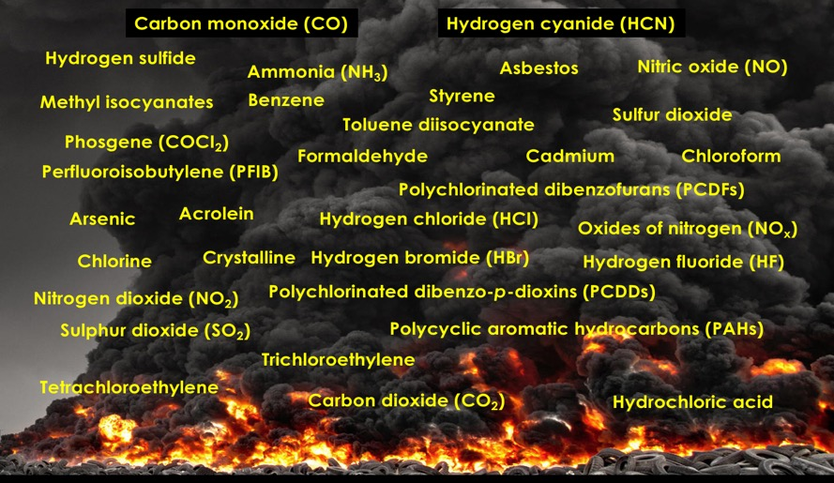
There are over 200 known chemicals in smoke
Smoke from fires includes suspended liquid and solid particulate matter, as well as gases and vapors that result from the combustion of material.
There are very large numbers of toxic components in smoke.
Firefighters have an occupational exposure to fire smoke that the general public does not.
Many of these chemicals are known group 1 carcinogens
FCSN urges the use of SCBA from initial fire attack to the end of overhaul!
Notes:
Pot-on-the-stove is a common response for firefighters.
Firefighters respond to many calls that include food or fires from cooking.
These fires produce an acrid smoke that has a telltale odor leading to a reduced concern about toxins and the “It’s just food on the stove” mindset.
Cooking, in particular high-temperature frying, generates substantial amounts of airborne particulate matter, including ultrafine and fine particles.
These can include polycyclic aromatic hydrocarbons (PAHs) and heterocyclic amines formaldehyde, acetaldehyde, acrylamide and acrolein.¹⁸
Firefighters who do not wear SCBA on these calls are getting unnecessary exposures to several carcinogenic toxins.
One or two exposures may not be a problem; it’s the repeated exposures that can lead to an issue with elevated cancer risks.¹¹
Straif, K., Baan, R., Grosse, Y., Secretan, B., El Ghissassi, F., Cogliano, V., & WHO International Agency for Research on Cancer Monograph Working Group. (2006). Carcinogenicity of household solid fuel combustion and of high-temperature frying. The lancet oncology, 7(12), 977-978. Retrieved from: http://monographs.iarc.fr/ENG/Monographs/vol95/mono95-7.pdf

Slide 6
Exposures are likely to occur during operations when in proximity to products of
combustion such as:
  Food on the stove (including when there is only smoke present)
  Natural vegetation fires
  Vehicle fires
  Live fire training activities
  Trash/Dumpster fires.
  Driver/Engineer performing pumping operations.
  Crews assigned to an exterior exposure line.
Unintended exposure of any personnel due to significant wind shift, scene dynamics or complications.
Fire Cause Investigations activities.
Ventilation operations.
Incident Commanders / Safety Officers performing Incident Command functions
If you smell smoke , you're being exposed!
Notes:
Pot-on-the-stove is a common response for firefighters.
Firefighters respond to many calls that include food or fires from cooking.
These fires produce an acrid smoke that has a telltale odor leading to a reduced concern about toxins and the “It’s just food on the stove” mindset.
Cooking, in particular high-temperature frying, generates substantial amounts of airborne particulate matter, including ultrafine and fine particles.
These can include polycyclic aromatic hydrocarbons (PAHs) and heterocyclic amines.
It also can generate certain gaseous pollutants, such as formaldehyde, acetaldehyde, acrylamide and acrolein.
Firefighters who do not wear SCBA on these calls are getting unnecessary exposures to several carcinogenic toxins.
One or two exposures may not be a problem; it’s the repeated exposures that can lead to an issue with elevated cancer risks.¹¹
Straif, K., Baan, R., Grosse, Y., Secretan, B., El Ghissassi, F., Cogliano, V., & WHO International Agency for Research on Cancer Monograph Working Group. (2006). Carcinogenicity of household solid fuel combustion and of high-temperature frying. The lancet oncology, 7(12), 977-978. Retrieved from: http://monographs.iarc.fr/ENG/Monographs/vol95/mono95-7.

Slide 7
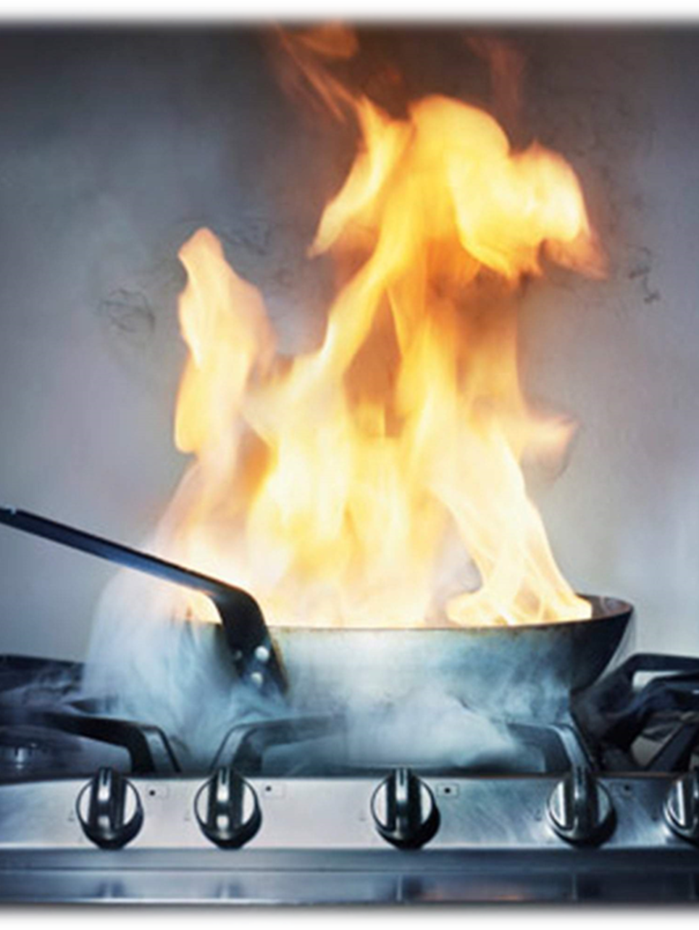
FOOD ON THE STOVE
Telltale odor leads to a reduced concern “It’s just food on the stove” mindset.
Produces airborne particulate matter, including ultrafine and fine particles, including polycyclic aromatic hydrocarbons (PAHs) and heterocyclic, acetaldehyde, acrylamide and acrolein
.
Notes:
Drag & Drop to add a picture in the placeholder

Slide 8
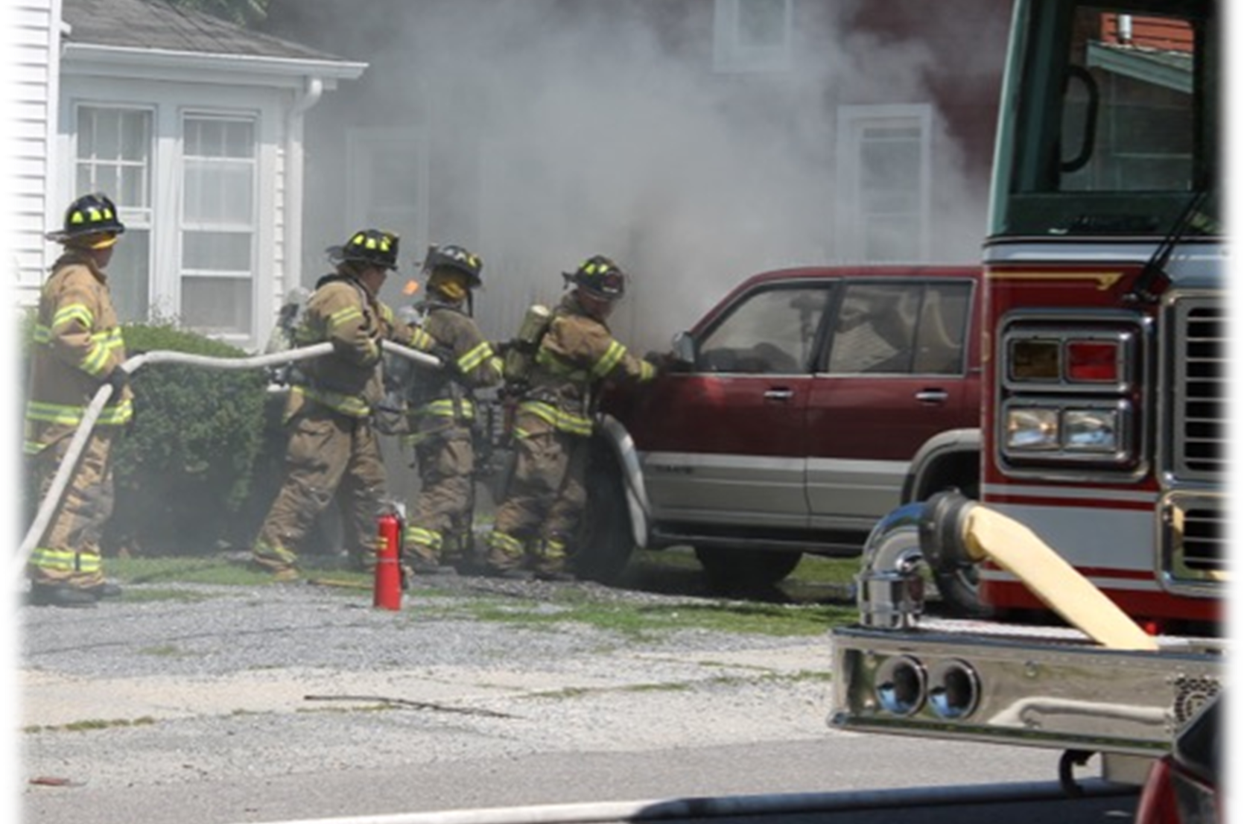
Vehicle Fires
Cars are constructed with many plastic and synthetic materials that produce toxins when burning.
Notes:
Cars are constructed with many plastic and synthetic materials that produce toxins when burning.
Smoke color is not an indication of the types of toxins off gassing.
Note the firefighters here are not wearing SCBA during fire attack. Firefighters cannot rely on holding their breath or hoping the smoke is moving away from them.
Being outdoors does not mean you avoid the carcinogens in fire smoke!

Slide 9

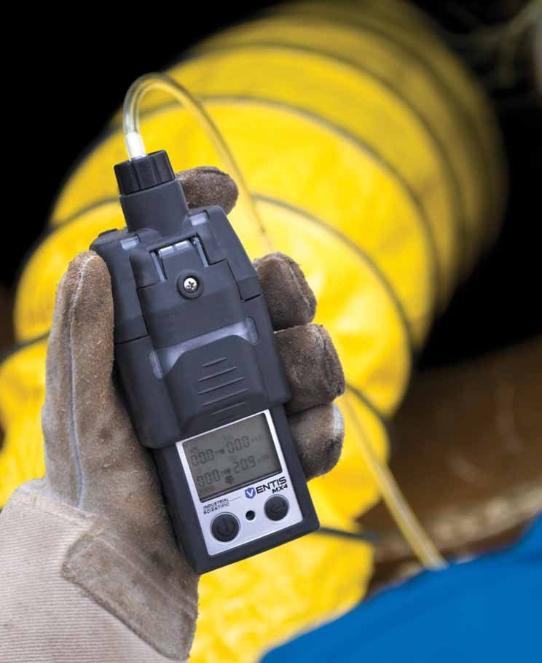
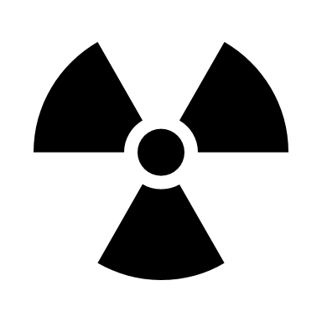

Fire Scene Air Monitoring
CARBON MONOXIDE
IDLH=1200 PPM | NIOSH REL 35 PPM
HYDROGEN CYANIDE
IDLH = 50 PPM | NIOSH REL = 5 PPM
There are many other gases that are
undetectable without monitors and are
FAR MORE DANGEROUS than CO or HCN!
ZERO
There is ABSOLUTELY NO CORRELATION between the levels found from air monitoring for CO and HCN and cancer-causing toxins found at a fire.
Notes:
Carbon monoxide and hydrogen cyanide are highlighted on the slide. It’s easy to monitor them with instruments. We urge firefighters not to use the metered levels of these two to indicate the air is clear and signal that the removal of SCBA is acceptable.
We cannot or do not monitor for dozens of other toxins that may be present.
Compounds such as benzene, styrene, formaldehyde, acrolein, arsenic, and polycyclic aromatic hydrocarbons are all known to be cancer-causing among humans. All can be present in fire smoke at varying levels.
Just because carbon monoxide and hydrogen cyanide have reached certain levels does not mean it’s safe to remove your mask.¹⁸
Bolstad-Johnson, D. M., Burgess, J. L., Crutchfield, C. D., Storment, S., Gerkin, R., & Wilson, J. R. (2000). Characterization of firefighter exposures during fire overhaul. AIHAJ-American Industrial Hygiene Association, 61(5), 636-641. Retrieved from: http://www.firefightercancersupport.org/wp-content/uploads/2013/06/characterization_of_firefighter_exposures_during_fire_overhaul.pdf

Slide 10
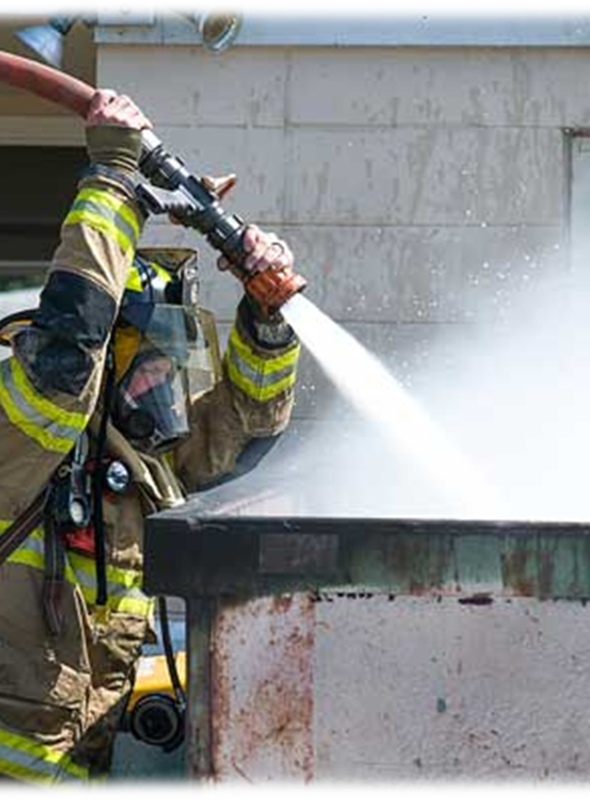
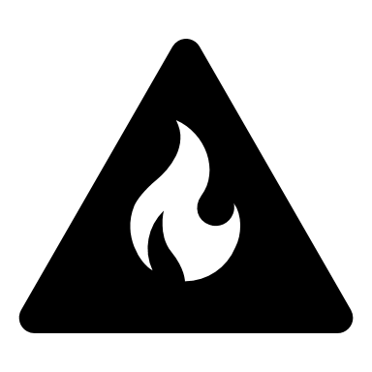
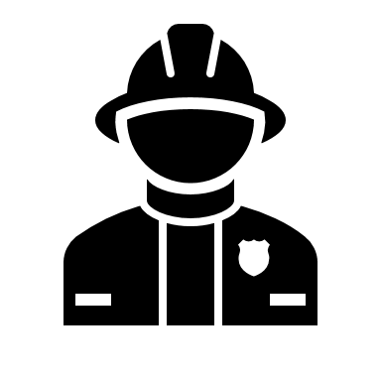
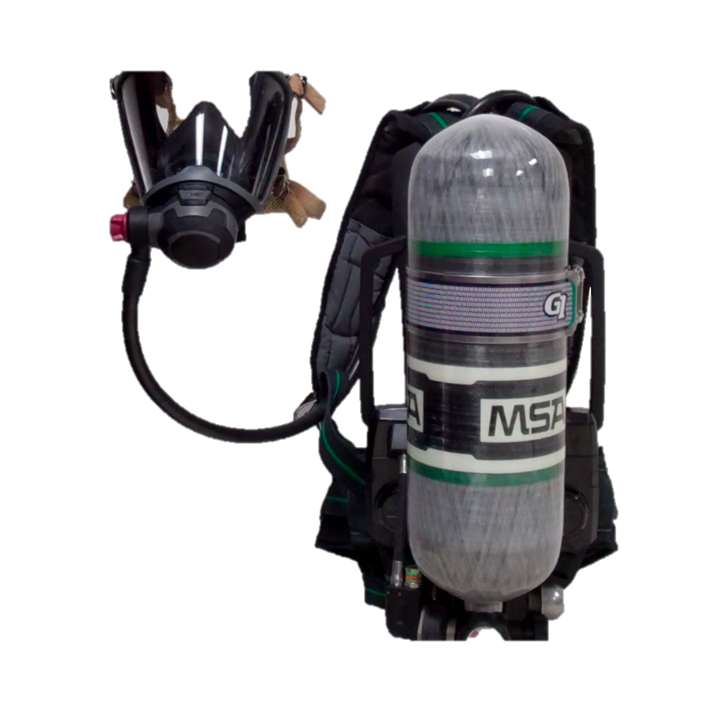
Outside Fires
Exterior firefighting in general may be perceived as safe. It’s important to understand that fire smoke is fire smoke whether it is inside or outside. All fire smoke contains products of combustion that can be carcinogenic.
The FCSN urges you to use your SCBA anytime products of combustion are present
Wearing the SCBA is the gold standard of respiratory protection
Notes:
Dumpster fires represent another outside suppression function, but they can contain unknown products.
Again, smoke color is not an indication of the types of toxins off gassing.
Many times, you'll have no idea what’s in that dumpster.
Exterior firefighting in general may be perceived as safe. It’s important to understand that fire smoke is fire smoke whether it is inside or outside. All fire smoke contains products of combustion that can be carcinogenic.17
Wearing an SCBA is a great way to reduce your exposure.
Note that the firefighter is wearing a mask but is not on air. It’s white smoke, not black smoke, but there’s roofing material or asphalt burning in the dumpster. Wearing your mask is great, but if you are going to dress out, use the air to protect your respiratory system!

Slide 11

Routes of Exposure
01
02
03
Inhalation
Absorption
Ingestion
Firefighters are exposed to toxic gases, vapors and particulates through inhalation.
This is especially true during the overhaul phase and not wearing a SCBA.
Firefighters are exposed to carcinogens found on the fireground through dermal exposure. Particulates are absorbed through the skin.
These contaminants are ingested at the incident scene through nutrition.
Notes:
Absorption: Firefighters are exposed to carcinogens found on the fireground through dermal exposure. Particulates are absorbed through the skin. For every 5 degree of temperature rise the absorption rate increases by 400%
Inhalation: Firefighters are exposed to toxic gases, vapors and particulates through inhalation. This is especially true during the overhaul phase and not wearing a SCBA. Inhalation can also occur through inhalation from off-gassing of contaminated equipment and diesel exhaust.
Ingestion: Transfer of contaminants from contaminated PPE or equipment to the skin. These contaminants are ingested at the incident scene through nutrition.
The by-products of combustion of ordinary household items such as cabinets, mattresses, curtains, insulation, and porch materials can be very carcinogenic.
Daily exposure to diesel exhaust in the firehouse can also precipitate cancer. Analysis of the kitchen and bunkroom walls and furniture in firehouses reveals a tremendous amount of diesel exhaust particles. These dangerous particles are inhaled and absorbed every shift and cause significant harm to firefighters
https://www.ncbi.nlm.nih.gov/pmc/articles/PMC7323473/

Slide 12
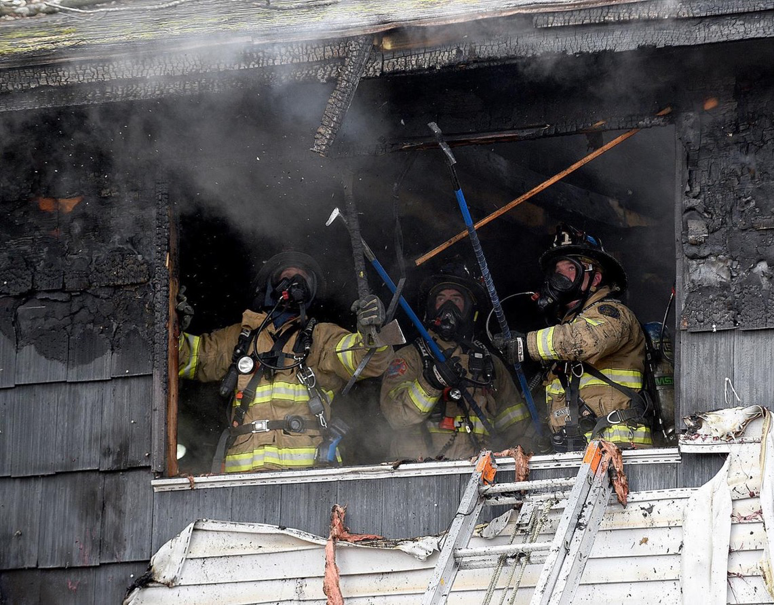
SCBA Use
  Too many firefighters either will NOT wear SCBA, or they will “ditch” their SCBA as soon as the fire is “out,” but before beginning overhaul —
  This is the ABSOLUTE WORST TIME to ditch your SCBA!
Notes:
Wearing SCBA from the beginning of fire attack to the end of overhaul, when everything is cool to the touch and nothing’s off gassing, is an important step in reducing unnecessary exposures.
There is no way to tell how much off gassing of those many other chemicals found in fire smoke is taking place.
Wearing SCBA and managing air use throughout fire operations, including overhaul, should be the standard practice for firefighters. This includes having policies and procedures about air management that will provide guidance on protection in the modern fire environment.
20 minutes of burning wood = 1 pack of cigarettes.
Fire cause investigators, if possible, wear the SCBA as well. It is the gold standard of respiratory protection.
Gagliano, M., Phillips, C. R., & Jose, P. (2008). Air Management for the Fire Service. PennWell Corporation.

Slide 13
The fireground should be divided into zones
as a best practice
Hot Zone
IDLH
Warm Zone
Cold Zone
01
02
03
Crews exit hot zone together and enter the warm zone for the Preliminary Exposure Reduction process
(PER)
Crews enter the warm zone and
begin the Preliminary Exposure Reduction process on air
Doff PPE’s
Rehab occurs here
Medically Monitored
Rehydration/Nourishment
No PPE’s allowed
Notes:
Whenever operation at a fire incident it is recommended to set up a hot zone, warm zone, and cold zones.
If you're operating in the hot zone you should be wearing your SCBA and be on air. It is recommended for Fire Investigators as well. The SCBA is the gold standard of respiratory protection.
Personal Hazard Reduction (PER) occurs in the warm zone, again using your SCBA and be on air. The firefighter with the lowest air should go through PER first.
No nourishment occurs in either the hot or warm zones to decrease ingestion to carcinogens. Nourishment occurs in the Rehab area or cold zone.
The cold zone or rehab area should be located away from any products of combustion and runoff.

Slide 14
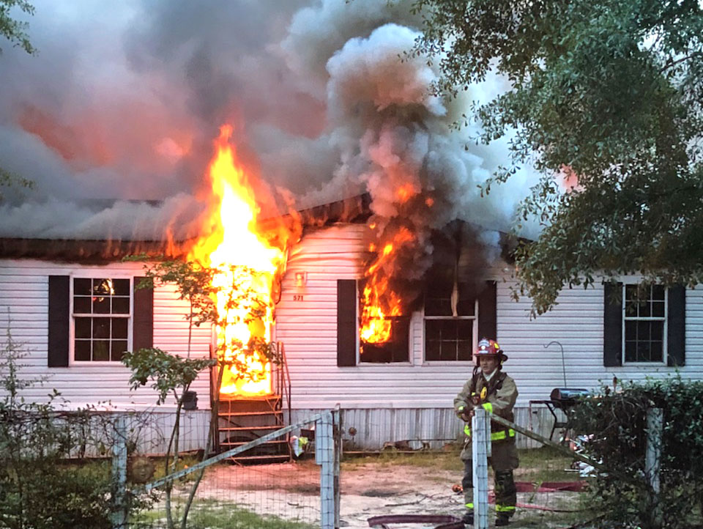
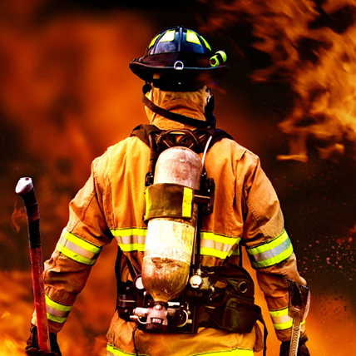
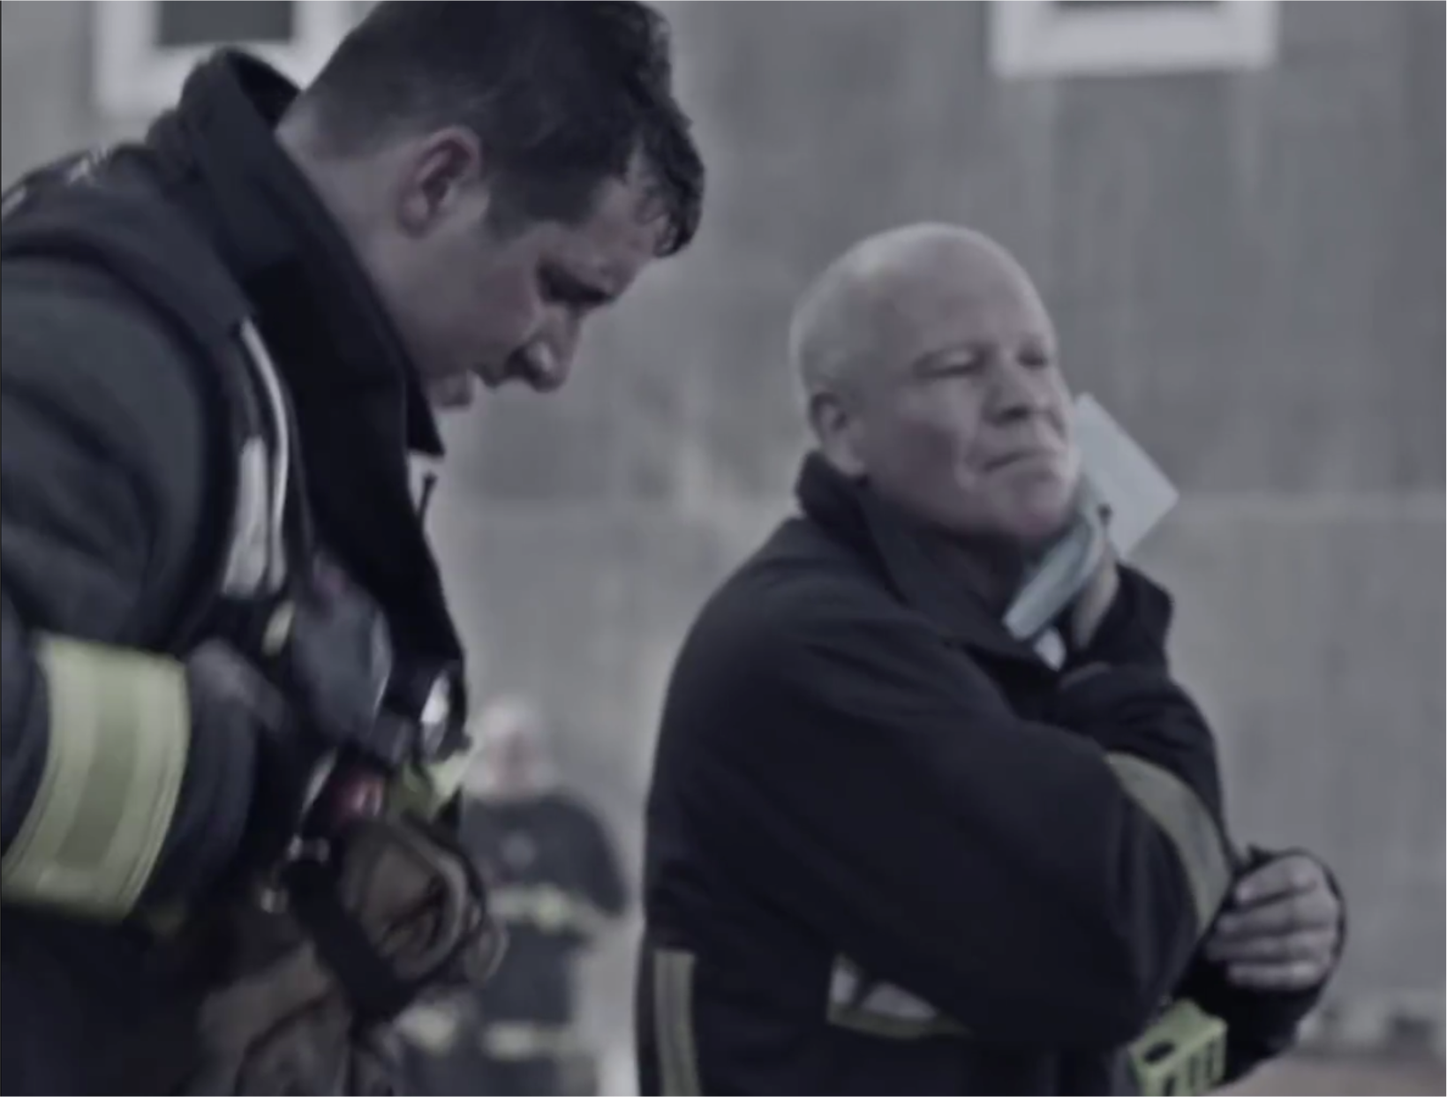
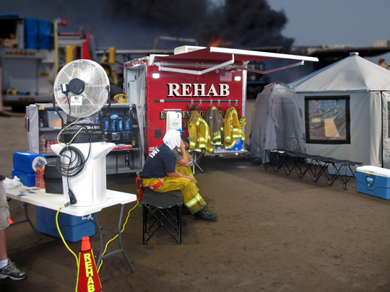
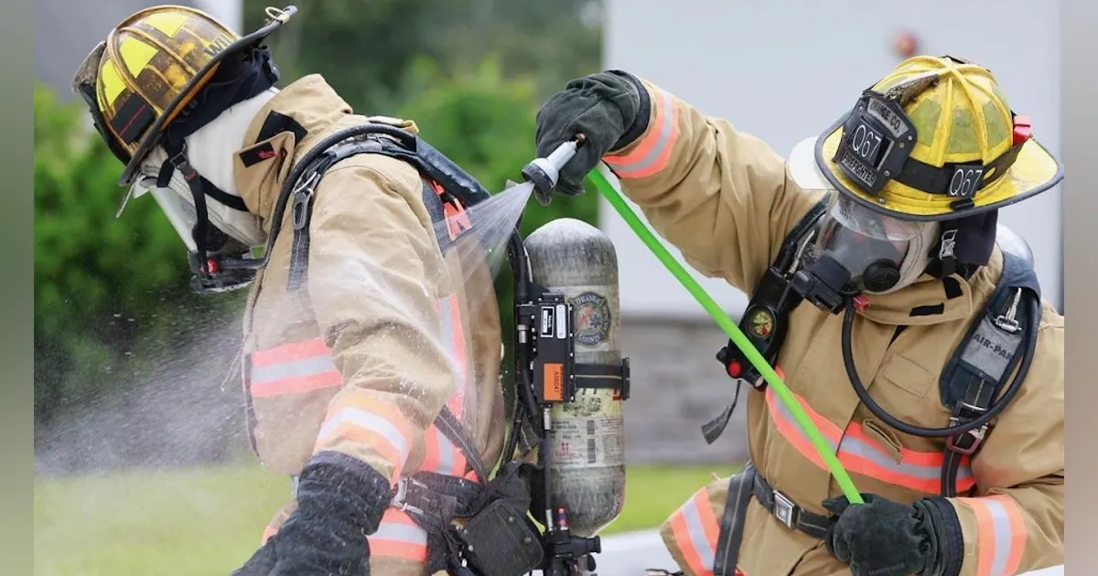
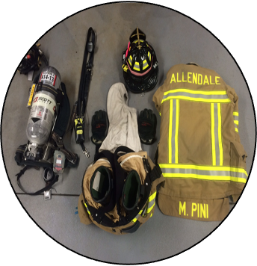
Fire Zone Infographic
Hot Zone
Warm Zone
Cold Zone
IDLH
Rehab
Uphill & Upwind
Direction of Travel
Use of
wet
wipes
Preliminary Exposure Reduction
Tool drop, SCBA and PPE Doffing
Notes:
Hot Zone:
Any area with high risk or within the immediate perimeter of any fire or where the products of combustion (which include smoke and soot) are present.
Warm Zone:
The area between the hot and cold zone. The area not in the immediate vicinity of any fire or products of combustion. Preliminary Exposure Reduction occurs in the warm zone. Also serves as the drop zone for doffing/dropping of equipment prior to entering rehab or bagging up contaminated PPE’s and equipment.
Cold Zone:
Any area outside of the hot and warm zone, ideally uphill and upwind. Rehabilitation (Rehab) shall be located in the cold zone.

Slide 15
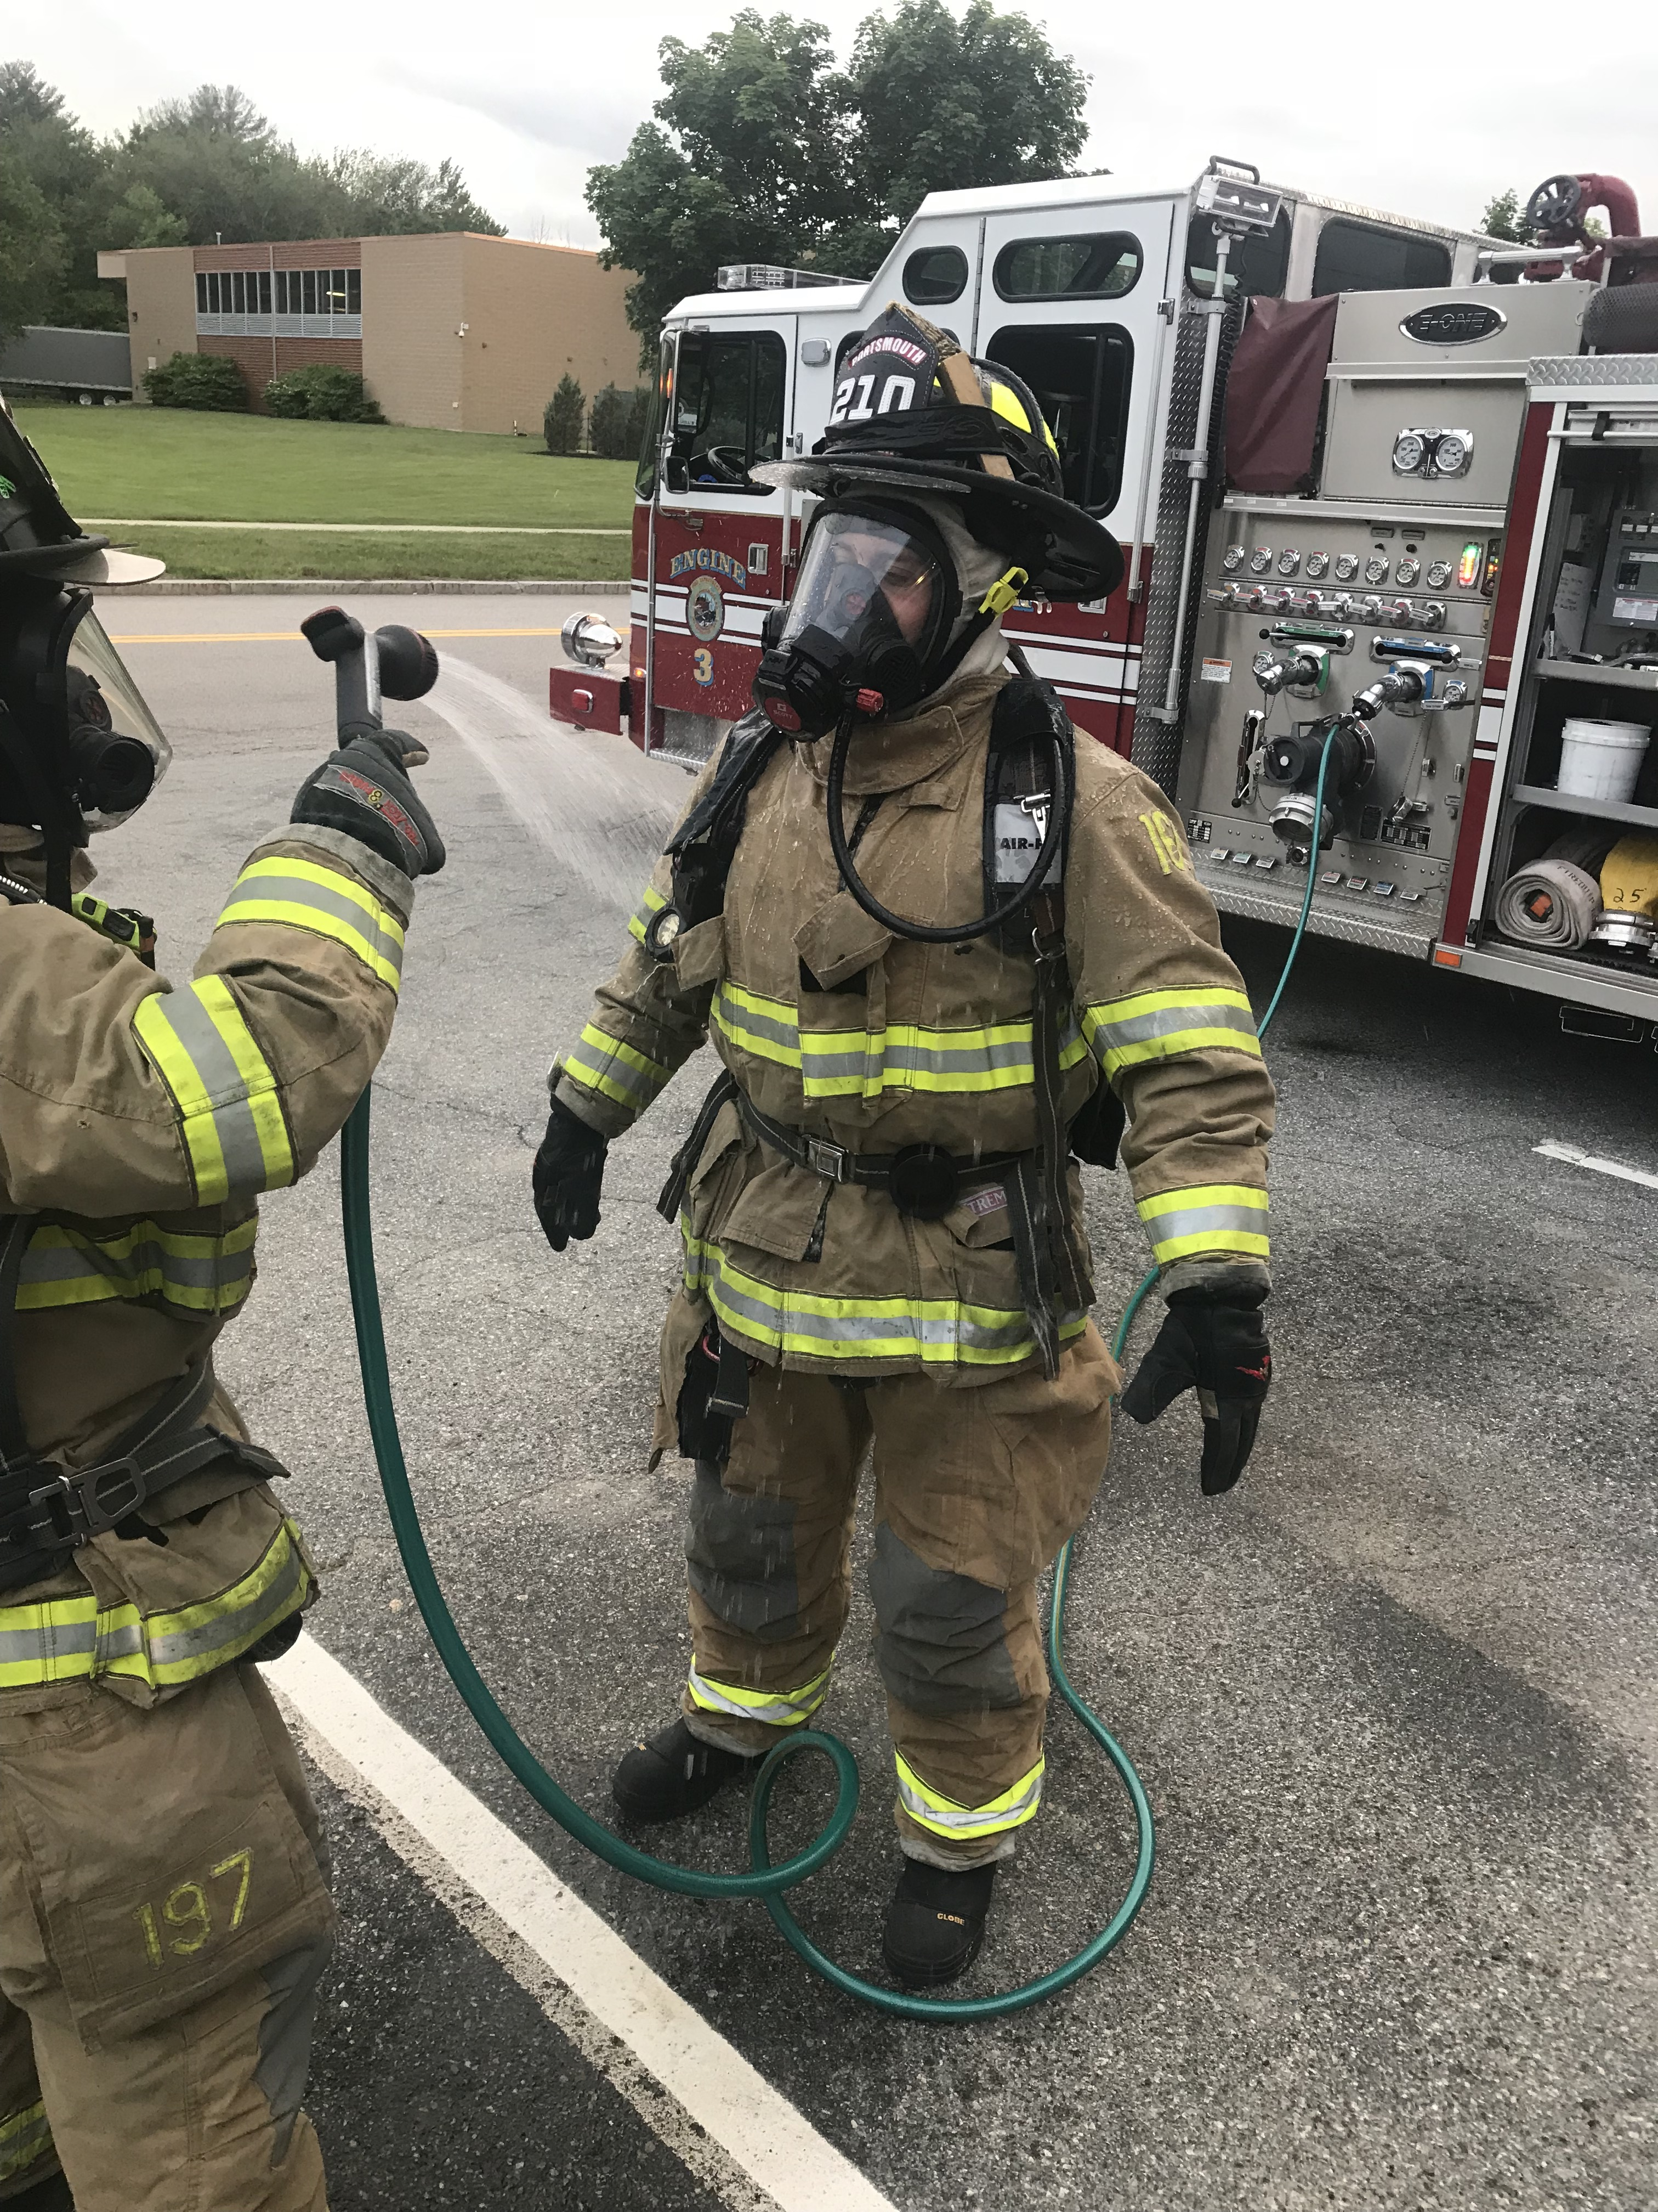
Preliminary Exposure Reduction
While exposure to toxins is inevitable in firefighting, we should strive to reduce or eliminate exposure when possible.
Prior to removing firefighting ensembles worn in the hot zone, a preliminary exposure reduction shall be performed to remove potentially harmful contaminants (NFPA 1851, 1500).
As a best practice, it is recommended to implement a Preliminary Exposure Reduction procedure in the warm zone to remove products of combustion such sas soot and particulates.
All firefighters exposed to products of combustion including Fire Cause Investigators need to go through PER.
Preliminary exposure reduction reduces surface PAH’s by 85%
Notes:
Firefighting PPE offers protection from the intense heat encountered while on fires but allow some cancer-causing particles such as soot to penetrate the gear and end up on firefighters' skin.
There, it can be absorbed into the body if action is not taken to mitigate the risk.
Performing a preliminary exposure reduction reduces PAH’s by 85%
Source: https://www.tandfonline.com/doi/full/10.1080/15459624.2017.1334904
Preliminary Exposure Reduction (Gross Field Decon)is an important measure.
Remove the large particulates from the PPE so they are not tracked around into the apparatus and firehouse.
Should be accomplished via wet decon
Dry decon while on air may be called for if the temperature is below 32 degrees F. Note that preliminary research results show that dry decon brush-off is only about 25 percent effective. Using soap, water, and a brush is about 85 percent effective. Use cleansing wipes afterward.
Dry decon should include brushing off particulates while actively wearing SCBA (on air).
Keep the interior of the PPE dry during wet-soap decon.
Recent studies measuring using PAH as a measurement found that wet-soap decon is most effective. In fact, it was able to remove 85% of the surfacecontaminates where dry brush removed only 23%
The FAST UV test demonstrated that there are contaminants reaching several areas of the firefighter’s skin.
Removing these contaminants as soon as possible will limit exposure.

Slide 16
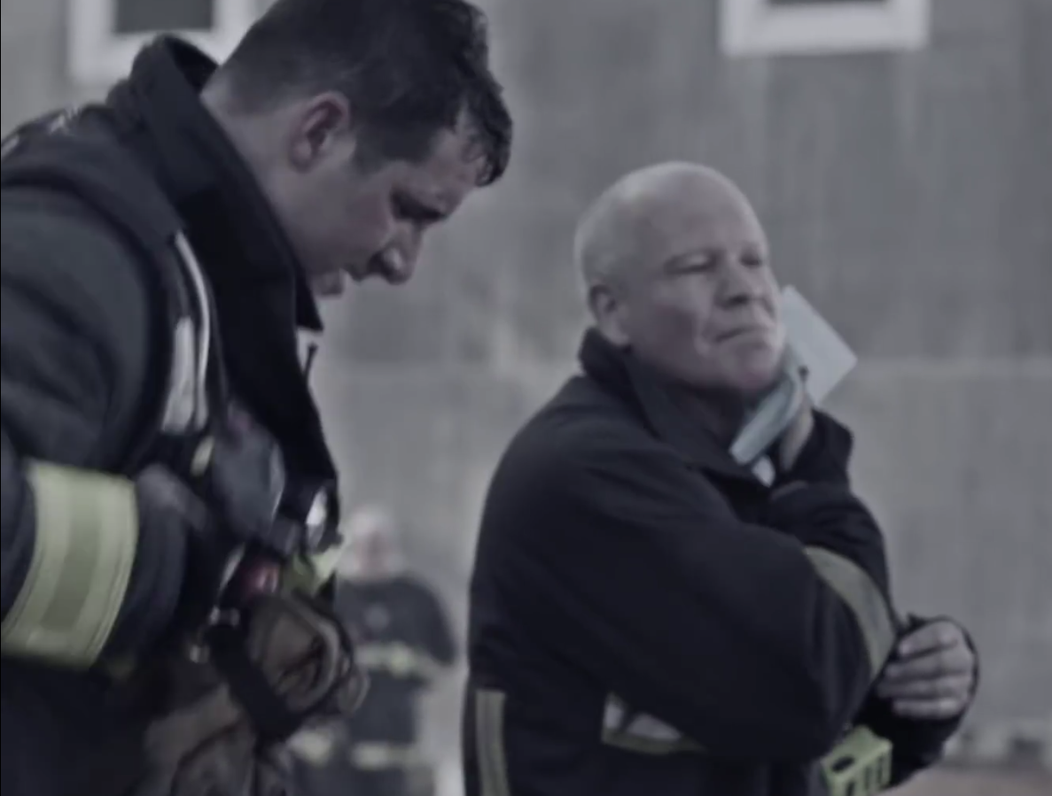
Fireground Cancer Prevention
Once Preliminary Exposure Reduction has taken place, personnel should also use wet wipes to decontaminate exposed areas of skin.
Briskly wipe skin with wet wipes in the most vulnerable exposure routes:
            Face
Jawline
Throat
Underarms
Forearms
Armpit
Groin
Using wet wipes can reduce PAH’s by 54%.
Using wet wipes is not a substitution of a shower.
Notes:
Studies show that skin absorption is a risk factor for firefighter cancer.
Oil-based chemicals produce many of the dangerous carcinogens that can be absorbed through the skin.
Shower within the hour is a recommendation to reduce exposures from firefighting.
Removing these contaminants as soon as possible will limit exposure.
Recent studies demonstrate that firefighters who used cleansing wipes to clean their necks after a fire reduced PAH levels by 54%.
Source Links:
https://pubmed.ncbi.nlm.nih.gov/28636458/
https://firefightercancersupport.org/wp-content/uploads/2020/12/Training-Brief-11-Actions.pdf

Slide 17
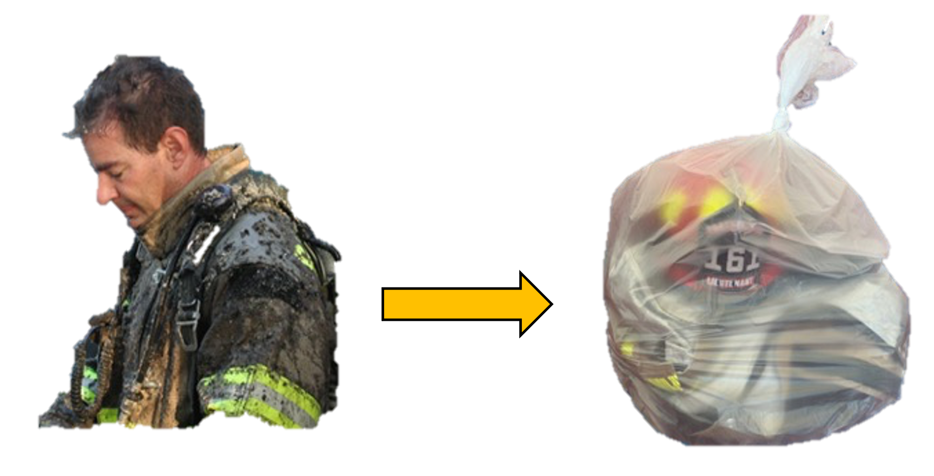
Bag and Transport of PPE
When released from the incident, fire fighters should bag their contaminated turnouts in large, encapsulating 6 mil leak-proof bags for transport back to the station.
Contaminated PPE, even when bagged, should not be transported in the passenger areas of apparatus or personal vehicles. This includes Investigators.
This will reduce cross contamination from off-gassing PPE and equipment.
Notes:
Once suppression efforts are done, PER has been accomplished it is recommended to bag up all contaminated PPE and equipment.
Keeping soiled gear out of the cab of the apparatus is an important step in removing contaminants that could potentially expose firefighters at a later time.
A simple way to do this is to bag all soiled PPE following exposure and transport it back to the fire house compartment or in the hose bed not in the cab of the apparatus.
Always remember to decontaminate and clean the PPE before placing it back into service. Use NFPA 1851 as your guideline for the proper cleaning of PPE.
Use a department extractor or an independent service provider to properly clean your PPE. Follow your SOP/SOG your department uses.

Slide 18
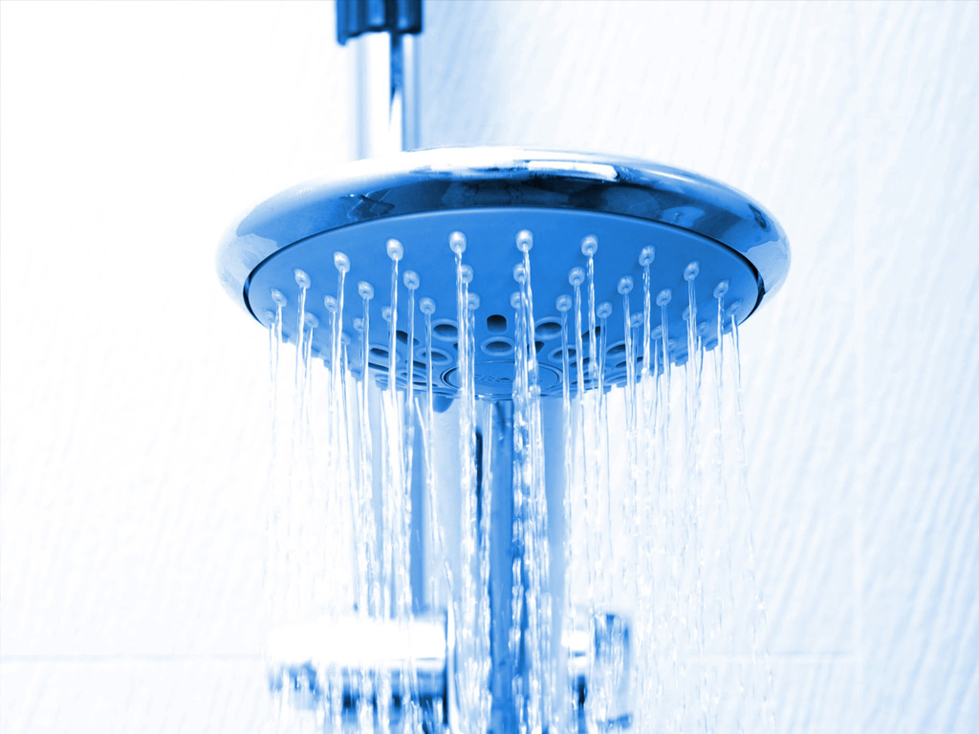
Shower within the hour
Clean your body first, then tools and equipment after.
This can be difficult for busier department.
If possible, units should be kept assigned to the incident so cleaning of personnel and equipment can take place.
Ensure the apparatus is decontaminated along with all equipment used.
Notes:
Shower within the hour can be a challenge sometimes for busier departments. These companies go from a job to a couple of medical calls or stills/alarms before returning to quarters. This may take an hour and a half or two hours.
Policy and procedure changes are needed if this is the case. Holding mutual aid or allowing companies time to decontaminate properly is something that should be commonplace in the fire service.
Apparatus should be decontaminated as soon as possible along with all exposed equipment.

Slide 19
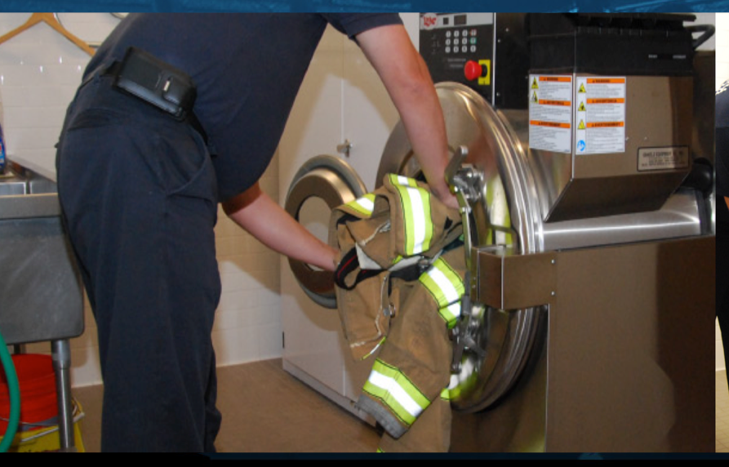
Ensure that your PPE is cleaned per NFPA 1851 recommendations 2020 version Standard on Selection, Care, and Maintenance of Protective Ensembles for Structural Firefighting and Proximity Firefighting
Notes:
Always remember to decontaminate and clean the PPE before placing it back into service. Use NFPA 1851 as your guideline for the proper cleaning of PPE.
Use a department extractor or an independent service provider top properly clean your PPE. Follow your SOP/SOG your department uses.
Once the firefighters are clean, it would be inappropriate to put on dirty gear for the next run and contaminate the body again.
When you’re wearing your SCBA to protect your lungs from something, your gear’s being exposed, too. It needs to be cleaned.
NFPA 1851 sets the standard for firefighter ensembles, including their selection, care, and maintenance.
Policies and training for advanced cleaning are required. Organizations must provide a means for having the firefighters’ ensembles cleaned and decontaminated.
Soiled and contaminated elements should be isolated. They should not be brought into the home, washed in home laundry or in public laundry unless the public laundry has a dedicated service for contaminated and soiled fire gear.
Washing can be accomplished in many ways. Policy should guide the firefighter about the method the department has elected. Many times, firehouses have washers to launder the contaminated PPE.
Follow manufacturer guidelines for washing instructions.
FCSN suggests using gloves and eye protection when handling contaminated gear.
NFPA 1851 2020 edition recommends washing PPE at least two times per year, one of which with ADVANCED CLEANING at 140 degrees F (increased temp from the previous 105 degrees F) AND INSPECTION. The second cleaning if done in-house MAY be at either the 105 or 140 temperature, but 140 is the preferred temp.

Slide 20
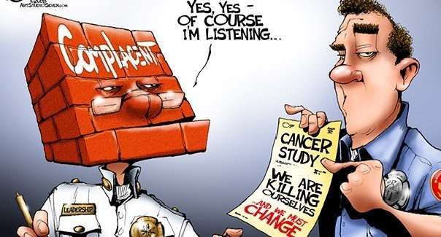
12 Key Immediate Actions to Protect Yourself
Use SCBA from initial attack through Overhaul (Gold Standard)
(Not wearing SCBA in both active and post-fire environments is the most dangerous voluntary activity in the fire service today.)
While onscene, perform a preliminary exposure reduction on PPE to remove as much soot and particulates as possible when exiting the Hot Zone. All PPE should be bagged up and sealed at the scene once fire suppression is complete.
Use Wet-Nap or baby wipes to remove as much soot as possible from head, neck, jaw, throat, underarms and hands immediately and while still on the scene.
Change your clothes and wash them immediately after a fire.
Shower thoroughly after a fire- preferably within the hour.
Notes:
The Firefighter Cancer Support Network put together 12 immediate actions one can take to protect themselves.
We can’t eradicate cancer in the fire service, but we certainly can reduce firefighters’ exposure to carcinogens

Slide 21
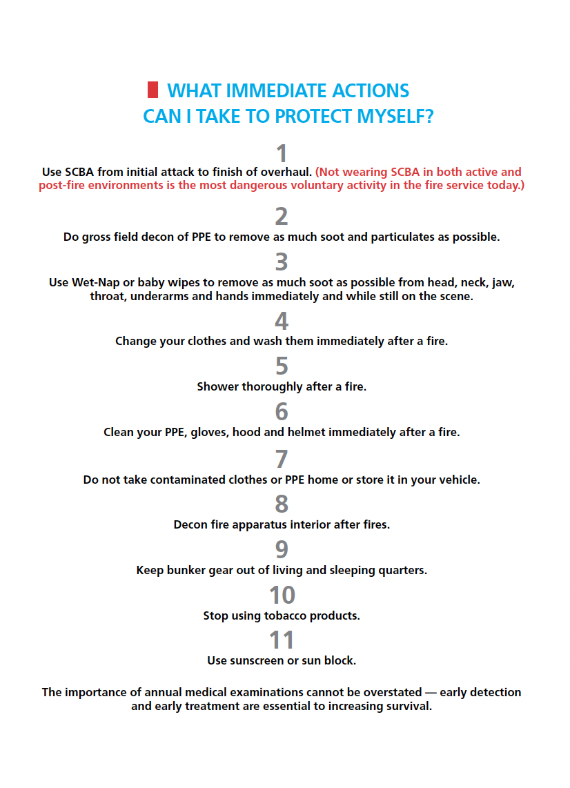
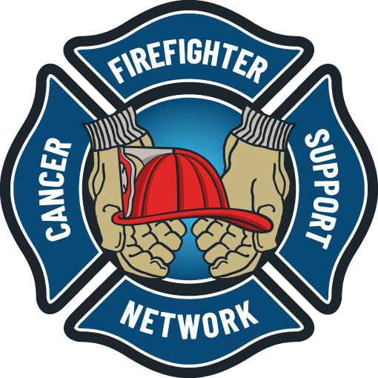
Fireground Cancer Prevention
12 Key Immediate Actions to Protect Yourself
Clean your PPE, gloves, hood and helmet immediately after a fire. (Follow NFPA 1851 Guidelines).
Do not transport contaminated clothes or PPE home or store it in your vehicle or inside the cab of apparatus.
Decontaminate apparatus interiors after fires.
Keep all PPE out of all living areas and sleeping quarters of the fire station.
Don’t use tobacco products.
Use sunscreen or sunblock.
Schedule annual medical exams. Take FCSN form to your physician. (Early detection and early treatment are essential to increasing survival).

Slide 22
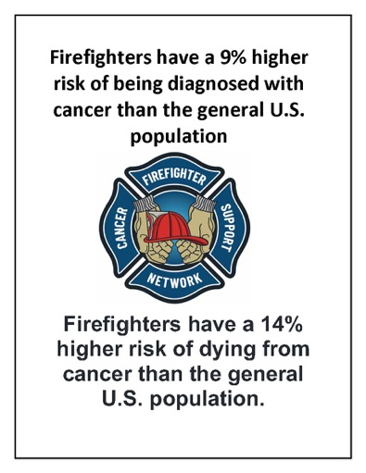
Summary
In this presentation we discussed fire ground cancer prevention, including preliminary exposure reduction practices, use of wet wipes, occupational exposures, and steps to take to reduce and mitigate your exposures.
Make the necessary changes to protect yourself

Slide 23
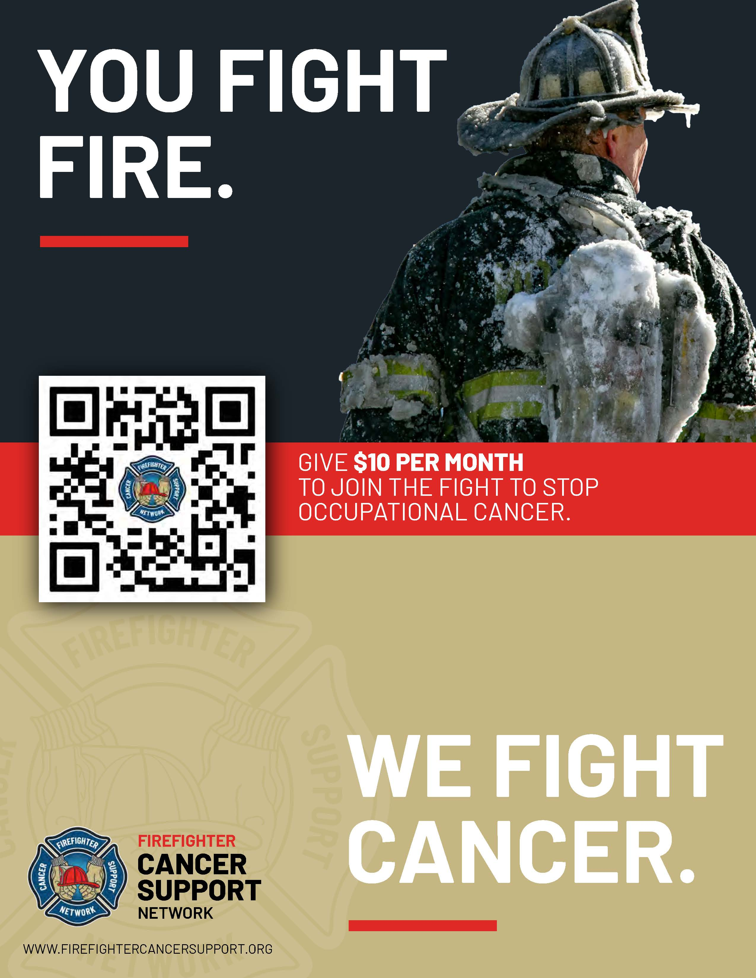
We hope you found this presentation to be valuable for you and your brother and sister firefighters and EMS providers.
If you did, please consider making a small donation to help FCSN continue to spread the word nationwide about the dangers firefighters face and the precautions they can take to reduce their chances of getting cancer
THANK YOU!

