Slide 1

Fire Station Best Practices
Call To Action
Cancer Prevention Best Practices at the Fire Station
You fight fire. We fight cancer!
FFCAM 2024
Notes:
Drag & Drop to add a picture in the back placeholder

Slide 2
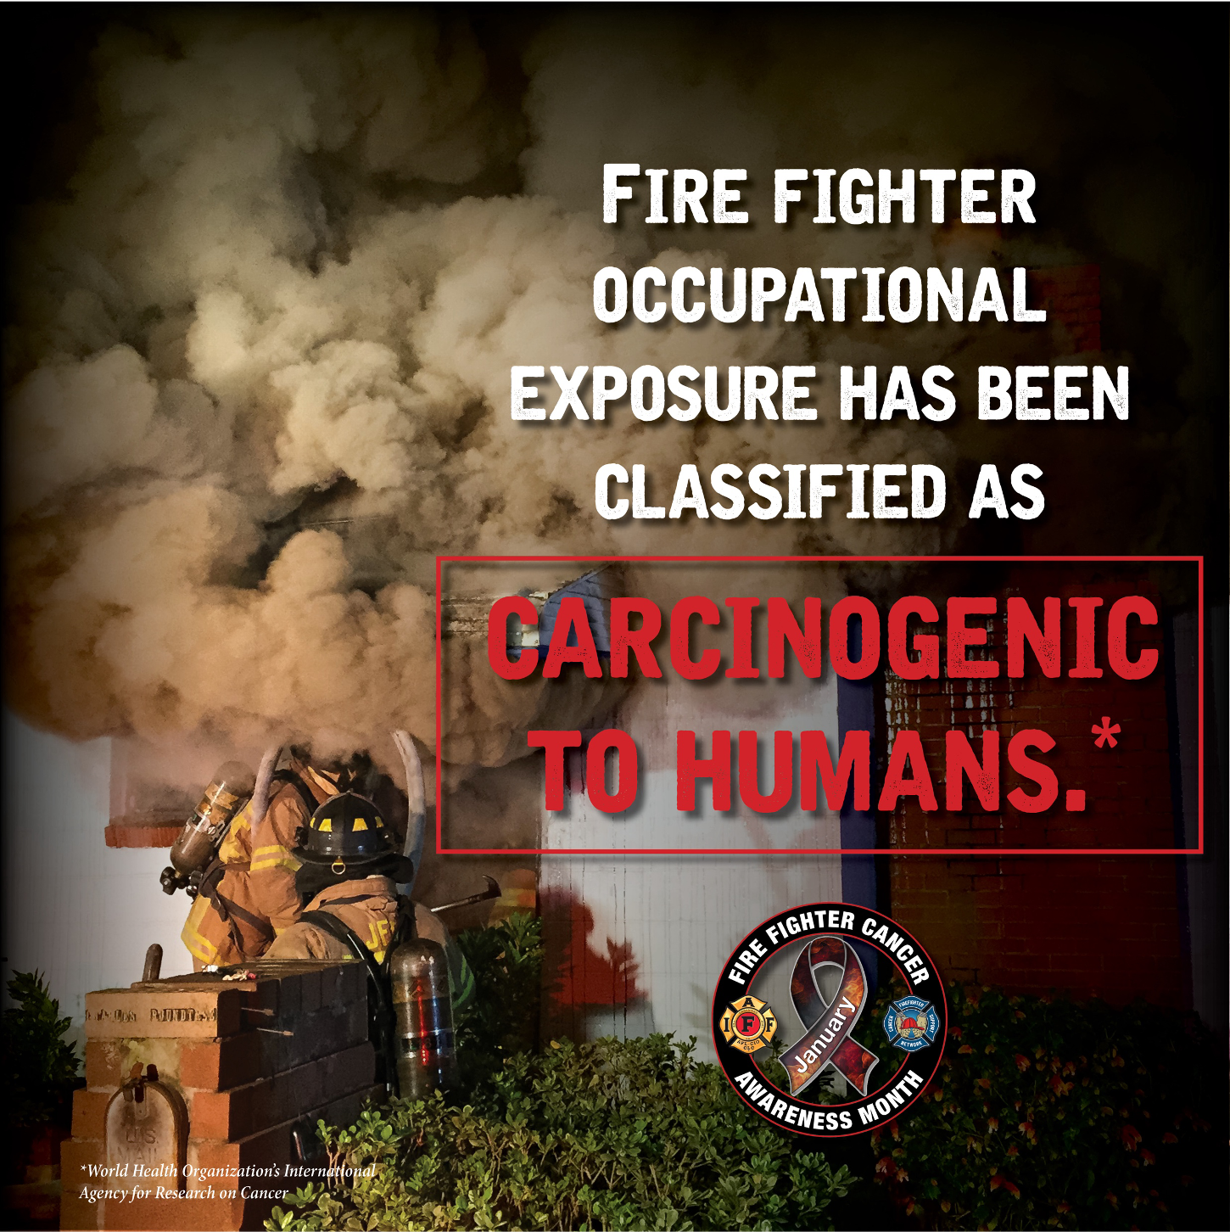
Fire Station Best Practices
Objectives
Discuss Fire station design
Review Direct capture diesel exhaust systems
Living quarters best practices
Apparatus bay best practices
Notes:
Firefighter Occupational Exposure Has Been Classified as Carcinogenic to humans

Slide 3
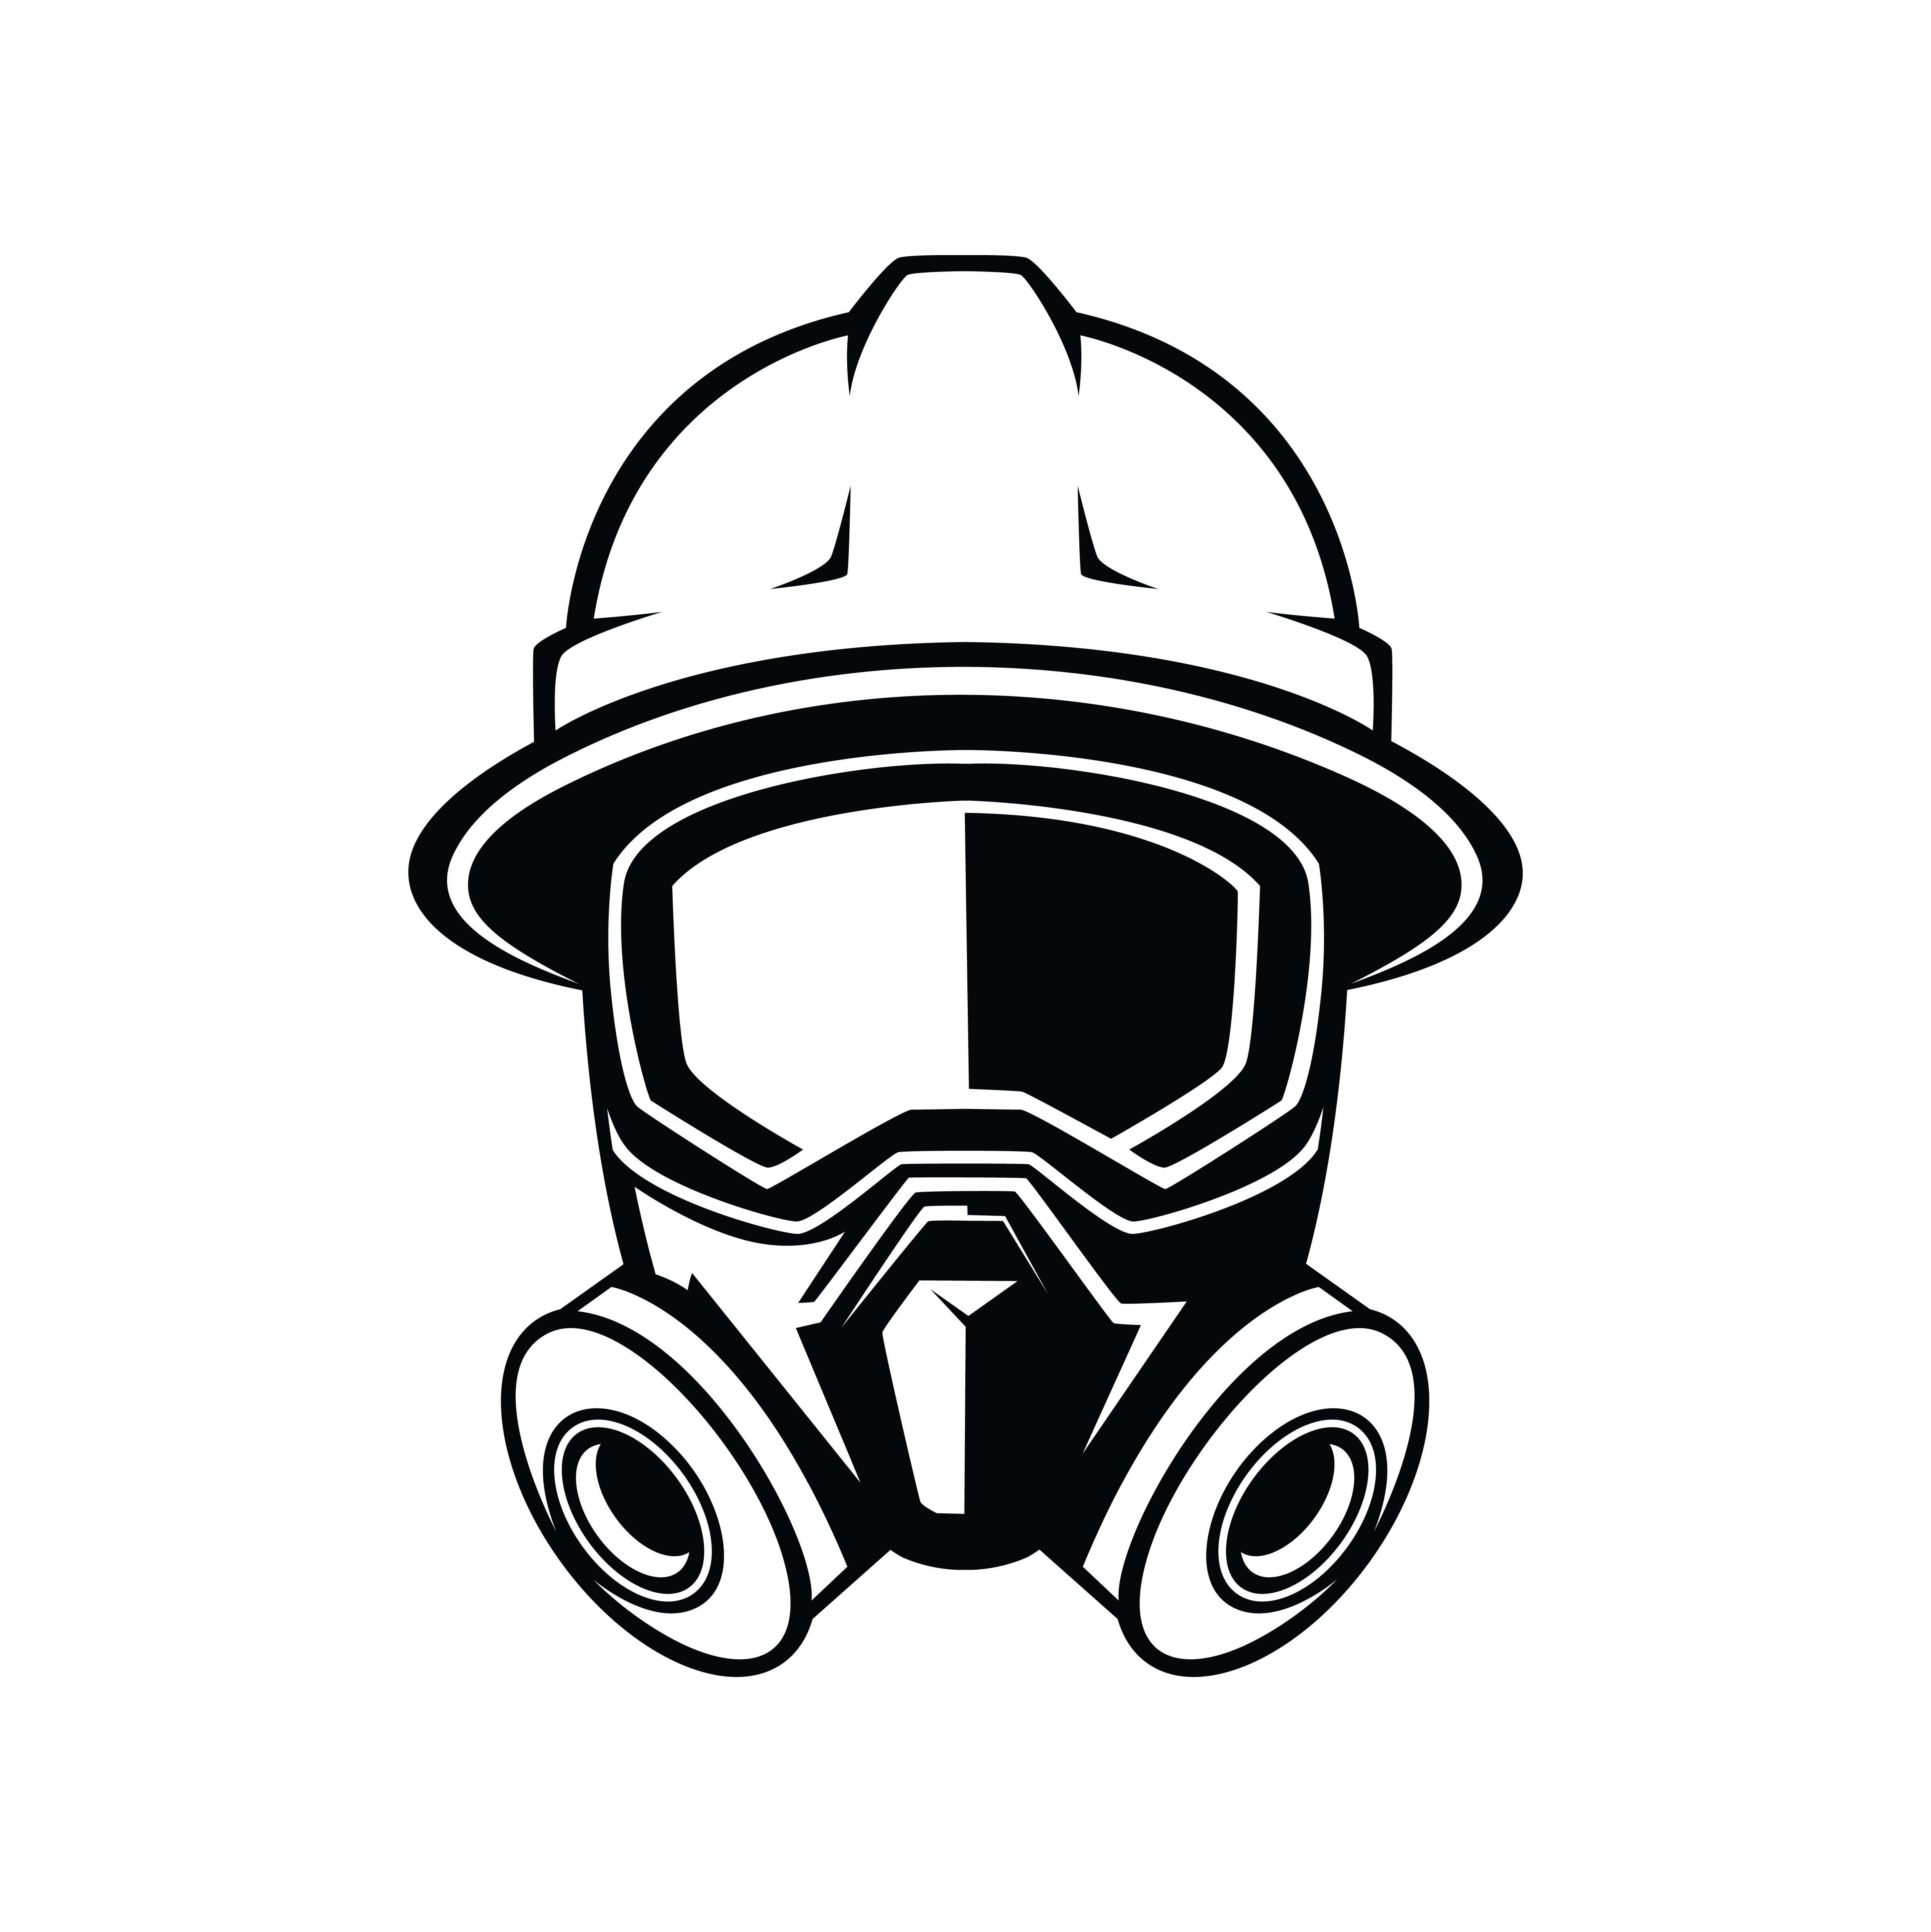
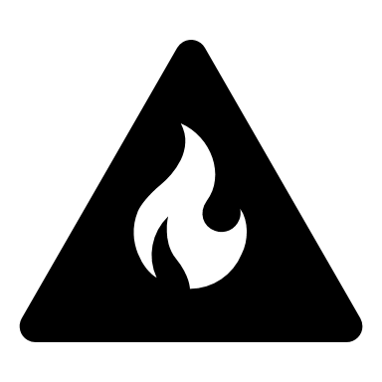
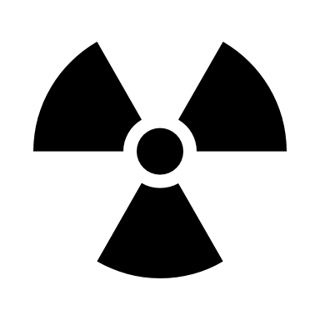
Fire Station Best Practices
01
02
03
All fire incidents produce toxic smoke that can have negative short and long-term health effects on firefighters.
Exposures can continue after leaving the fireground through inhalation, ingestion, absorption of toxicants.
These Contaminants can be inadvertently transported back to the fire station and to homes and family when failing to clean or decontaminate tools, equipment, and personnel after each fire incident.

Slide 4
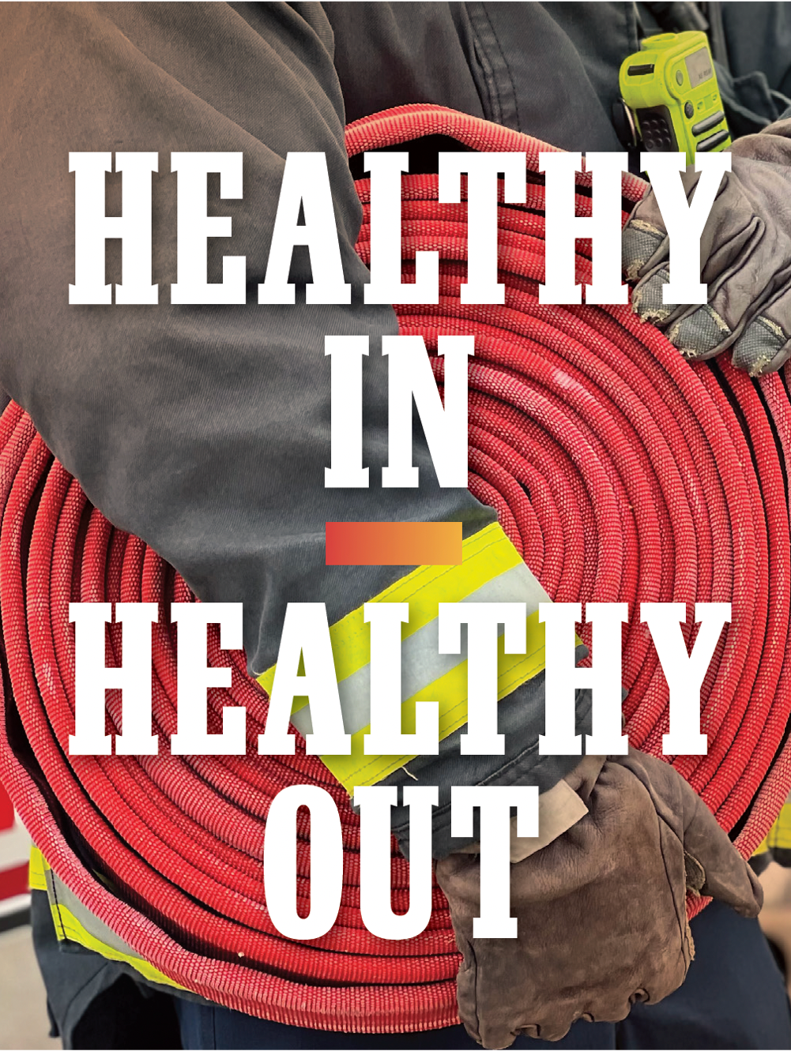
Fire Station Best Practices
Fire Station Design
Fire station design can be used to reduce exposures, preventing cross contamination of carcinogens, contaminants, and other harmful agents.
Fire station design should be centered around Total Worker Health and include ways to mitigate behavioral health and sleep outcomes..
The overall design of fire stations should be done with the reduction of exposures and cross contamination of firefighters
Notes:
Fire station design needs to be thought of with reducing exposures to carcinogens and other toxicants.
This includes retro fitting older fire stations as well.
Some components of successful design include individual climate control in dorms, alerting systems specific to each room in the fire station, and providing natural light sources while also reducing bright light exposure at night. Existing stations can be retrofitted to best accomplish these best practices where possible.
Solid surfaces throughout the station for ease of decontamination and cleaning.
Source: Healthy in Healthy out 2023
Source: USFA Safety and Health Considerations for the Design of Fire and Emergency Medical Services Stations

Slide 5
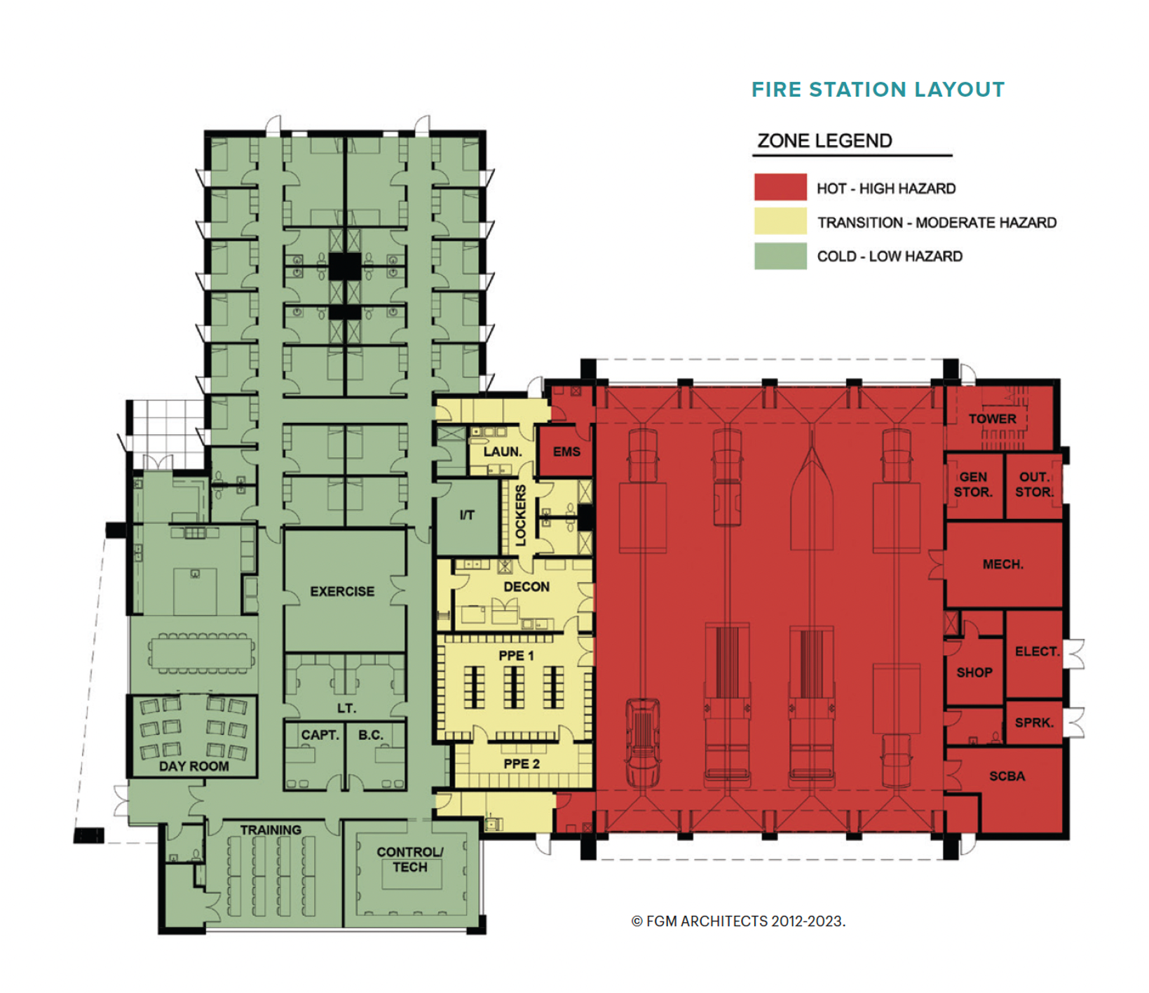
Fire Station Best Practices
Fire Station Design
HOT ZONE: Area with highest risk of exposure. This is generally the apparatus bay and adjacent areas that support the storage of vehicles. They should include boot-washing and hand-washing sinks.
TRANSITION: Designed for for cleaning contaminated equipment including SCBA, EMS equipment from medical calls, fire hose, turnouts, etc. Transition from hot and cold zones
COLD ZONE: The green zone is the living quarters
of the fire station including the kitchen, living area, sleeping area, personal hygiene facilities and office. Contaminated EMS equipment, turnouts, etc., are never allowed.
Notes:
Fire station design has changed during the past 10 years. The focus is now on controlling the environment and stopping the toxins from finding their way into the living areas in the fire house.
Paul Ericson is a noted designer of the zoned fire station. Taking the hazmat model and applying it to the design of the fire house creates a system to contain the contaminants, separate the living areas from the contaminants, and control crossover by focusing on the highest hazards to firefighters.
Think of this as a hot, warm, cold zoning similar to hazmat operations.
Red zone are spaces exposed to carcinogens (apparatus bay, decon area)
Green zones are for living and working intended for extended occupancy.
Yellow zones allow for movement between the hot and cold zones.
Erickson, Paul. (2016) Miami Hot Zone Design: Containing the Contaminates. Retrieved from: January 26, 2016, conference presentation.
Healthy In, Healthy Out” 2023.

Slide 6
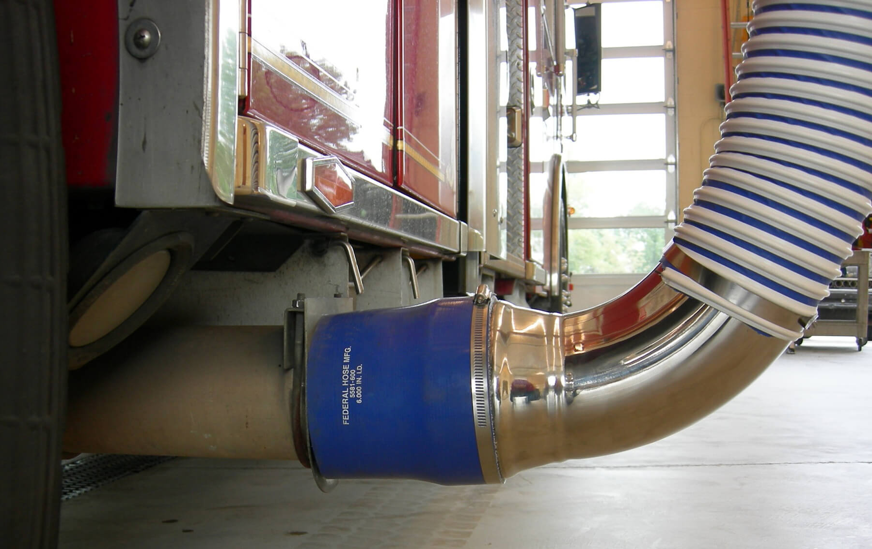
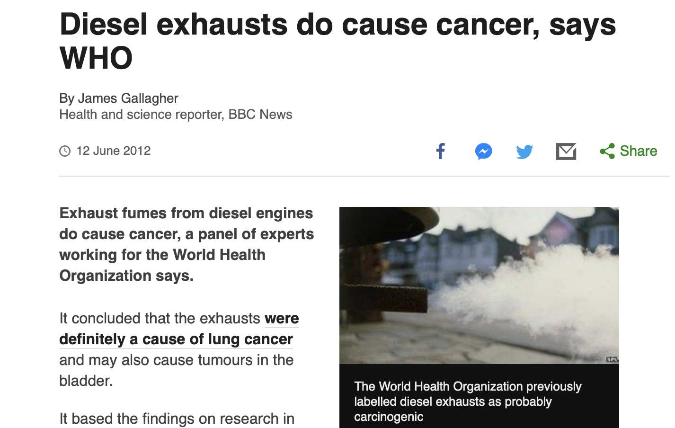
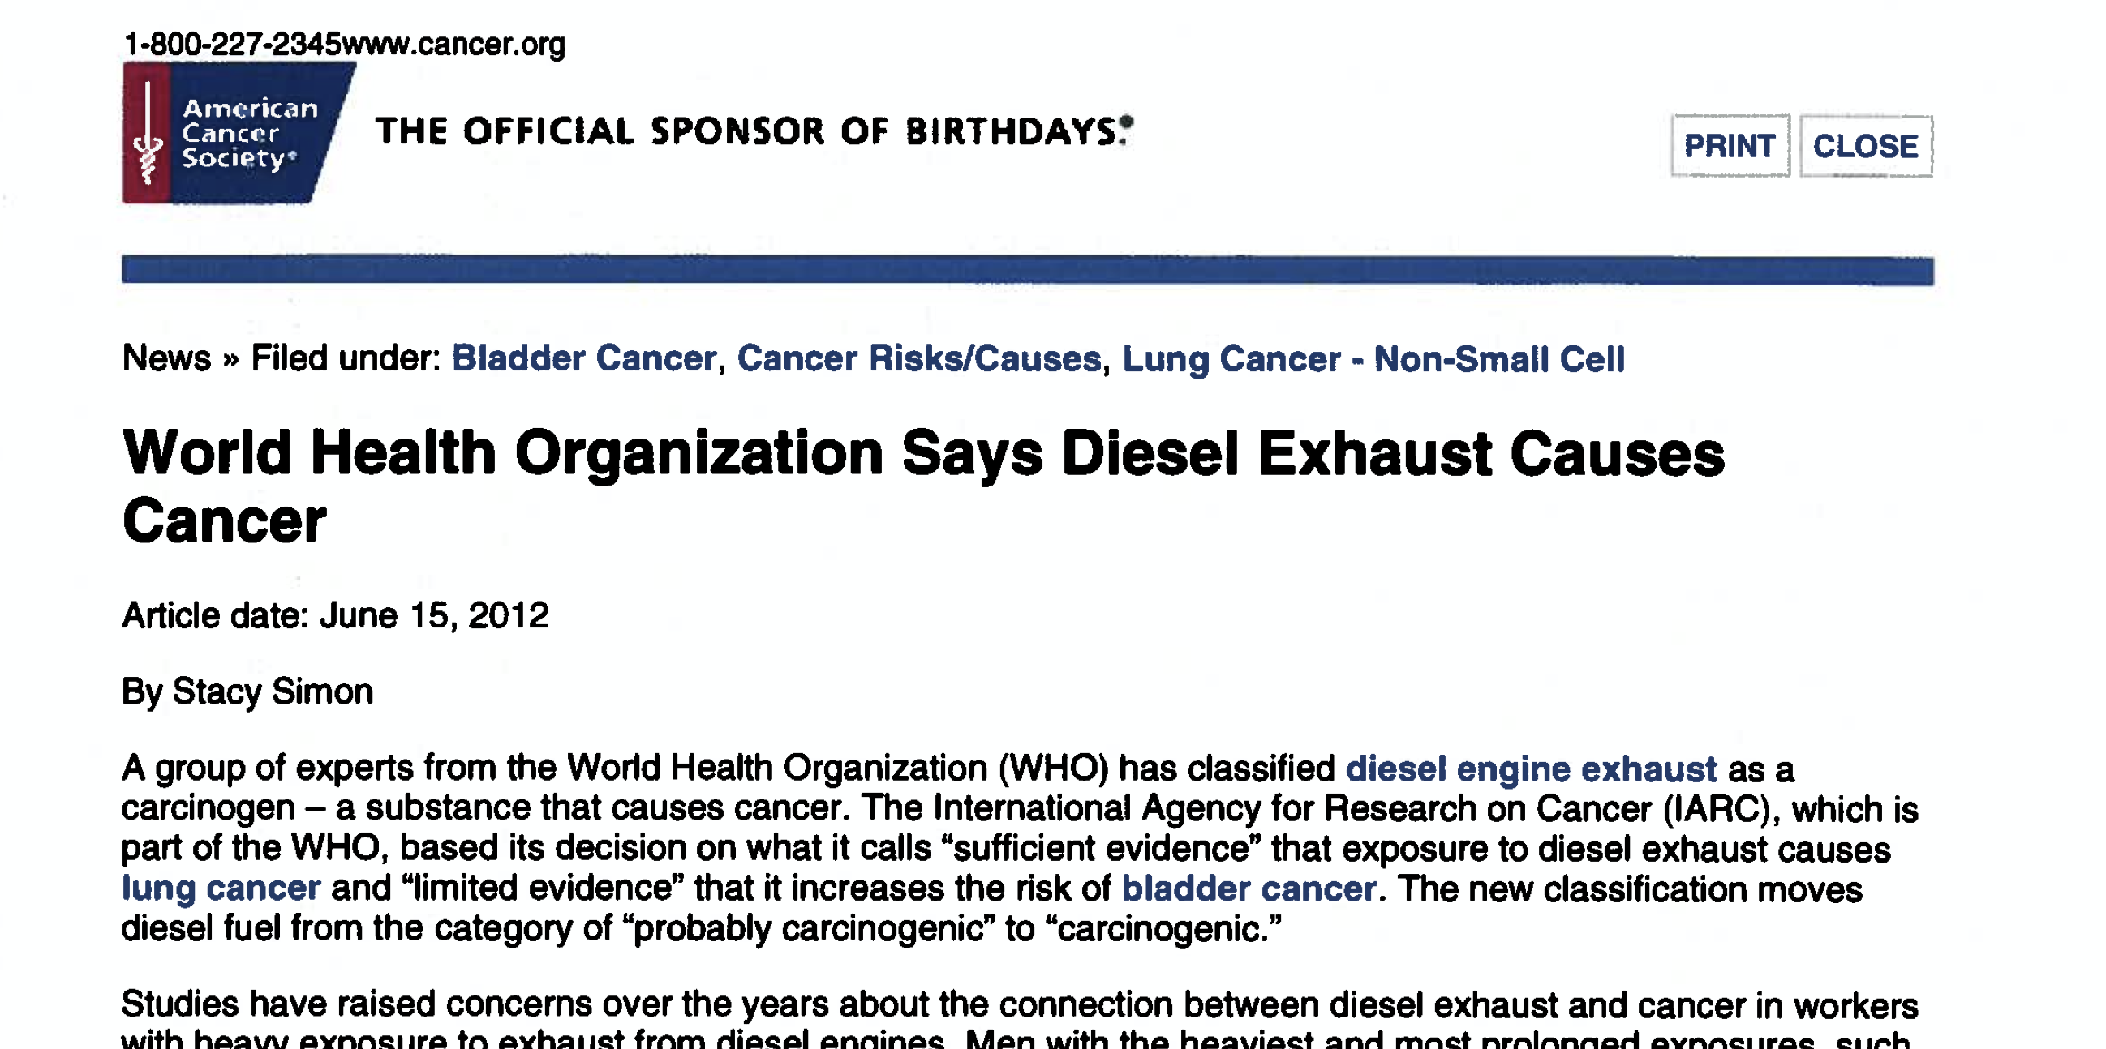
Fire Station Best Practices
Diesel Exhaust Capture Systems
All new station design should include direct-source capture diesel exhaust handling systems for all vehicles and for every apparatus bay.
These can be retrofitted into existing stations.
Maintain these systems.
Do not run engines at idle or do apparatus checkouts with the engine running inside the fire station.
Exhaust source capture is the most reliable means to reduce or eliminate exposure of fire station occupants to diesel exhaust emissions.
The International Agency for Research on Cancer (IARC), which is part of the World Health Organization (WHO), classified diesel engine exhaust as carcinogenic to humans (Group 1).
Notes:
Diesel exhaust has been classified as a known carcinogen and is linked to many cancers.
Open all apparatus doors when returning to the station, leave them open for ten minutes.
Do not use air blowers or leaf blowers to clean apparatus floors. This stirs up diesel particulates.
Use a dry mop and wet mop on the floors.
https://www.cancer.org/cancer/cancer-causes/diesel-exhaust-and-cancer.html
https://www.iarc.who.int/wp-content/uploads/2018/07/pr213_E.pdf

Slide 7
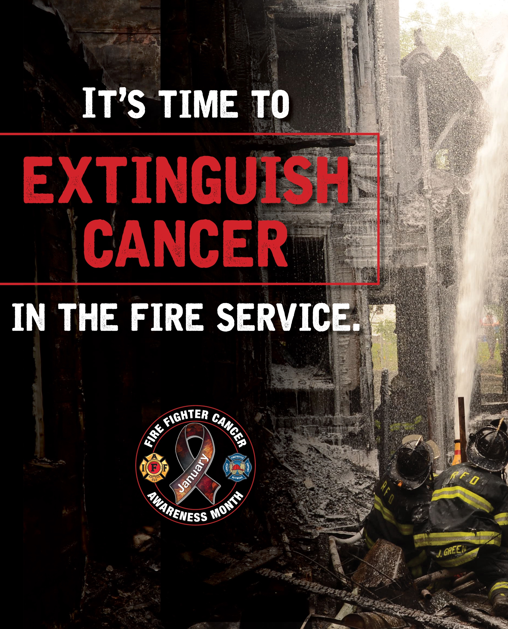
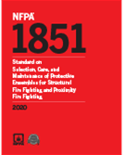
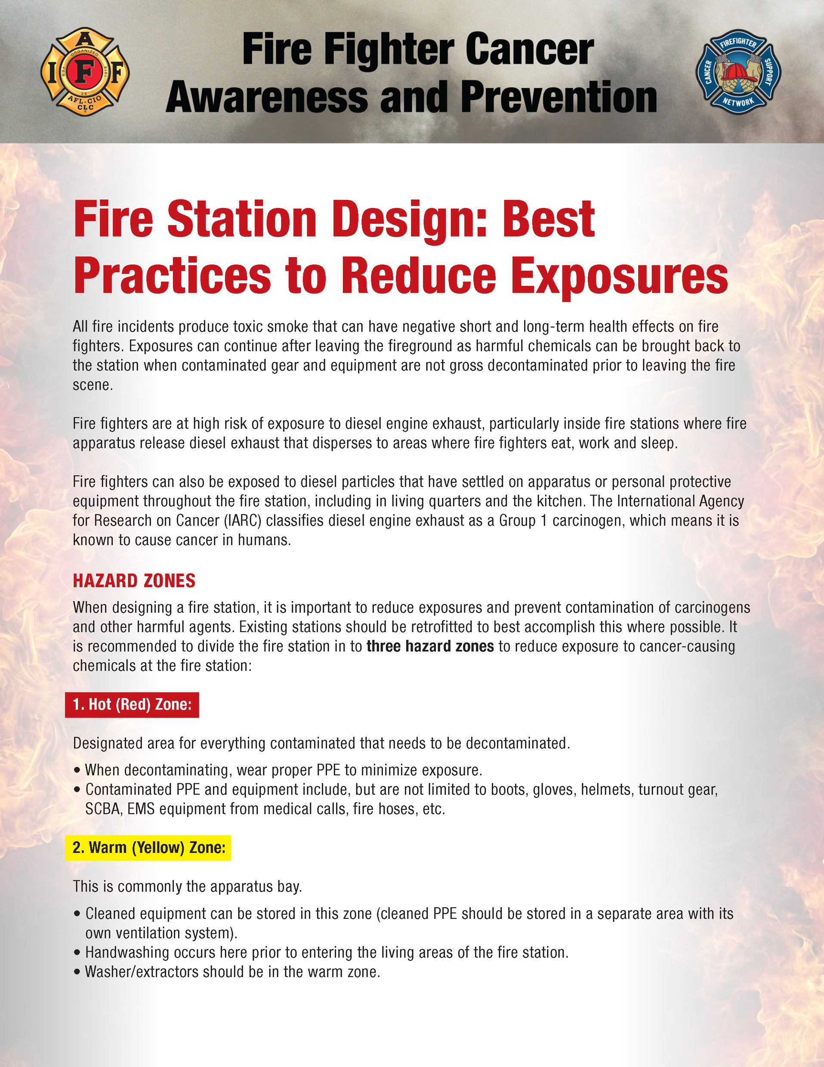
Fire Station Best Practices
To avoid exposures to UV light, turnout gear should be stored in an enclosed ventilated room
(NFPA Standard 1851).
The HVAC system in living and working areas should be positive pressure and systems in the apparatus bay and decon areas should be negative pressure to prevent airborne contaminants from entering the Cold or Safe Zone (GREEN).
Air vestibules are now common in the Transition Zone (YELLOW) of new fire station designs to help reduce cross-contamination between Hot Zone (RED) and Cold or Safe Zone (GREEN).
Notes:
Carpet in fire stations acts like a sponge, collecting dirt, soot, feces, MRSA, staph, blood and other potentially infectious materials (OPIM) from response footwear worn by fire and EMS personnel. Removing carpet and installing hard-surface flooring, such as polished concrete, is one way to mitigate these exposures, as solid surfaces are easier to clean than carpet.
Similarly, furniture and fixtures in fire stations attract and collect dirt and biological toxins. A 2011 study by the University of Washington Field Research and Consultation Group found MRSA on chairs, phones, computers and kitchen counters in fire stations in western Washington. This study shows the importance of keeping frequently touched items clean and disinfected.

Slide 8
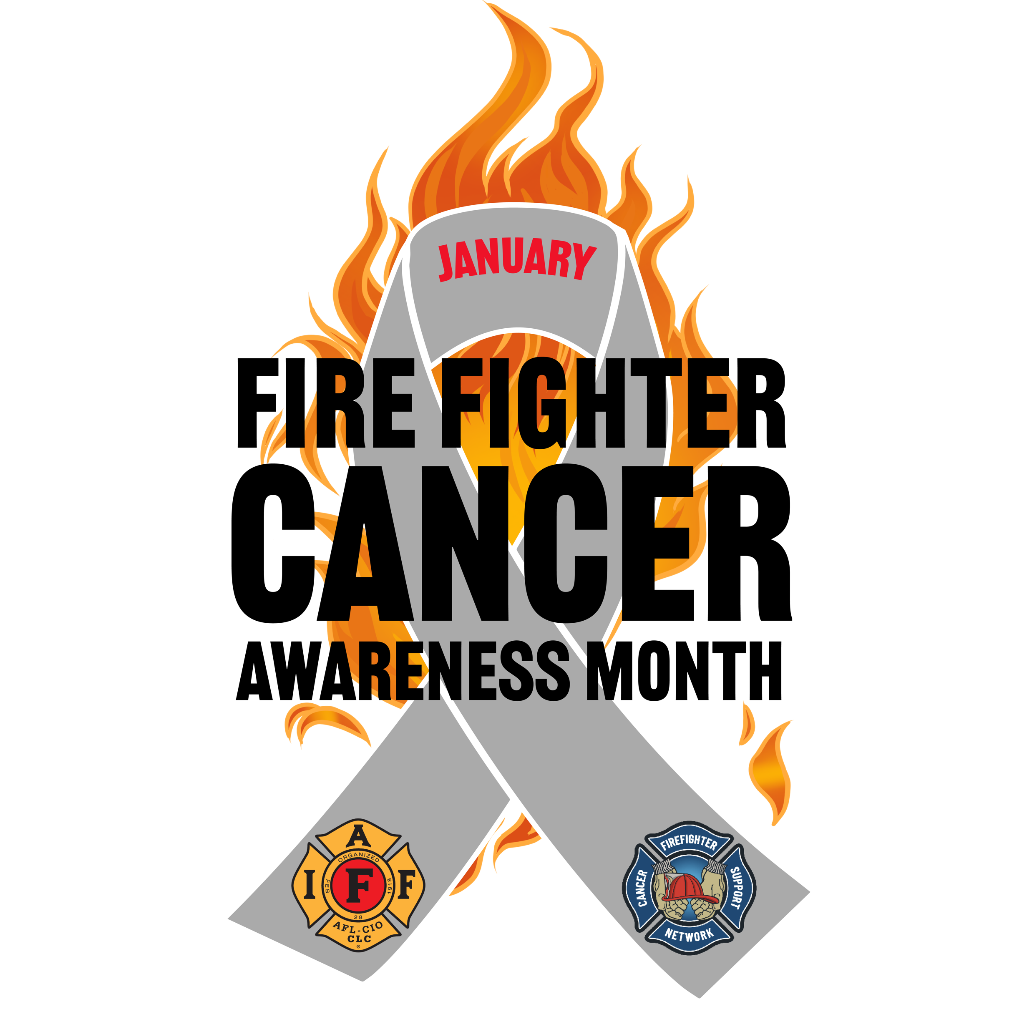
Fire Station Best Practices
Apparatus Bays
It is recommended that all fitness or exercise activities occur in the Cold or Safe Zone (GREEN) of fire stations.
Participating in those activities within apparatus bays poses a substantial risk of personal contamination, as there is the potential for contaminants and toxic chemicals to enter the body through ingestion absorption, and respiration.
The risk of cancer can be reduced by limiting time spent in the apparatus bay; this time should be for apparatus and equipment maintenance, practical training and emergency response.
Other training, meetings and general relaxation should take place in the separated living quarters.
The apparatus bays are recognized as the most hazardous and unsafe areas for such activities.
Notes:
Items that should never be located in the hot zone due to diesel exhaust and particulates
include but not limited to:
Ice machines or refrigerators.
Workout equipment.
Recliners/loungers/couches
Best practices for reducing exposure to carcinogens in the fire station, as outlined by the U.S. Fire Administration and the Leukemia & Lymphoma Society, include a clear separation of living quarters from the apparatus floor
https://www.usfa.fema.gov/downloads/pdf/publications/design_of_fire_ems_stations.pdf

Slide 9
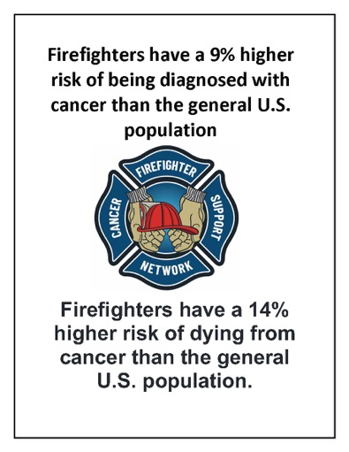
Fire Station Best Practices
Summary
In this presentation we discussed fire station best practices, design, and materials to reduce exposures. In addition we discussed diesel exhaust direct capture systems.
Make the necessary changes to protect yourself

Slide 10

We hope you found this presentation to be valuable for you and your brother and sister firefighters and EMS providers.
If you did, please consider making a small donation to help FCSN continue to spread the word nationwide about the dangers firefighters face and the precautions they can take to reduce their chances of getting cancer
THANK YOU!

