Slide 1
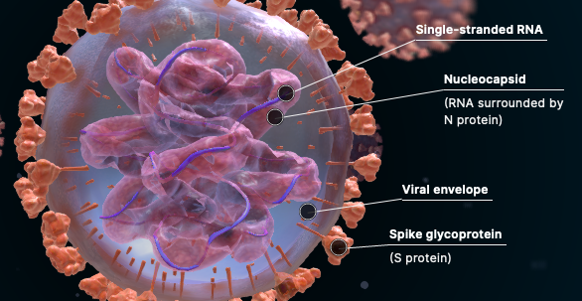
COVID 19 Vaccine Educational Brief Kevin E Mackey MD, FAEMS, Sacramento Regional Fire Shira A Schlesinger MD, MPH, FACEP, Newport Beach Fire

Slide 2
Essential Scientific Material is Included to Address Common Questions

Slide 3
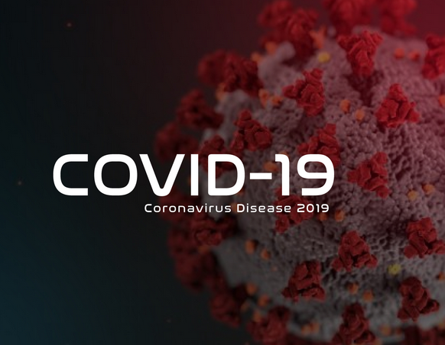
SARS-CoV2 Virus Explained
“SARS” = Severe Acute Respiratory Syndrome
CoV = Coronavirus
COVID 19= COronaVIrus Disease - 19 (first identified in 2019)
A “novel” virus, meaning there are no previous human diseases involving this virus
Belongs to the Coronavirus family, typically causing respiratory illness, similar to other coronavirus that are less lethal (common cold) and more lethal (SARS, MERS)

Slide 4
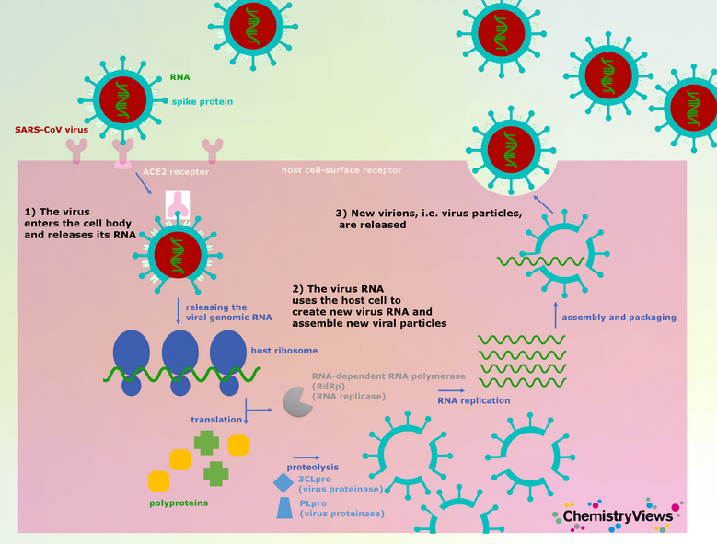
How Does COVID Infect Humans?
The COVID 19 virus binds to cells expressing ACE2 receptors (highest cell count is in the respiratory system)
Invades cells via “spike proteins” found on the virus surface
Spike protein binds to surface of human cells, then helps virus enter the cell
Once inside the cell, the virus hijacks the cell’s machinery to replicate itself. When it has made enough copies, they burst the cell and are released from the cell

Slide 5
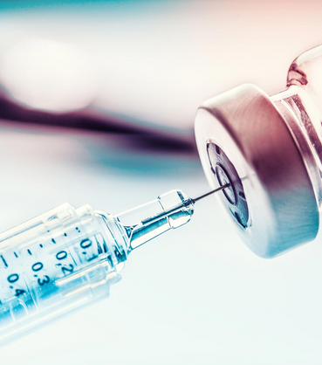
The COVID-19 Vaccine

Slide 6
Two Leading Developers

Slide 8
Why is an EUA necessary?
Normally, most vaccine development happens in non-humans (ie: animals, in vitro testing)
In emergency circumstances (a pandemic), the FDA will allow tightly controlled, limited testing in healthy human volunteers in three phases
Phase 1: Small scale safety testing in healthy human volunteers (generally 100 - 200)
Phase 2: Safety testing of varying doses on 1000-2000 volunteers reconfirming safety in the larger group
Phase 3: Testing in 10,000+ volunteers to seehow well the vaccine protects against the virus, with continued safety assessment.

Slide 9
Pfizer Phase 3 Stats

Slide 10
Pfizer Phase 3 Results
> 44,000 vaccinated volunteers
95% effective beginning 7 days after Dose 2
1 COVID+ case in immunized group after 2nd dose
170 total COVID + cases observed in the 44,000
162 in placebo group, 7 in immunized group after Dose 1
Of SEVERE COVID disease (required hospialization): 9 were in placebo group, one in the vaccinated group
Duration of vaccine protection under investigation

Slide 11
Moderna Phase 3 Results
30,000 volunteers, half received vaccine, half placebo
7000 over age 65
42% of enrollment in medically high-risk populations, 28% volunteers from minority groups
11 COVID+ cases in immunized group
185 COVID + cases in the place
162 in placebo group, 7 in immunized group after Dose 1
No severe COVID disease (requiring hospitalization) in the vaccinated group. 30 cases, and 1 death, in the placebo group
Durability of immune protection: recent study in NEJM shows excellent antibody protective ability 90 days after the second injection

Slide 12
Side by Side Comparison
Pfizer
Moderna
RNA-based vaccine
2 injections, 21 days apart
95% effective (Phase 3) at preventing symptomatic disease after 2nd dose
Common side effects: injection site pain, self-limited fever, fatigue, headache, muscle or joint pain
RNA based vaccine
2 injections, 28 days apart
94% effective (Phase 3) at preventing symptomatic disease after 2nd dose
Common side effects: Injection site redness, self-limited fevers (especially with 2nd dose), headache, fatigue

Slide 13
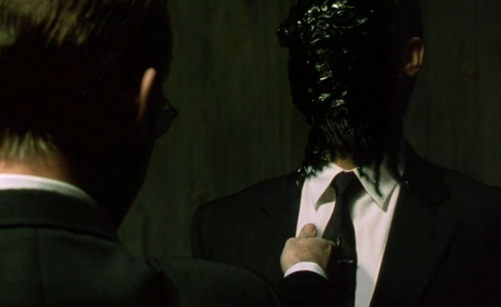
How does the vaccine actually work? Hint: Replication

Slide 14
- REMEMBER: the “spike protein” is unique to COVID-19 virus, and helps the virus invade human cells - The vaccines contains viral mRNA that “writes” the spike protein without the rest of the virus - The mRNA is taken up by cells → the human cell’s own manufacturing plant (ribosomes) making the spike proteins (but not other parts of the virus) - The spike proteins are released into the body, triggering the body to “learn” what the spike proteins ”look like” and create antibodies and immunes cells against them.
***Note: the nucleus of the cell containing the DNA is not involved***

Slide 15
The resulting “Activated B” immune cells seek out and destroy cells expressing the spike proteins (e.g. any viral particles or infected cells)

Slide 16
Antibodies produced in the B cells also flow through the body looking for cells containing the spike protein (like SARS-CoV 2 infected cells) and destroys them thereby stopping the spread of the infection to nearby cells.

Slide 18
Myth: The COVID 19 Vaccine will stop you from contracting COVID-19
Fact: You may still contract COVID-19. The investigators only tested patients who developed COVID-19 symptoms; “silent infections” were not investigated. But only 5 of >14,000 vaccinated people (Moderna) developed symptomatic disease, compared with 90 of the >14,000 placebo group.
In addition, the risk of serious disease and disease long-term sequelae is almost 100% neutralized in the vaccinated group, which is the goal of ANY vaccine.

Slide 19
Myth: The process of vaccine development was rushed and haphazard
Fact: Vaccine development was done under an established (not new) program designed to deal with pandemic circumstances, called an Emergency Use Authorization. This process is closely monitored for safety by the FDA

Slide 20
Myth: There have not been any prior RNA vaccines used in humans
Fact: False. Similar RNA vaccine technology has been used to treat gastric cancer in humans and hATTR, a rare debilitating human peripheral nerve disease.

Slide 21
Myth: RNA vaccines can implant material into the human genome (DNA) or fundamentally change a human’s genetic structure
Fact: This is simply not true and frankly, biologically impossible. mRNA does not enter the cell nucleus or contact DNA. The vaccine utilizes the cell’s normal processes to produce inert proteins that mimic the virus in order to trigger the human immune response. The cell that does this is then destroyed by the body’s immune system.

Slide 22
Myth: The COVID vaccine uses live virus
Fact: Both Pfizer & Moderna vaccines are mRNA, and do not use virus components. The mRNA vaccines can only code for one tiny cell part – the spike protein. They do not carry any other parts, or genetic/DNA material, from the COVID-19 virus

Slide 23
Myth: The COVID vaccine was made from “aborted fetal tissue”
Fact: This is simply not true. Despite internet misinformation, neither the Pfizer nor Moderna vaccines used any cell lines came from fetal tissue. The Catholic U.S. Bishops convention has issued a statement approving vaccination with these.

Slide 24
Myth: COVID treatments have gotten much better, so a vaccine is unnecessary
Fact: We wish it were true. But it’s not. None of the “prophylactic” treatments have shown efficacy in preventing or treating COVID-19. Even steroids and the HHS-supplied treatments Remdesivir and the monoclonal antibodies have only decreased mortality by at most < 50%

Slide 25
Myth: Ill effects from the vaccine won’t be seen for months or years
Fact: 70 years of vaccines refute this. Under an EUA, 50% of all individuals must have received all doses and 90 days must have passed to assess for side effects. For COVID-19, 75000 people received both doses in the 2 trials >90 days ago and NO serious side effects have occurred. Despite misinformation about vaccines in general, the incidence of side effects from any approved vaccines is extremely low.
On the other hand, research indicates that as many as 1 in 3 people who contract COVID experience prolonged illness and/or a post-COVID syndrome which effects their quality of life.

Slide 26
Changes to PPE Use After Vaccination
Vaccine Distribution
Other Frequently Asked Questions

Slide 27
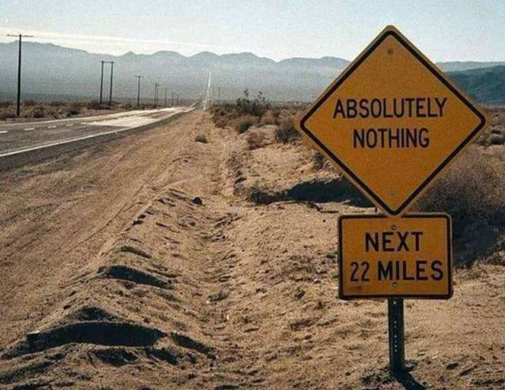
Will PPE Use Change After Vaccination?

Slide 28
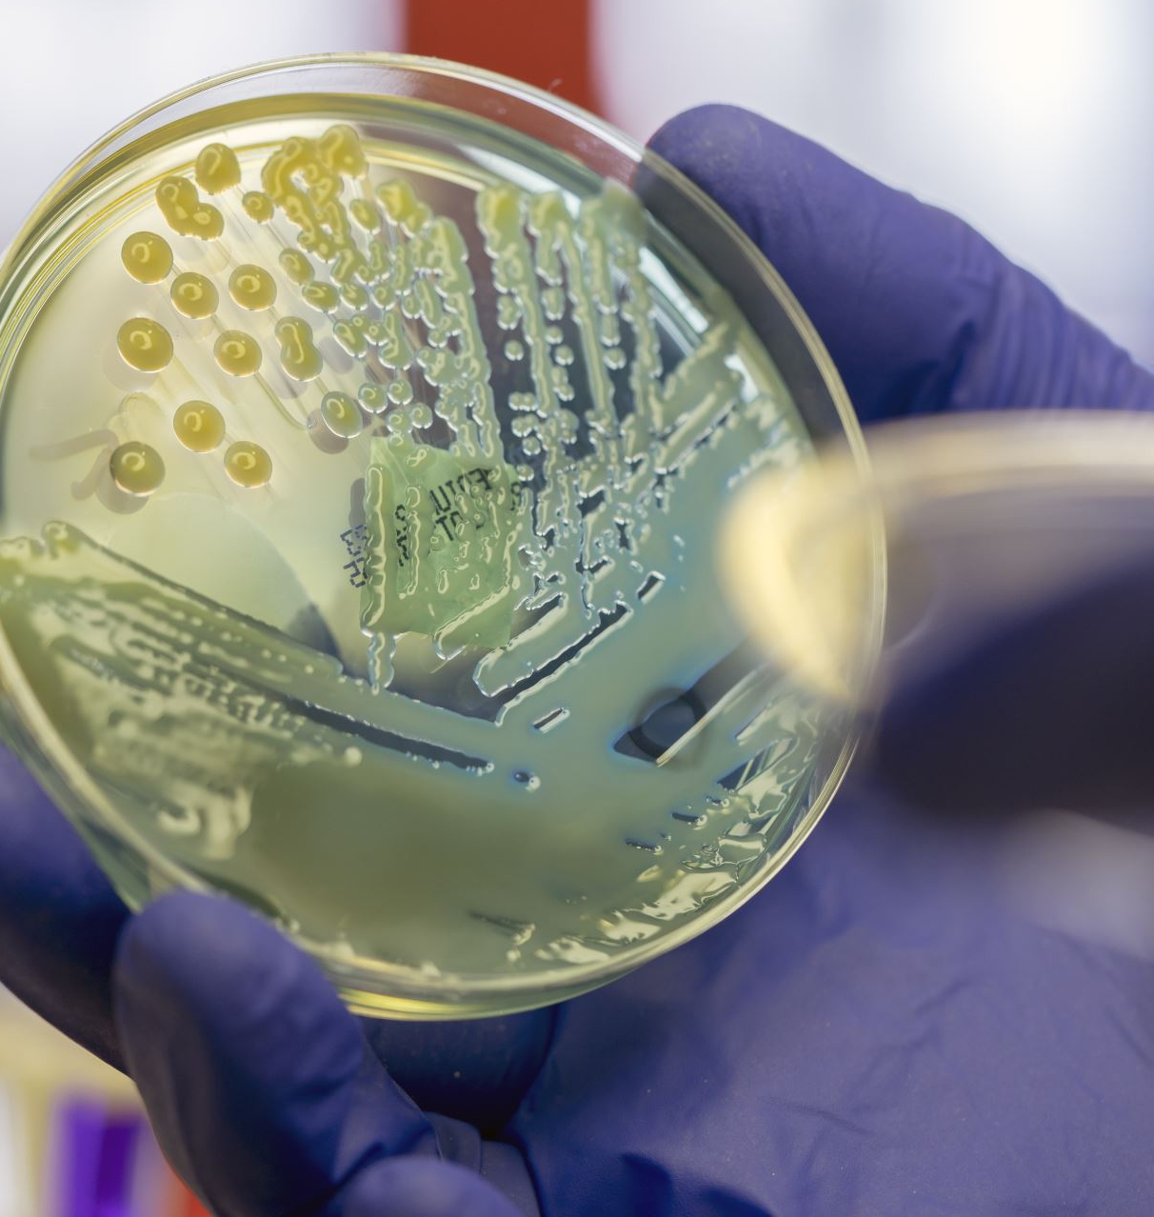
PPE use shall continue until morale improves!
NOTHING changes. PLEASE continue to follow PPE guidance using eye protection, face masks, gloves, frequent hand sanitizing, cleaning procedures for equipment, and follow department specific and local policies. PROTECT YOURSELF and PROTECT OTHERS!

Slide 29
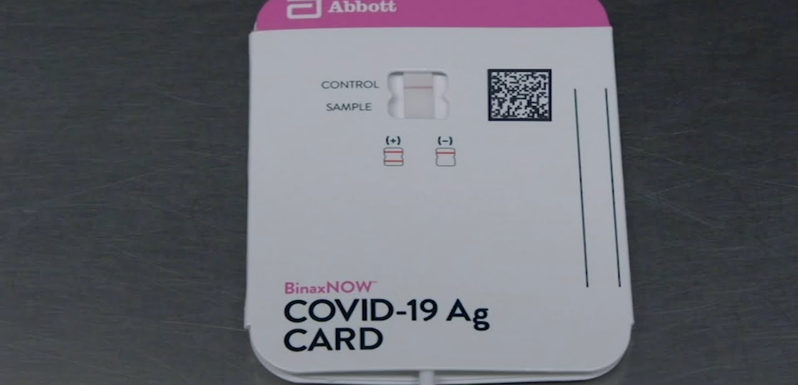
Can vaccination cause “false-positive” tests for COVID?
No. COVID vaccination will not affect PCR or Antigen tests for COVID. If you become symptomatic and test positive, this still means that you have contracted the disease.

Slide 30
Question: If I get COVID symptoms after vaccination, what happens?
A: Since there is still a chance that you could get (and transmit) COVID-19 after vaccination, we will continue to follow our current protocol. This may change over time as we (and the country) get more data.

Slide 31
Will the vaccine prevent me from passing COVID-19 to family or friends?
Maybe. We don’t know how many asymptomatic infections occurred during the trial. But there also have not been reports of “super-spreader” events related to the vaccine trials. Our hope is that the vaccine prevents you contracting the disease, thus preventing you from passing it on.

Slide 32
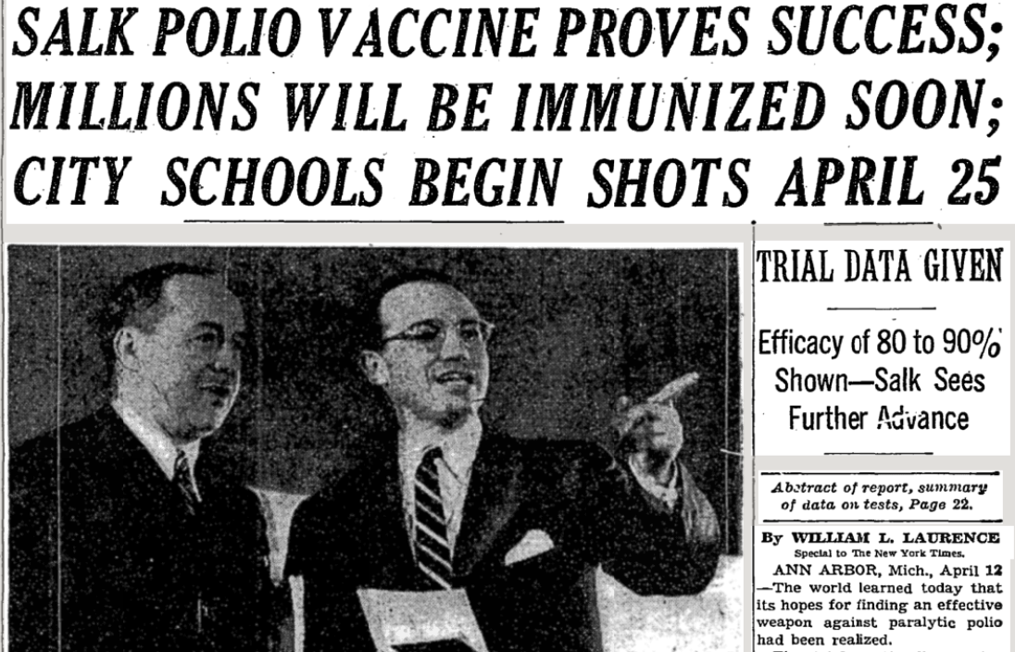
How will vaccines be distributed?

Slide 33
Operation Warp Speed

Slide 34
Operation Warp Speed
Partnership with Department of Health and Human Services (HHS), including the Centers for Disease Control and Prevention (CDC), the National Institutes of Health (NIH), and the Biomedical Advanced Research and Development Authority (BARDA) of the Department of Defense (DoD).
Phased approach
Phase 1: limited doses available, healthcare and frontline workers
Phase 2: larger supplies available, expand to at risk populations first, as well as essential infrastructure, then general population
Phase 3: if pandemic persists, integration into routine vaccine programs and broadscale vaccine distribution

Slide 35
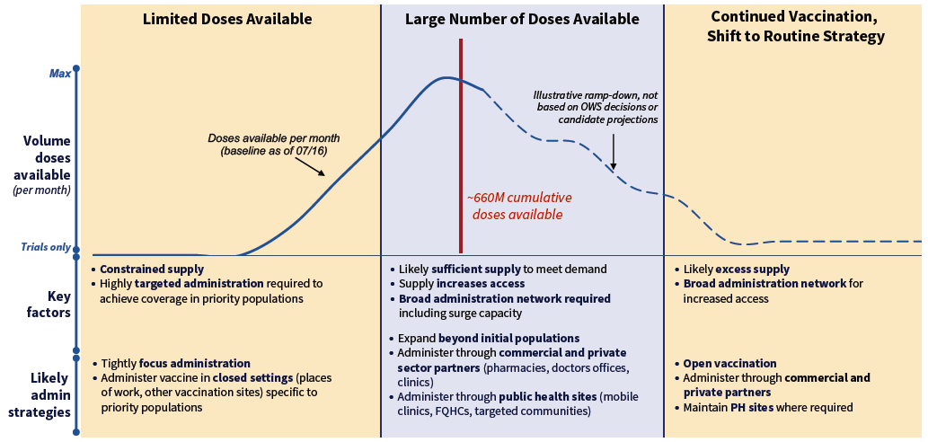
Phase 1
Limited doses available
Healthcare and frontline workers
Phase 2
Larger supply available
Prioritize at risk people & essential workers
Then general population
Phase 3
Large regular supply
Integration into routine vaccination programs

Slide 36
Why are we getting the Moderna vaccine when hospitals are getting Pfizer?
Moderna & Pfizer have shown similar effectiveness. But they have VERY different storage needs, with Pfizer requiring storage at -70ºC. The Moderna vaccine can be stored up to 28 days in a normal refrigerator, making it more appropriate for Fire Department logistics.

Slide 37
What other ingredients are in the vaccine?
Each 0.5 mL dose contains:
100 mcg of mRNA encoding the viral spike (S) protein
4 lipids: SM-102; 1,2- dimyristoyl-rac-glycero-3-methoxypolyethylene glycol-2000 [PEG2000-DMG]; cholesterol; 1,2-distearoyl-sn-glycero-3-phosphocholine [DSPC])
Buffers: tromethamine, tromethamine hydrochloride, acetic acid, sodium acetate, sucrose

Slide 38
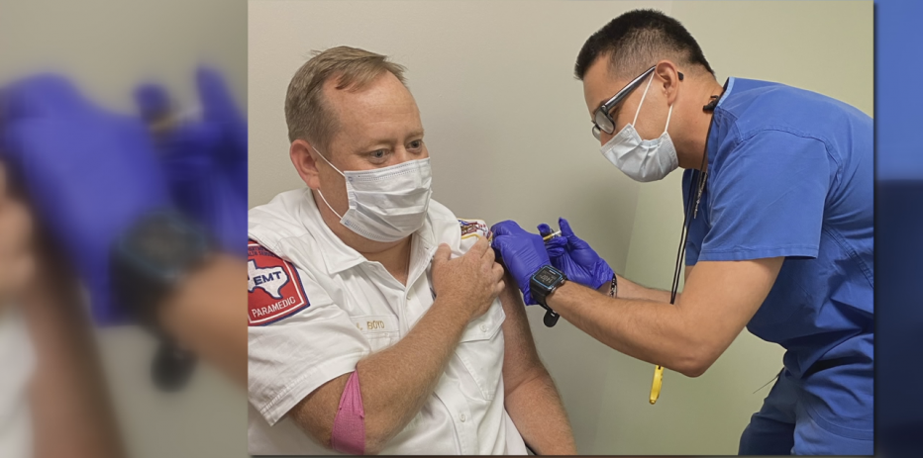
What are the side effects of the vaccine?
Reported side effects from the Moderna vaccine included arm redness at injection site, 1-2 days of mild fever (after 2nd dose), mild headache, or fatigue

Slide 39
Question: If I experience side effects, how do I report them?
A: Let your supervisor know so you can be directed on whom to contact. As the vaccinator, we will report all side effects that you share with us to the CDC’s VAERS system.

Slide 40
What if I miss or delay my 2nd dose?
In the Pfizer trial, even a single dose was >50% effective in preventing disease. But we’re aiming for >90%, so we will “catch up” your 2nd dose as soon as possible.

Slide 41
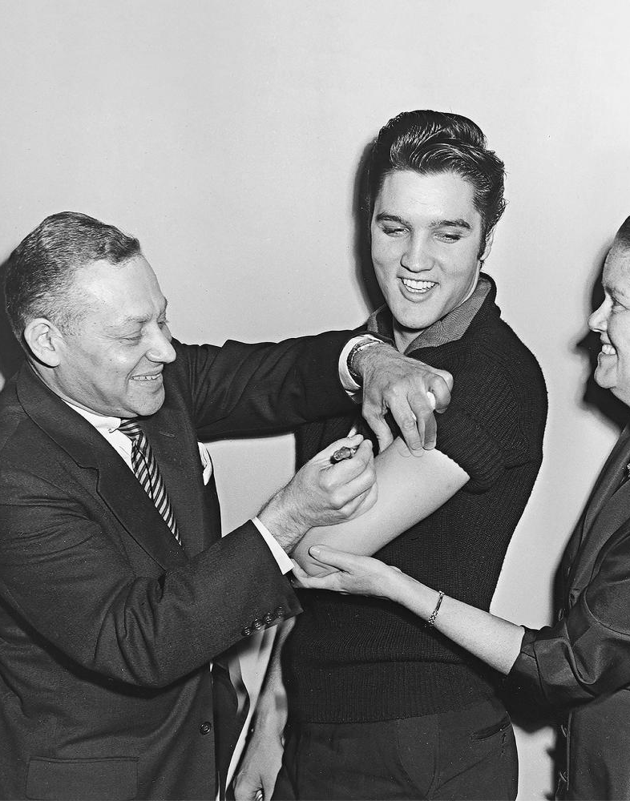
History Repeats
In 1955, Salk introduced the 1st polio vaccine. The public was reluctant to try it.
Elvis Presley received his publicly to encourage others.
Rates of polio paralysis and death in the USA decreased from almost 20,000/year before the vaccine, to <100 afterwards.
> 300,000 Americans have died from COVID this year. How many lives might we save with vaccination?

Slide 42
References

Slide 43
SARS CoV2 explained and how human infection occurs
https://en.wikipedia.org/wiki/Coronavirus_disease_2019#Virology
https://www.chemistryviews.org/details/ezine/11225161/Coronavirus_Entering_and_Replicating_in_a_Host_Cell.html
What is an EUA?
https://www.who.int/emergencies/diseases/novel-coronavirus-2019/covid-19-vaccines/how-are-vaccines-developed
https://www.fda.gov/vaccines-blood-biologics/vaccines/emergency-use-authorization-vaccines-explained
https://www.drugtopics.com/view/fda-permits-emergency-use-experimental-treatments-covid-19
Pfizer vaccine and trial results
https://www.businesswire.com/news/home/20201118005595/en/
https://www.pfizer.com/news/press-release/press-release-detail/pfizer-and-biontech-conclude-phase-3-study-covid-19-vaccine
https://www.fda.gov/advisory-committees/vaccines-and-related-biological-products-advisory-committee/2020-meeting-materials-vaccines-and-related-biological-products-advisory-committee
Moderna vaccine and trial results
https://investors.modernatx.com/news-releases/news-release-details/moderna-completes-enrollment-phase-3-cove-study-mrna-vaccine
https://www.nih.gov/news-events/news-releases/promising-interim-results-clinical-trial-nih-moderna-covid-19-vaccine

Slide 44
How the Pfizer and Moderna COVID vaccine work/durability
https://www.nytimes.com/interactive/2020/health/pfizer-biontech-covid-19-vaccine.html
https://www.nytimes.com/interactive/2020/health/moderna-covid-19-vaccine.html
https://www.nejm.org/doi/full/10.1056/NEJMc2032195
Prior RNA vaccine use to treat disease
https://www.ncbi.nlm.nih.gov/pmc/articles/PMC7177048/
https://www.jci.org/articles/view/134915
https://www.fda.gov/news-events/press-announcements/fda-approves-first-its-kind-targeted-rna-based-therapy-treat-rare-disease#:~:text=FDA%20News%20Release-,FDA%20approves%20first%2Dof%2Dits%20kind%20targeted%20RNA%2Dbased,to%20treat%20a%20rare%20disease&text=The%20U.S.%20Food%20and%20Drug,(hATTR)%20in%20adult%20patients.
Vaccine distribution plan
https://www.hhs.gov/coronavirus/explaining-operation-warp-speed/index.html
https://www.hhs.gov/sites/default/files/strategy-for-distributing-covid-19-vaccine.pdf

Slide 45
Addressing COVID & Vaccine misinformation on the internet
https://www.ncronline.org/news/coronavirus/use-pfizer-moderna-covid-19-vaccines-morally-acceptable-say-bishops
https://www.heritage.org/public-health/commentary/the-covid-vaccine-and-the-pro-life-movement
https://www.nejm.org/doi/full/10.1056/NEJMoa2007764
https://jamanetwork.com/journals/jama/fullarticle/2770279
https://www.who.int/emergencies/diseases/novel-coronavirus-2019/advice-for-public/myth-busters?gclid=Cj0KCQiA2uH-BRCCARIsAEeef3kLX9BGHJNqEHN8hHFaOFiCVZ8b9wH9qoEoz5rndsg8s9OVi-61f3oaAlyrEALw_wcB#chloroquine

