Slide 1
Frontline Fire Officer Training:
Firestopping and Path of Travel
Why it should matter to you
Developed by the International Firestop Council
www.firestop.org
Notes:
For additional information or assistance, contact the International Firestop Council at (216) 224-6150

Slide 2
Key Questions
Do you need to count on that floor or wall?
What is protecting you from below during search and rescue?
What allows you to advance a hose line down a hallway?
What can I do to better protect myself and my colleagues?

Slide 3
Across the country budget reductions result in frontline companies being asked to do more and more with less
Are you being asked to do more inspections?
Do you think these inspections are effective?
Do you know what you are looking for?

Slide 4
Objectives
Protect your work environment
  Notice fire safety hazards
  Report fire safety hazards
Understand code requirements that help fire compartmentation
  Be an advocate for building code and fire code requirements that help buildings be built safe and stay safe
Notes:
Bring up locate, confine, and extinguish during your discussion of compartmentation

Slide 5
Fire Protection
Detection
Control/Suppression
Containment
Notes:
State: Now let’s look at types of fire protection.
Ask: How may fire and products of combustion can be limited or suppressed?
Answer: Through the use of detection, suppression/control, and passive protection or containment.
[Click to show Detection] Ask: What are some means of fire detection? [Get answers from the group, which should include smoke detectors, heat detectors, flame detectors; audible and visual alarms]
[Click to show Control/Suppression] Ask: What are some means of fire suppression or control? [Get answers from the group, which should include sprinkler systems, foam, CO2 systems, and dry and wet chemical systems]
[Click to show Containment] Ask: What are some means of containment? [Get answers from the group, which should include fire-rated wall and floor assemblies, fire-rated doors, fire-rated HVAC duct dampers, and firestops.]
State: The rest of this presentation will focus on containment, which is also known as compartmentation.
Ask if anyone has questions before proceeding to a discussion of compartmentation.

Slide 6
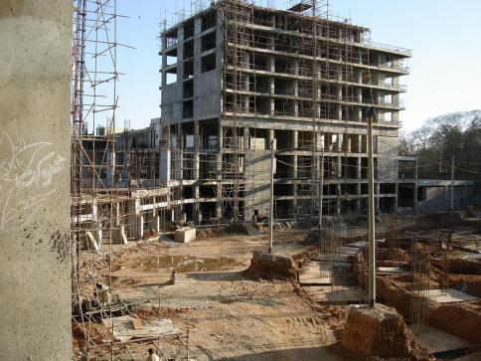
Compartmentation
Use of fire-rated construction to divide a building into smaller areas
Key to minimizing path of travel
Divide and conquer

Slide 7
Importance of Compartmentation
What % of civilian fire deaths are caused by smoke inhalation?
75%
What % of people killed in fires are NOT in the room where the fire started?
About 57%
How many firefighters perish due to fire contact and smoke inhalation?
xxxxx
Notes:
State: First, let’s look at the importance of compartmentation.
Ask: What percentage of fire deaths are caused by smoke inhalation? [Get answers from the group before clicking to reveal 75%.]
[Click to reveal next question.] Ask: What percentage of people killed in fires are not in the same room where the fire started? [Get answers from the group before clicking to reveal 57%.]

Slide 8
Why is building fire compartmentation important?
Fire should not get behind you
  From below
  From the side
Fire should not get ahead of building occupants in the path of egress
Prevents multi-story fire spread

Slide 9
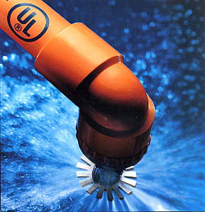
???
If a building has sprinklers, is compartmentation still needed?
YES!
Notes:
Ask: If a building has sprinklers, is compartmentation still needed?
[Get show of hands for “yes” or “no” from the group before clicking to reveal the answer of “yes.” ]
Ask: Why?
Answers should include:
Sprinklers may fail
Sprinklers do not stop the spread of toxic smoke and gases

Slide 10
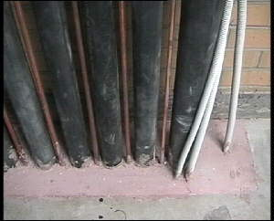
What is firestopping?
The use of third-party tested products and systems to seal penetrants, gaps, or openings in fire-rated floors or walls to restore the rating of a barrier compromised by such openings.
Notes:
Ask students what firestopping is.
[Click to show the IFC’s definition.] State that this is the definition of firestopping according to the International Firestop Council (IFC). Penetrations compromise the fire rating of an assembly (walls, floors, and ceilings). By sealing the penetration, firestopping helps to restore the fire rating to the assembly and to meet code requirements.

Slide 11

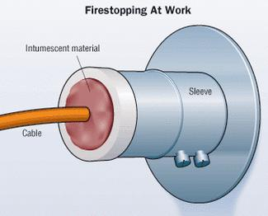
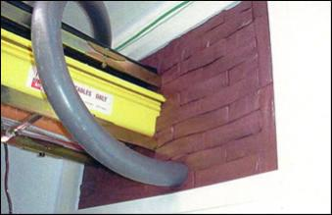
How Do Firestop Products Work?
Filling the voids around penetrations
Cim.pennnant.com
Firestoplogistics.com
Notes:
State that briefly put, firestop products work by filling the voids around penetrations.
There are many types of firestop products, including caulks and sealants, wraps and collar inserts, pillows, foam, and mineral wool.
Some firestop products intumesce or expand in the presence of heat. The intumescing action seals and stops the spread of flames and smoke to other floors and rooms for penetrations that melt or change shape in a fire (for example, plastic pipe)
State that you’ll discuss the different types of firestops and how they work in more detail in Module 3, How Firestopping Works.
Transition: Ask if students have any questions before you move on to a history of firestopping.

Slide 12
When inspecting
Understand occupancies with fire-rated (protected) corridors, separation walls and floors
Fire walls
Fire floors
FW
FW
FF
FF
FF
FF
FF
FF
FW
FW
FW = Fire Rated Wall
FF = Fire Rated Floor

Slide 13
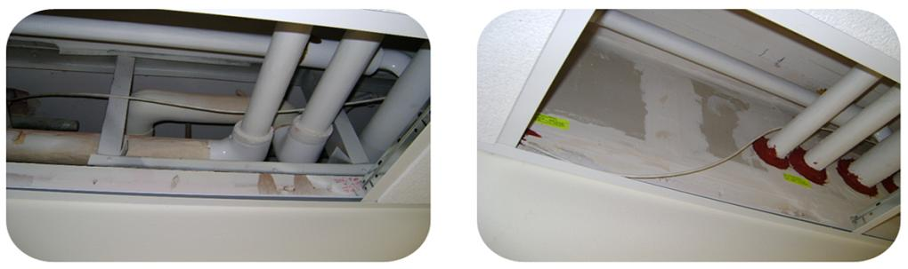
When inspecting
You will walk past problems
  Poor original installations
  Building changes over time
Fire-rated corridor:
The way you might find it
Fire-rated corridor:
The way it should be

Slide 14

Where to look
Check electrical/mechanical closets
Spot check by popping ceiling tiles
Check walls between occupancies
Look for rated doors
Look for concrete block walls
Look for fire/smoke dampers in ducts
Walls with wire glass

Slide 15
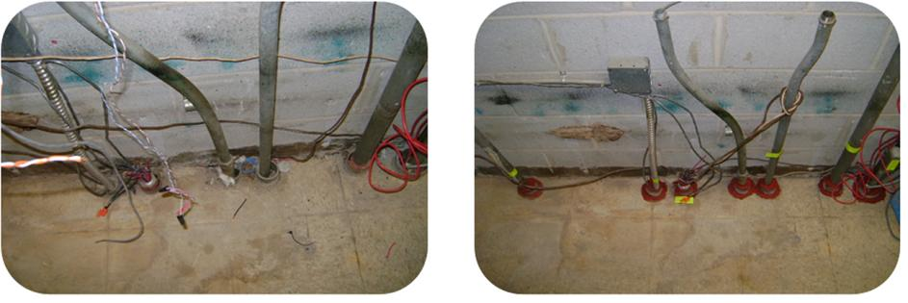
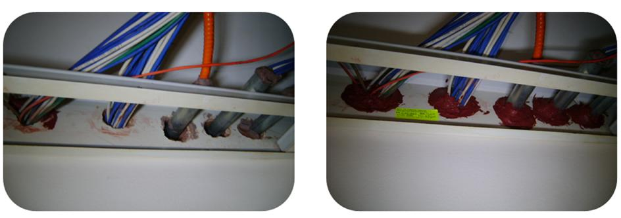
Problem vs. problem solved
Notes:
Note firestop system identification labels provided by the installing contractor
→ Very helpful in recognizing proper firestopping, but not code-mandated

Slide 16
When inspecting
Ask to walk with someone who knows the building
Report/discuss the problems you see
  Refer to your fire prevention bureau
  Refer to the building department
Chapter 7 of the International Fire Code mandates maintenance including through penetrations
  2009 IFC mandates annual inspection by property owner + correction of noted gaps in rated walls/floors

Slide 17
When reporting on a fire
What did you observe?
Where and how did fire and smoke spread?

Slide 18
When your community considers building or fire code changes
Jurisdictions adopt “model codes”
  e.g. IBC, NFPA 101, NFPA 1
Local amendments commonly made
  Can strengthen or weaken the model code
  Weaker codes can imperil the population and the firefighter
  Weaker codes commonly advocated for by the local real estate/construction community
  (lower their costs)

Slide 19
When your community considers building or fire code changes
You can make a difference!
Tell your representatives to get involved
  Attend code change hearings
  (local, state, national)
Request that your Chief get involved
Make yourself available
(city, state, national)

Slide 20
Wrapping it all up…
Locate
  Locate where firestopping has been neglected
Confine
  Confine the fire to a room and protect your means of egress
Extinguish
  Proper firestopping allows for the fire to be extinguished in a safer manner

Slide 21
Want to get involved, but want help with the first steps?
Contact Battalion Chief Sean DeCrane
Cleveland Fire Dept
IAFF National Code Development representative
rovloc93@aol.com
Or contact the International Firestop Council
www.firestop.org

