Slide 1
New Recruit
IAFF Orientation
Notes:
There are two title slide options: One without photos (here)

Slide 2
CONGRATULATIONS & WELCOME TO THE IAFF

Slide 3
% of Fire Fighters are members of
IAFF Local ___

Slide 4
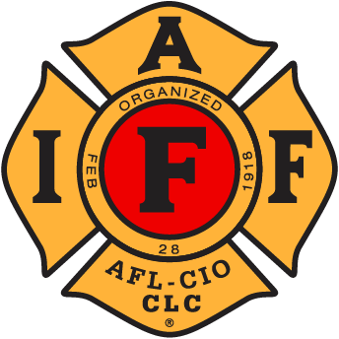
When You Join, You Belong To 3 Organizations
International Association of Fire Fighters
[Insert State Association]
[Insert Local]

Slide 5
International Association of Fire Fighters
Founded on February 28, 1918
354,812 Members & 3,549 Locals (3/1/2025)
112,888 New Members since 2000 (+47%)
Important Resources:
- Government Affairs & Political Action
- Communications
- Legal Services
- Hazmat Training & Grant Administration
- Health, Safety & Medicine
- Collective Bargaining/Financial Analysis
- GIS/EMS Analysis
- Center of Excellence (BH Treatment)
- Burn Fund

Slide 6
Recent Major IAFF Victories
Social Security Fairness Act: $233 billion in retirement benefits restored for our members.
AFG/SAFER Grants Reauthorization: $700 million annual funding to fire departments.
Push for Collective Bargaining Rights in Southern States: Local collective bargaining ordinances and first ever CBAs in Georgia, Tennessee, Texas, Virginia, etc.

Slide 7
[Insert State Association]

Slide 8
Recent Major State Victories
[Insert State Win] Example: Statewide Firefighter Cancer Bill.
[Insert State Win]
[Insert State Win]

Slide 9
[Insert Local]

Slide 10
Recent Major Local Victories
[Insert Local Win] Example: 8% Pay Increase.
[Insert Local Win]
[Insert Local Win]

Slide 11
Previous New Recruit Classes Who All Joined the IAFF

Slide 12
Previous New Recruit Classes Who All Joined the IAFF

Slide 14
Current IAFF Initiatives
Honor Our Fallen Heroes Act: Recognize first responders’ occupational cancer deaths as occurring in the line of duty and provide death benefits to their survivors.
Public Safety Officer Free Speech Act: Further protections for fire fighters to speak openly and freely about job-related issues.
PFAS Alternatives Act: The development of next-generation protective gear free of carcinogens.
9/11 Responder and Survivor Health Funding Correction Act to fulfill our nation’s commitment to protecting and honoring those who responded to the Sept. 11 terror attacks.
Wildfire Preparedness and Response Act: Ensure our nation’s fire fighters are properly trained and ready to protect their communities from wildfires.
Public Safety Employer-Employee Cooperation Act: National fire fighter collective bargaining rights.

Slide 15
Benefits of Membership

Slide 16
Benefits of Membership - Return on Investment
[If Applicable] Collective Bargaining Agreement Representation
An organization with the sole purpose of advocating for your profession, family, and community.
Collective Voice with Local, State, and Federal Government
IAFF Financial Corporation benefits
Disaster Relief Financial Assistance and Burn Support
Access to discounted Associates & Bachelor Degrees
Discounted Legal Services
[Insert Other Benefits]
$___ per [month/pay period]

Slide 17
Benefits of Membership - Return on Investment
[Insert Local Union Victory] Example 2022: Significant compensation increases and 4% step plan
[Insert Local Union Victory] Example 2023: Win civil service protections
[Insert Local Union Victory]
[Insert Local Union Victory]
[Insert Local Union Victory]
[Insert Local Union Victory]
$___ per [month/pay period]

Slide 18
[Insert Recent Lobby, Fundraiser, other Event]

Slide 19
[Insert Recent Lobby, Fundraiser, other Event]

Slide 21
Current Local Initiatives
[Insert Local Initiative] Example: Compensation increases
[Insert Local Initiative] Example: Coats for Kids
[Insert Local Initiative]
[Insert Local Initiative]

Slide 22
Getting Involved

Slide 23
How You can get involved
Stay Informed:
Read your emails
Visit the IAFF’s website: www.IAFF.org
Visit our Local’s website: [insert URL]
Facebook
Instagram
Twitter

Slide 24
How You can get involved
Attend & Participate in Union Functions:
Attend Union Meetings
Zoom Updates
Fundraisers
[Insert other events/functions]

Slide 25
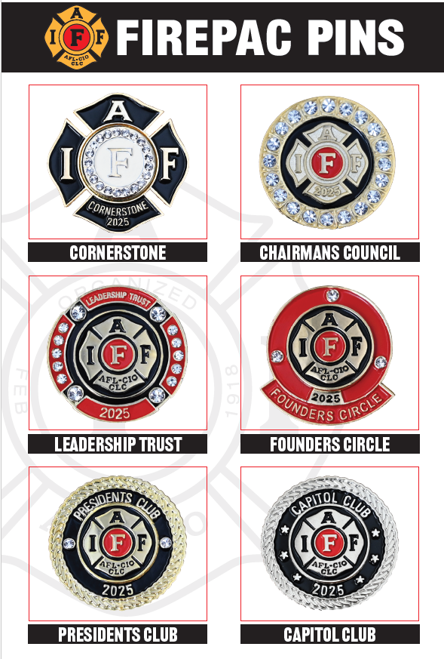
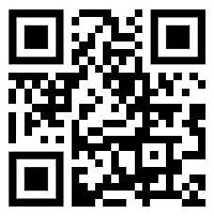
How You can get involved
Local/State Political Action Committee (PAC)
FIREPAC

Slide 26
Member’s Responsibilities
Be the best in your profession
Know your rights and look out for each other
Learn everything you can
Bring your interests and talents to the Local
Protect your voice through the political process
Help in the community with charities
STAY INVOLVED IN THE JOB

Slide 27
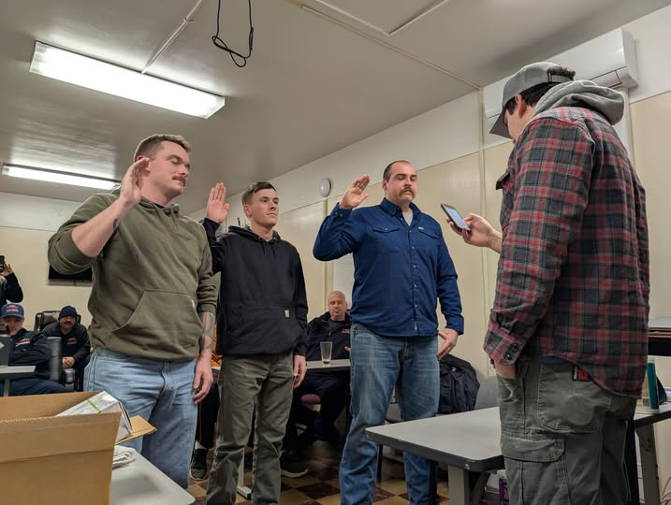
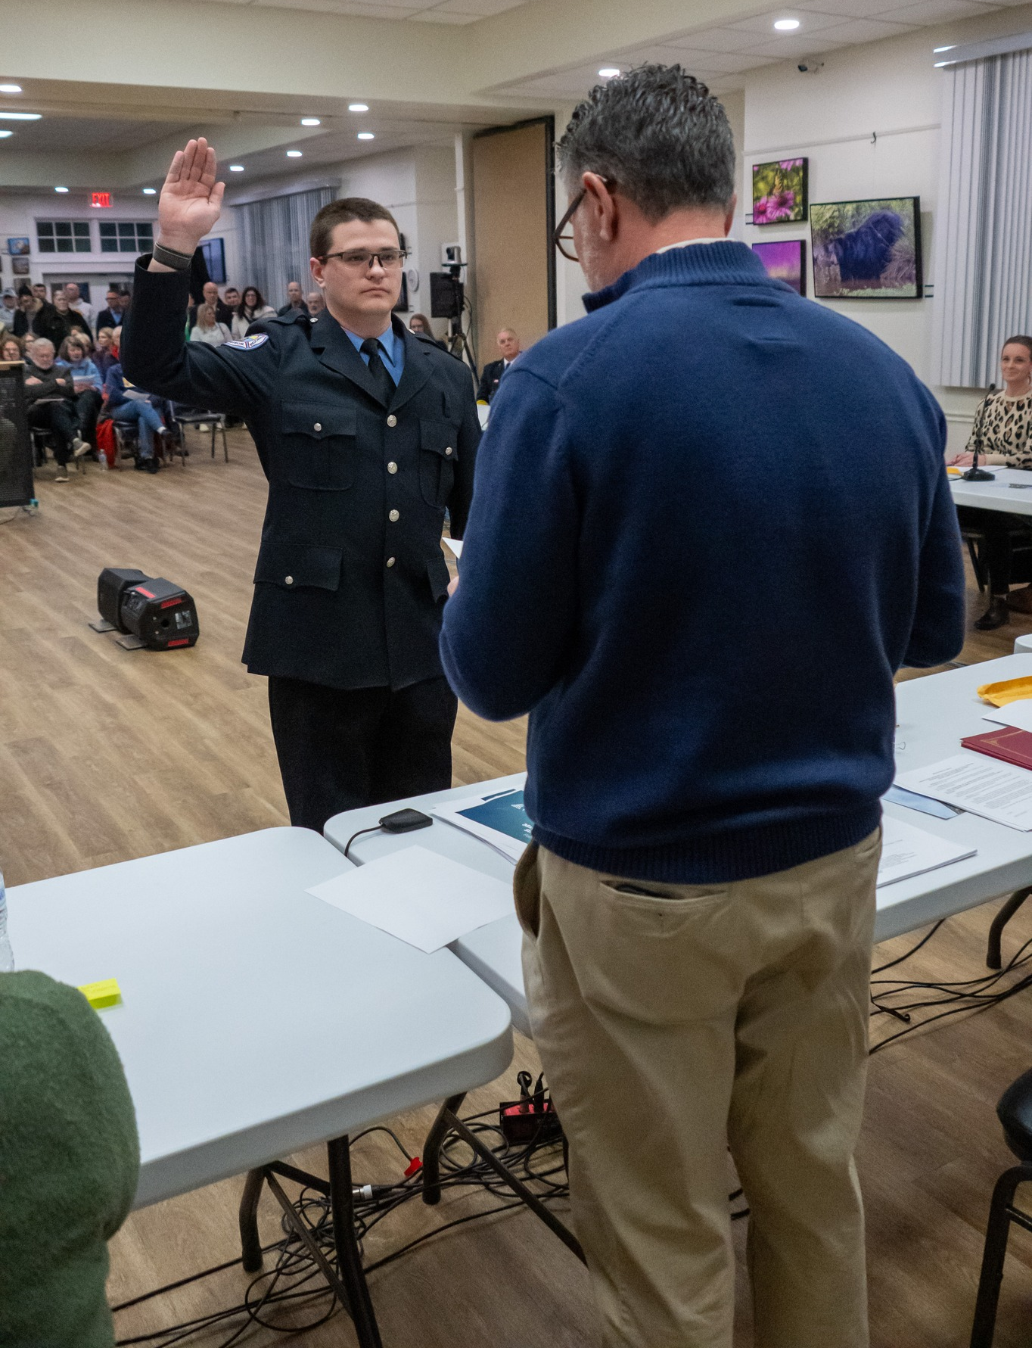
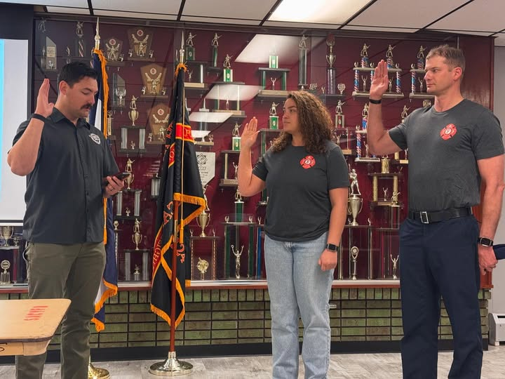
What is a Union?
Family
Voice

Slide 28
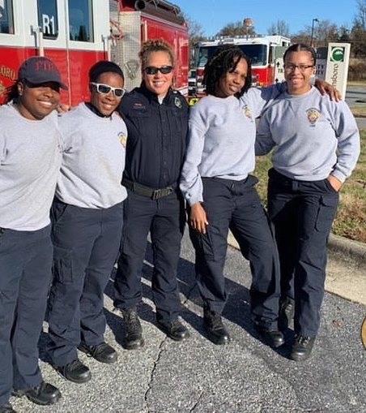
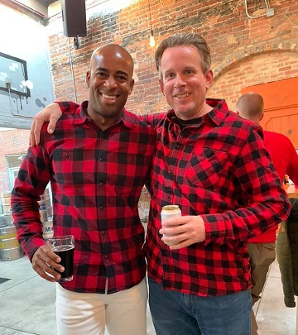
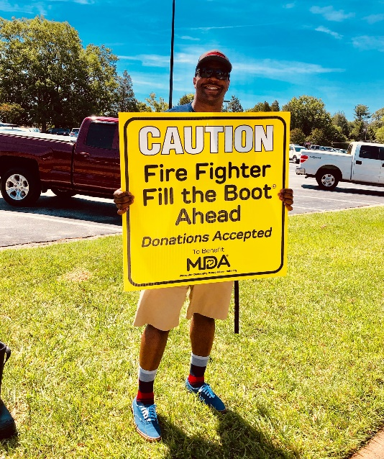
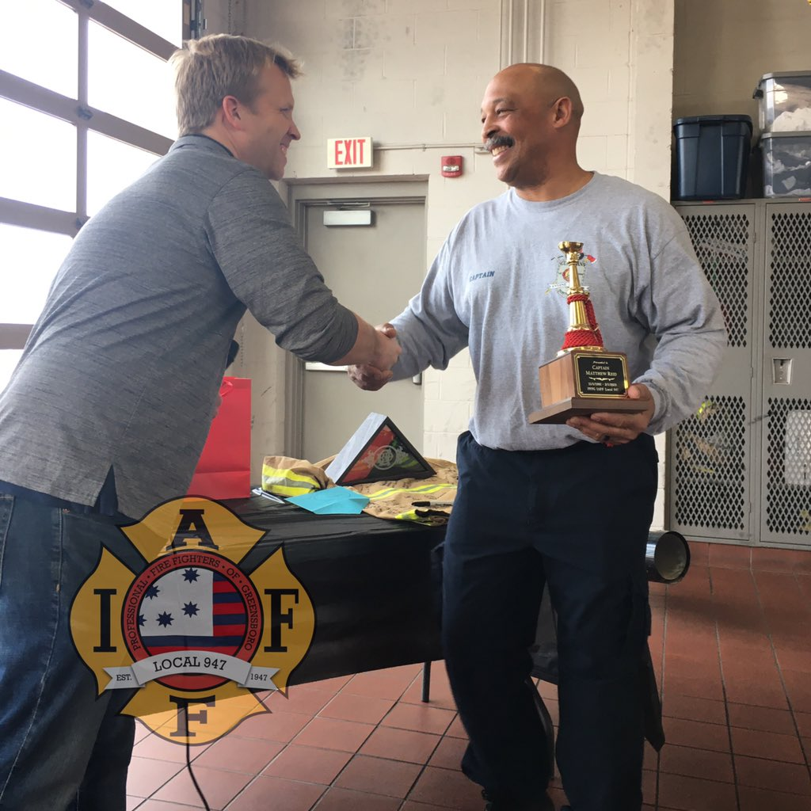
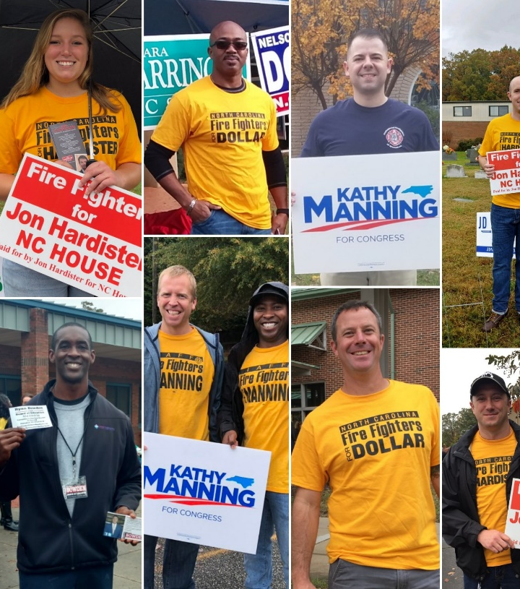
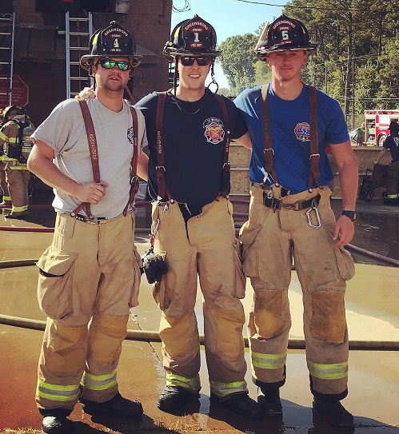
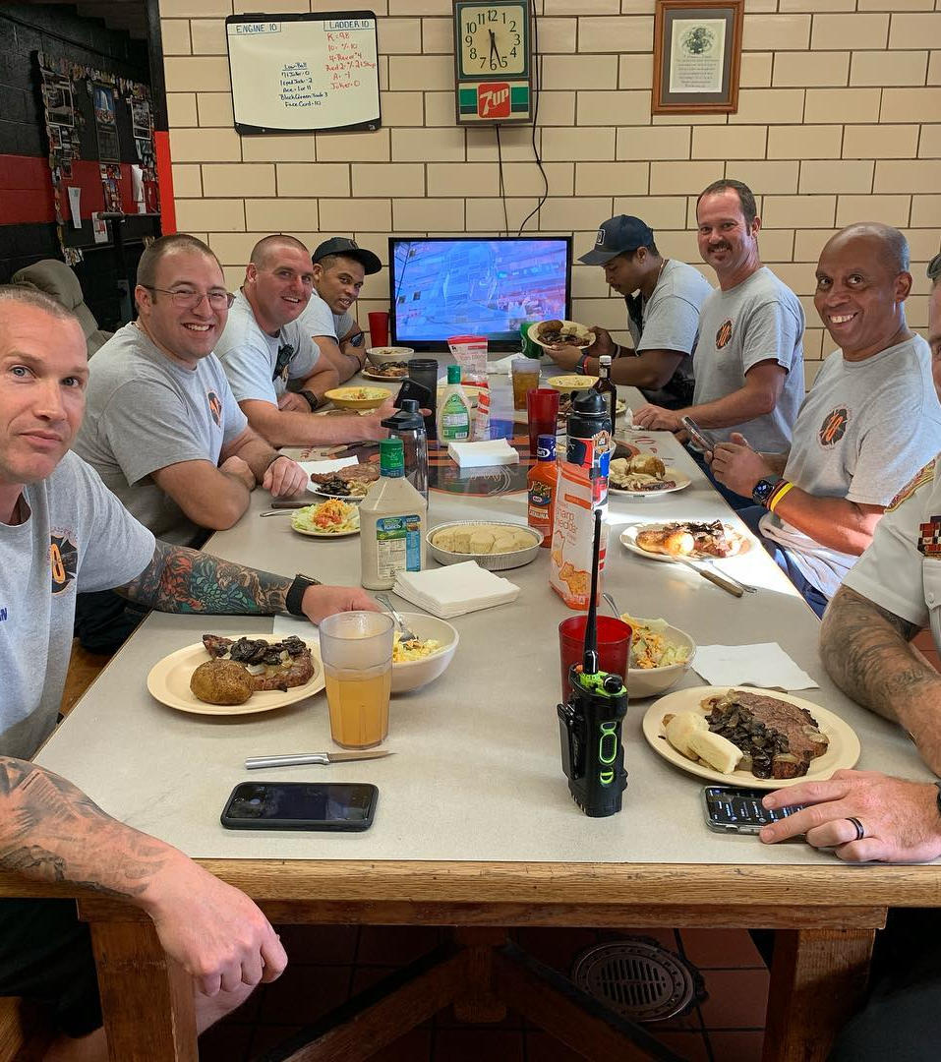
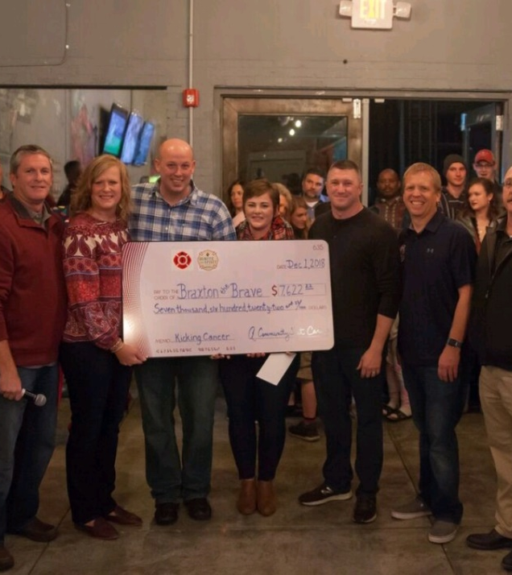

Slide 29
Join our Union Family!

Slide 30
THANK YOU! ANY QUESTIONS?

