Slide 1

Support Services
Name of Local Presenter
Local #
Date

Slide 2
IAFF & ACS Partnership
Know
Know more about the American Cancer Society as a trusted partner and resource hub for accurate information and support programs to help those on a cancer journey and to prevent cancer
Understand
How the ACS & IAFF partnership can support our members, their families and the community
Actions
To encourage our members, family, friends and community to use these resources to prevent and detect cancer
Notes:
I want to share with you the overall focus of the IAFF’s partnership with the American Cancer Society to ensure we are utilizing their services and make sure our members and their families are too.

Slide 3

About American Cancer Society

Slide 4
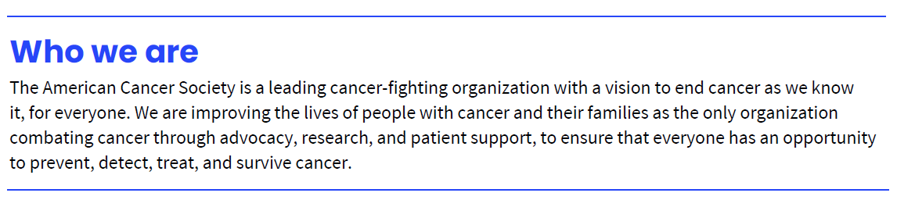
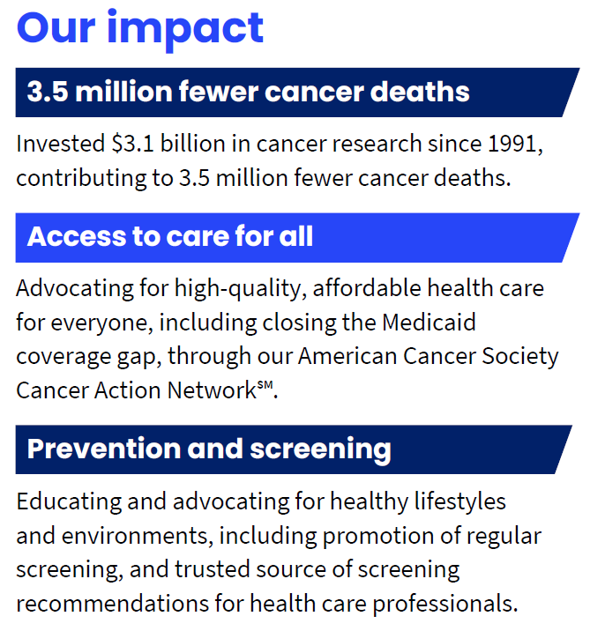
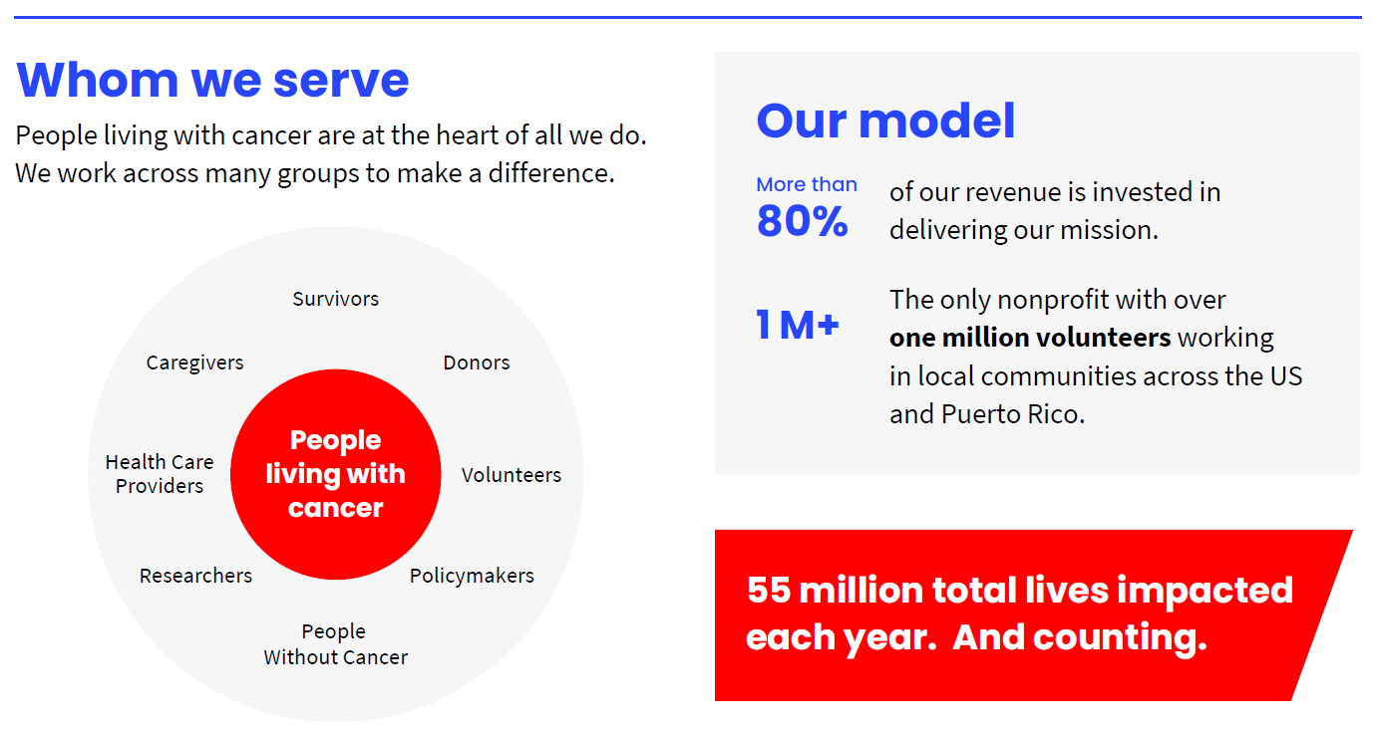
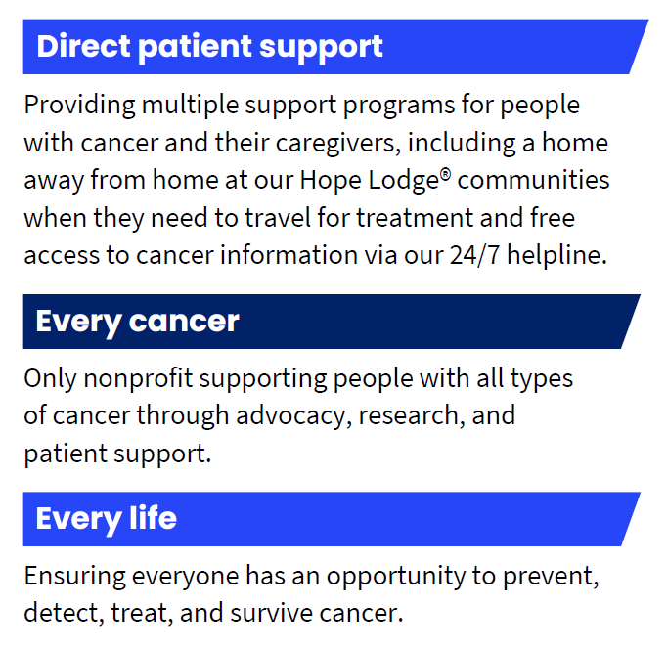
Notes:
American Cancer Society is serving 55 million lives and counting. Throughout communities nationwide.
ACS Vision: End cancer as we know it, for everyone
Mission: Improve the lives of people with cancer and their families through advocacy, research, and patient support, to ensure everyone has an opportunity to prevent, detect, treat, and survive cancer.
ACS is the Trusted Leader in the Fight Against Cancer. 110 Years leading the fight against cancer. #1 trusted source for cancer information
As you can see on this slide ACS is attacking cancer from every angle by working across many groups (providers, researchers, policymakers) but people living with cancer is at the heart of all they do. And they are making huge impacts across the spectrum of their work.

Slide 5
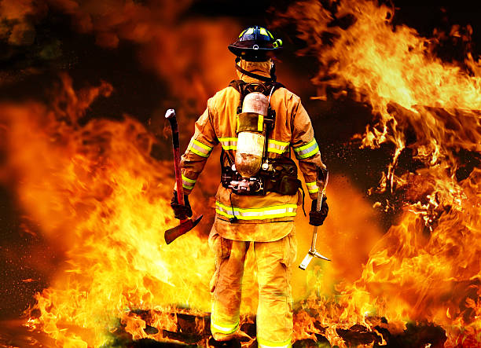
Our United Mission
Fight Cancer in the Fire Service
5
Notes:
The overarching theme of the partnership between IAFF and ACS is to support those on a cancer journey and to help prevent others from getting cancer

Slide 6

Our Shared Values and Experiences
Together, we can use our collective power to engage our community, drive awareness around cancer in the fire service, and raise funds to ensure fire fighters, rescue workers, and their families are supported.
Fire fighter occupational cancer is the leading cause of line-of-duty death in the fire service.
The IAFF is committed to protecting the health and well-being of our members by implementing proactive measures and ongoing initiatives to combat this
critical threat.
Our goal is to improve the lives of people with cancer and their families through advocacy, research, and patient support, to ensure everyone has an opportunity to prevent, detect, treat, and survive cancer
Notes:
Together we can use our collective power to engage our community, drive awareness around cancer in the fire service, and raise funds to ensure fire fighters, EMT’s and their families are supported.
A healthy lifestyle can prevent 40% of cancer cases and 50% of cancer deaths in the U.S.*

Slide 7
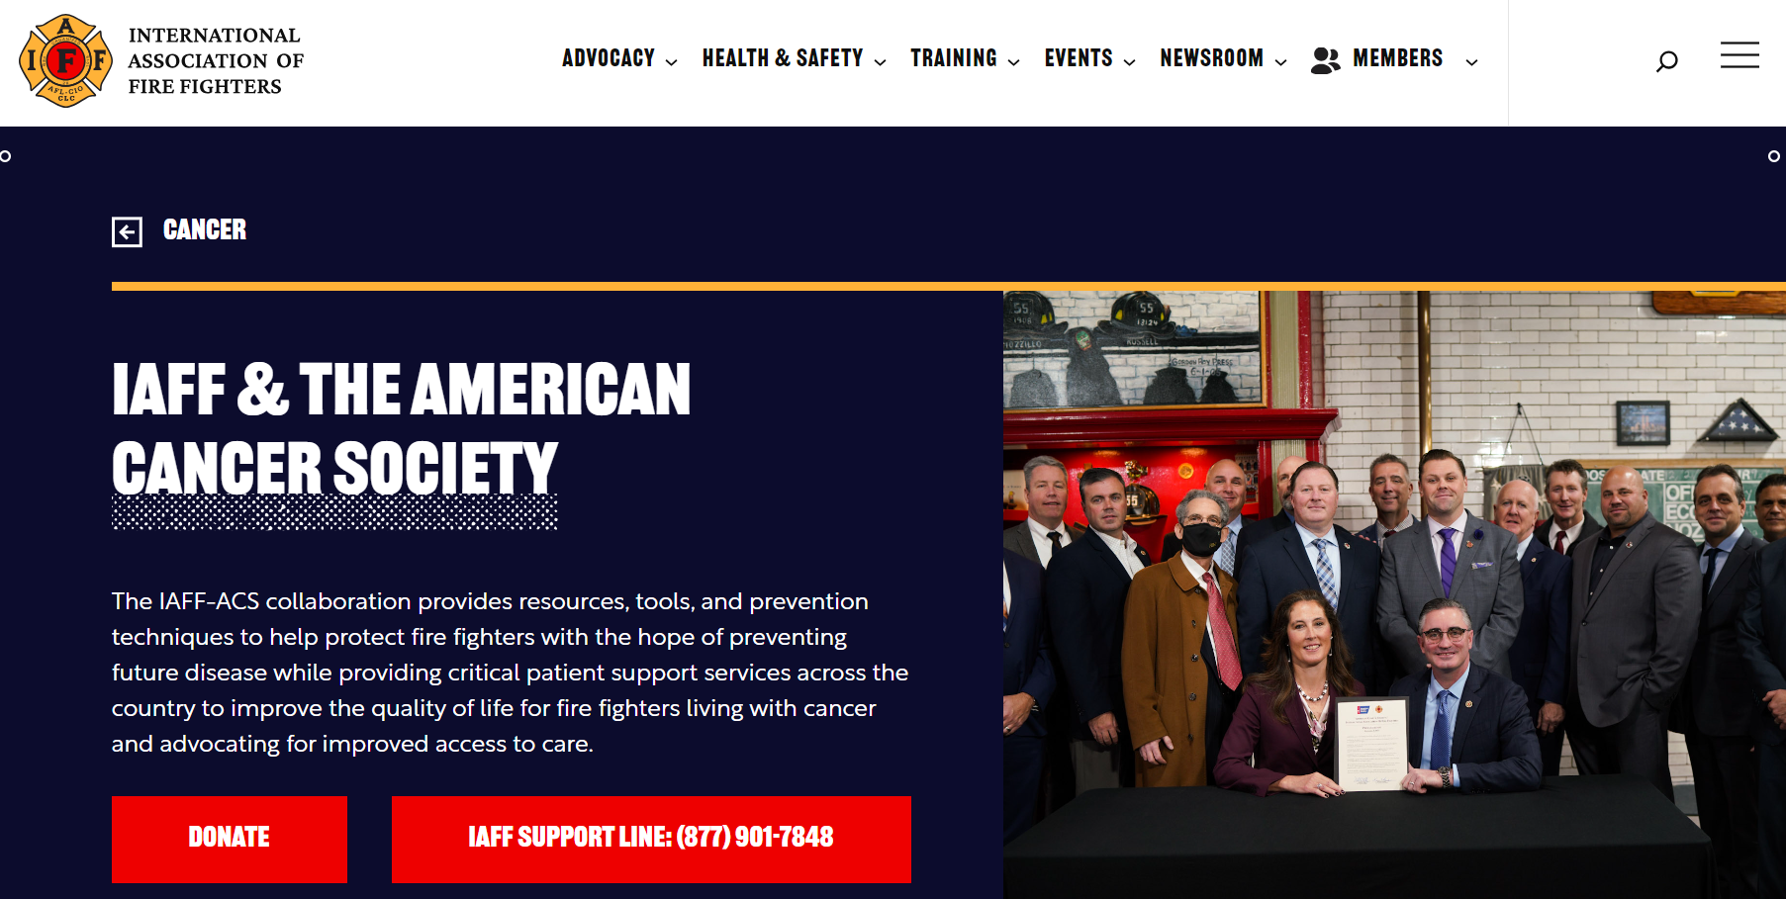
Support for IAFF Members and their Network
For 24/7/365 support
American Cancer Society Support Line for IAFF members via phone and chat:
1-877-901-7848
Additional Resources for IAFF members : IAFF.org/fightcancer
Notes:
I want to ensure we all know of some of the custom resources that the American Cancer Society and IAFF have worked together to provide to you and our Membership. Your help in continually spreading the word about the resources will help your brother and sisters increase their knowledge about resources available to them and their family, friends and community.

Slide 8

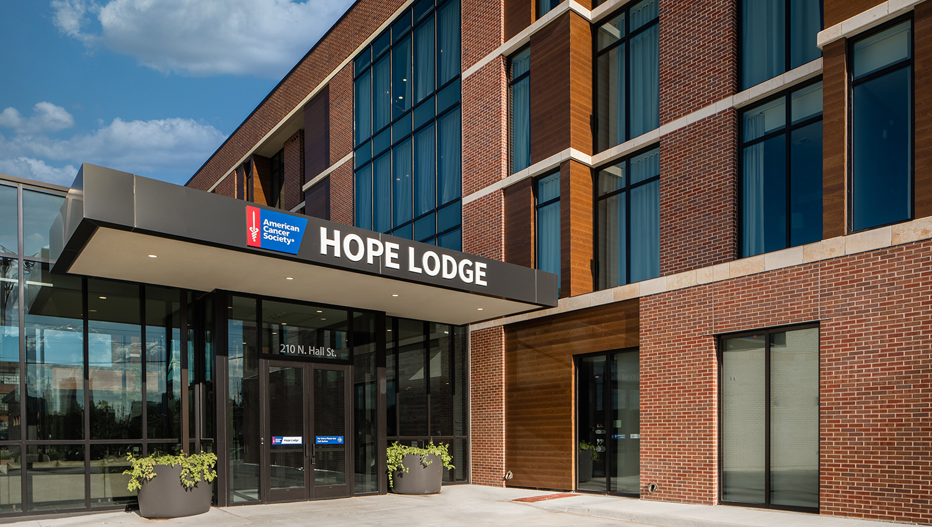
The ACS Hope Lodge communities provide free lodging for cancer patients and their caregivers, removing financial burdens and improving access to the best care available. The Hope Lodge program also offers a supportive environment designed to improve the quality of life for cancer patients and their caregivers in over 35 communities. Where there is not an ACS Hope Lodge, ACS can help with free or reduced hotel rooms.
To inquire or schedule, call the ACS/IAFF helpline.
Notes:
The American Cancer Society has top-notch “homes away from home” for cancer patients and a caregiver free of charge at these places around the country. In addition to a private room, there is access to a kitchen, meeting areas and activities. If there is not a ACS Hope Lodge, ACS can work with IAFF members and others to find free to discounted rooms through a partnership with Extended Stay America. If there is a Hope Lodge in your community and you would like a tour, reach out to the IAFF HQ and they can connect you with the appropriate person at ACS to make that happen. Volunteers are also always needed to help cook meals, run errands, etc.

Slide 9
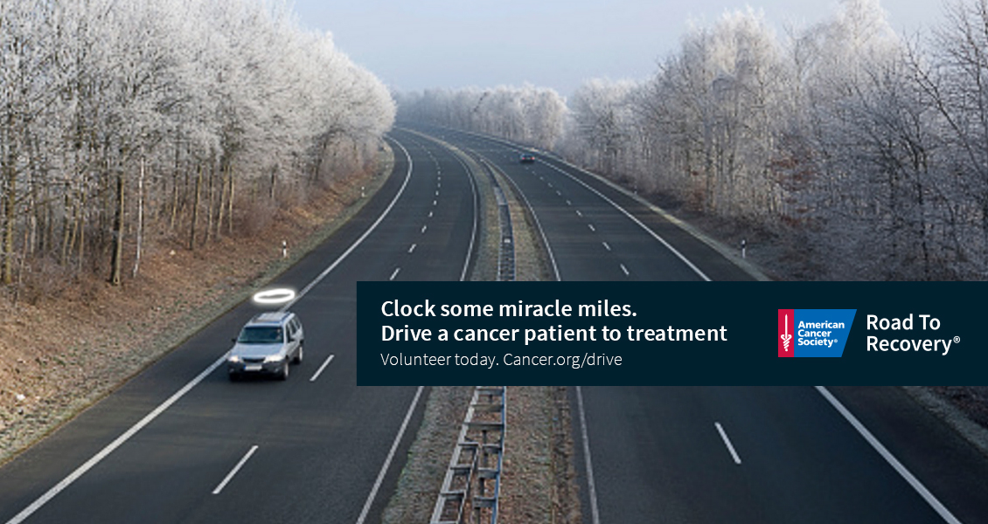

ACS Road to Recovery
The American Cancer Society Road To Recovery® program eases your burden by giving free rides to cancer-related medical appointments. Our trained volunteer drivers are happy to pick you up, take you to your appointment, and drop you off at home. All for free and all to make your days a little easier. Not having a ride shouldn’t stand between you and lifesaving treatment.
To inquire or schedule, call the ACS/IAFF helpline.
Notes:
Free rides to cancer-related medical appointments is also available through ACS. Not having a ride shouldn’t stand between you and lifesaving treatment, which is one of the largest barriers we hear as to why people do not receive their treatments. Volunteer drivers are also needed in many communities so any assistance in helping volunteer or recruiting volunteers is also appreciated.

Slide 10
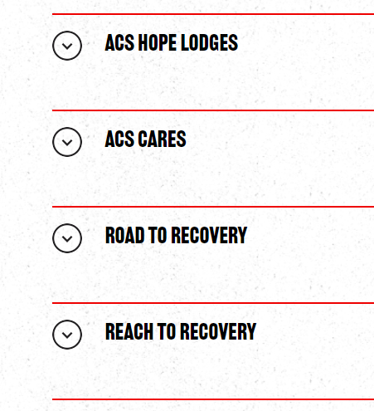
Support for IAFF Members and their Network

Slide 11

Contact Information:
With additional IAFF questions, reach out to your IAFF Health & Safety team at: cancer@iaff.org
For access to ACS resources or with questions, call the ACS/IAFF member hotline at 877-901-7848
©2023, American Cancer Society, Inc.

Slide 12
Thank You
©2023, American Cancer Society, Inc.
Notes:
So I am going to end here and let get into a little Q&A

