Slide 1
Managing Peer Fitness Trainers in your Department
Ron Gemsheim
Captain
Fairfax County (Va.) Fire & Rescue

Slide 2
Getting Started…
Develop mission statement and goals.
Determine areas of use and number of PFT’s required.
PFT Selection
Time requirements or demands of PFT’s.
Develop a budget.
Determine available funding.
Notes:
This is a template on things you need to do to start your program.
We will go over each one individually.

Slide 3
Getting Started
Develop Mission Statement and Goals
Mission Statement
Description of the program’s purpose that is clear, direct, and keeps the PFT’s focused within the scope of the program.
Goals
Something to be accomplished to keep the program moving forward.
Notes:
Mission statements generally relate to:
-Quality
-Excellence
-Commitment to uniformed personnel
-Department goals
-Compliance with regulations
-Consistency of service and confidentiality
Goals:
-Specific
-Measurable
-Attainable
-Realistic
-Time bound

Slide 4
Getting Started
Determine Areas of Use and Number of PFT’s Required
Areas of use
How will the PFT’s be used in the program?
Number of PFT’s needed
Tasks
Workload
Number of personnel in your department
Budget

Slide 5
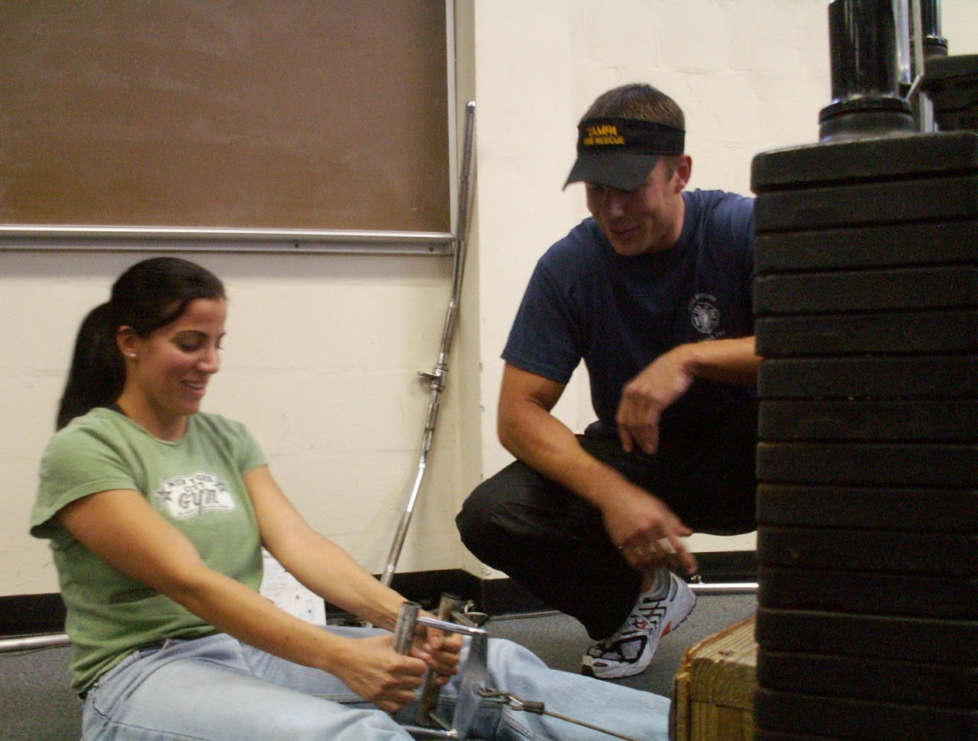
Getting Started
PFT Selection
Personality
Previous Training
Availability
Motivation
Diversity
Notes:
-Advertise for interest
-Interview
-Selection person/panel

Slide 6
Getting Started
Time Requirements or Demands of PFT’s
What will be required of them once accepted to the program?
Participation Areas/Time
Committees
CEC’s (On own time or FD time)
Notes:
Make sure before they are accepted into the program that they fully understand what is expected of them.
Allot of money may be wasted on someone who is getting into something they didn’t understand fully.

Slide 7
Getting Started
Develop a Budget
Develop based on your long term goals and objectives.
Certification
Equipment
Overtime
Training (CEC’s, conferences)
Uniforms
Can be implemented in Stages
Notes:
Develop a budget that is based on your long term goals and objectives.
The budget should divide costs into program components or areas, and delineate personnel, operating costs, and capital costs per fiscal year.

Slide 8
Getting Started
Determine Available Funding
Work with city council to secure funding for the program.
“Matching fund” program
Cost savings of program (Risk Management)
Consider teaming up with other Fire Departments (Regionalize)
Grant Funding
www.firegrantsupport.com
Seek out additional information and approaches used by other departments.

Slide 9
After the Program is Established…
Develop an implementation strategy.
Internal education/marketing.
Monitor progress.
Collect Data.
Meet and review program regularly.
Notes:
This is a basic template on getting your program rolling.

Slide 10
After the Program is Established…
Develop an Implementation Strategy
After the concept has been accepted, the program should be officially adopted.
May be done through an administrative process.
General order signed by the fire chief
Union contract negotiations
Memorandum of understanding

Slide 11
After the Program is Established…
Internal/External Marketing
Educating all parties involved in the process regarding all aspects of the program is CRUCIAL to the success of the program.
Emphasize benefits and safeguards
Support from labor/management
Health benefits for members
Cost savings for department
Testimonials

Slide 12
After the Program is Established…
Monitor Progress
Progress should be regularly reviewed and periodically assessed for possible changes.
Is program meeting needs of the members?
Are the members using the program? Why/Why not?

Slide 13
After the Program is Established…
Collect Data
Baseline data collection is essential to future benchmark and comparison data.
The value of future cost-benefit support needs good baseline data.

Slide 14
After the Program is Established…
Meet and Review Program Regularly
It is essential the program be reviewed periodically to measure progress, evaluate effectiveness, and ensure the objectives of the program are still valid.
The information from evaluations will help identify program strengths and areas for improvement.

Slide 15
PFT Manual
Mission Statement and Goals
Scope of Practice
Conduct and Demeanor
Sample Exercise Programs
Resources
Assessment Forms
CD’s/DVD’s

Slide 16
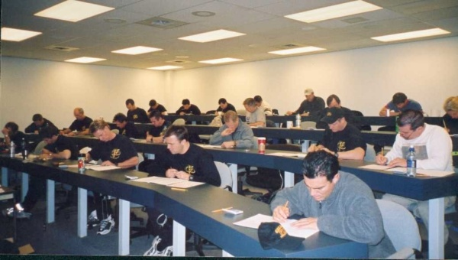
Certification/C.E.C.’s
Initial certification
IAFF/IAFC/American Council on Exercise PFT Program
5 day course
Students are trained in:
Anatomy
Kinesiology
Exercise Physiology
Exercise Programming
Nutrition
Exercise techniques
Fire service specific knowledge
Find information about class at www.iaff.org

Slide 17
Certification/CEC’s (cont.)
CEC’s
Must obtain every 2 years for recertification
Obtained by:
Attending conferences
In-house classes
Monthly fitness magazine quizzes

Slide 18
Areas for PFT Involvement
Prior to being hired:
Job Fairs/Recruitment
CPAT Mentoring
CPAT Proctors
Pre-Recruit School Training Program

Slide 19
Areas for PFT Involvement
Recruit Training
Daily PT training during probie school.
Fitness assessments throughout probie school to show progress.
Family day.
Mentoring program following graduation.

Slide 20
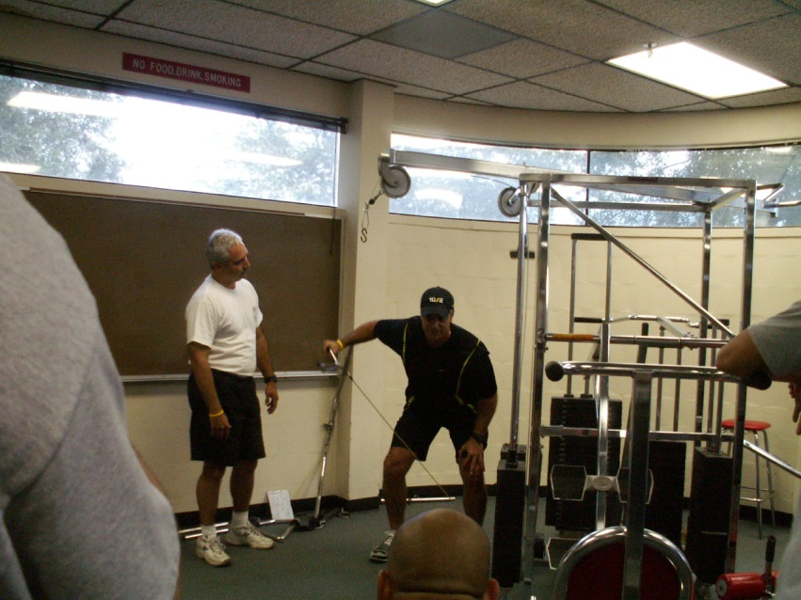
Areas for PFT Involvement
Incumbent Firefighter Training
Fitness assessments.
Personalized exercise programs/nutritional advice.
Station visits.
Shift workouts.
Fitness classes.
New equipment instruction.
Incumbent testing.
Fitness Challenge.

Slide 21
Other Areas of Involvement
Equipment maintenance/purchase.
O.S.H. committee member.
Officer training.
Program design (civilian employees, families)
Workout books for stations.
Newsletter
Q&A on department website

Slide 22
Keeping the PFT Motivated
Give them ownership of program
Assign Project
Send to conferences/classes
Uniforms
Purchase resources for the
PFT

Slide 23
Keys to a Successful Program
Proper Personnel Selection
P.R. for the program
Pictures and bios of PFT’s
Stay Current
Be Visible
Station visits
Be Professional

Slide 24
Questions & Answer
Ron Gemsheim
Captain, Fairfax County (Va.) Fire & Rescue
Ian Crosby
Wellness Coordinator, Calgary (Ca.) Fire Department
George Cruz
Captain, L.A. County Fire Department

